Slide 1

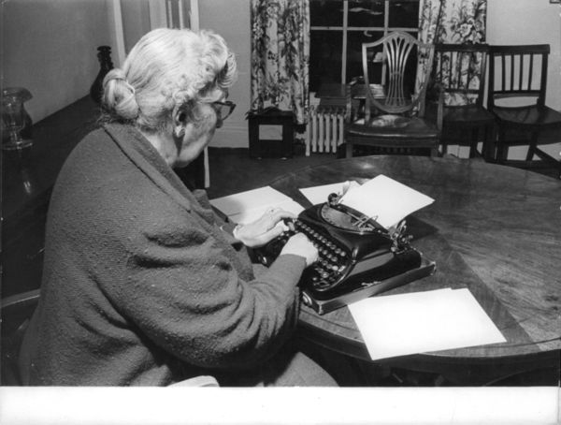
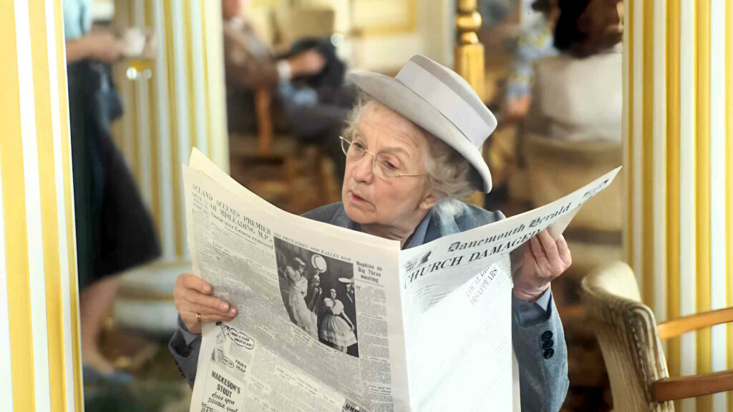
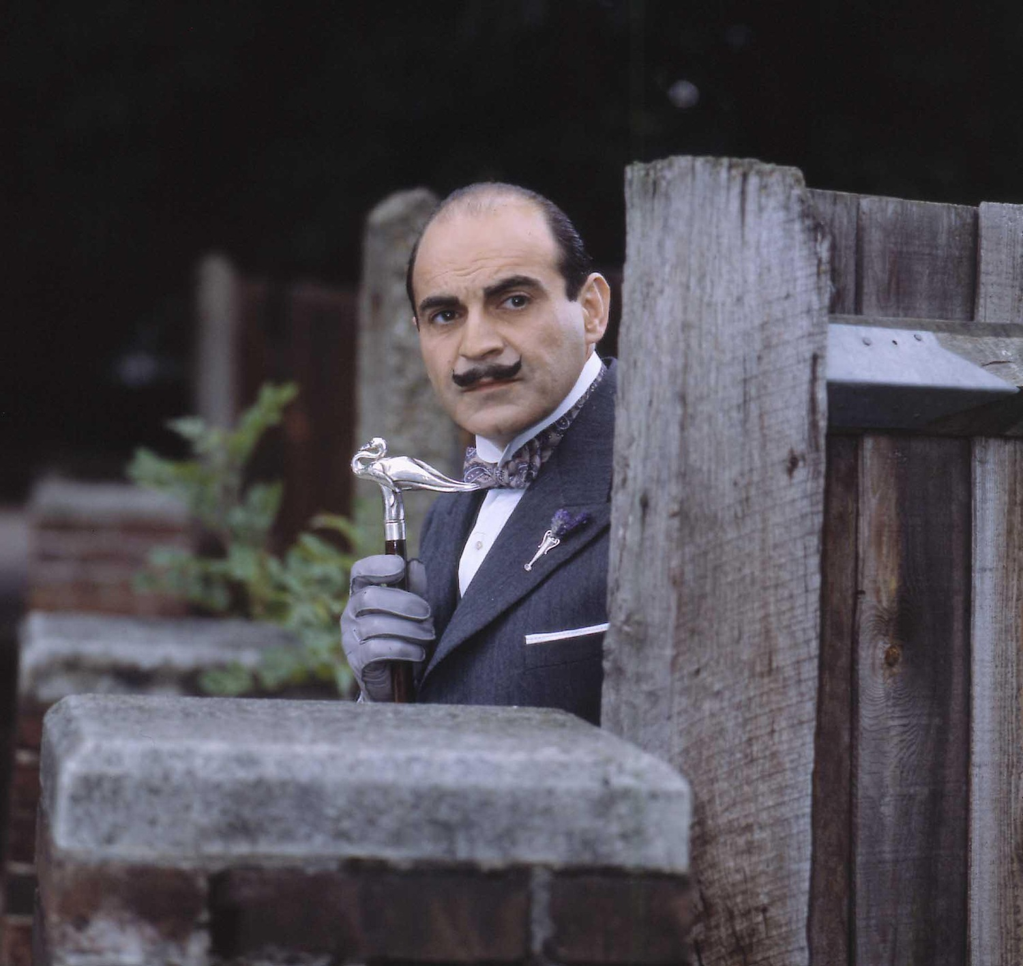
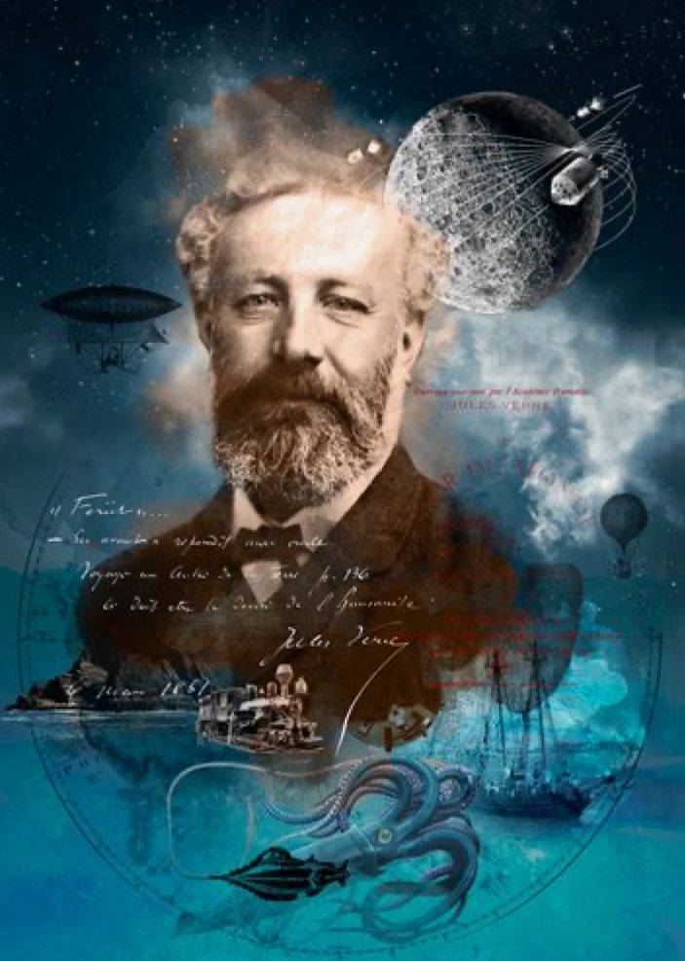
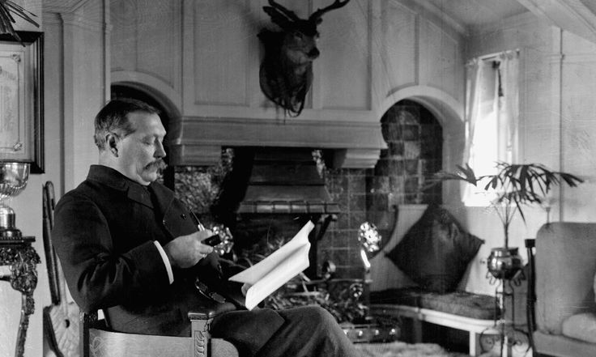
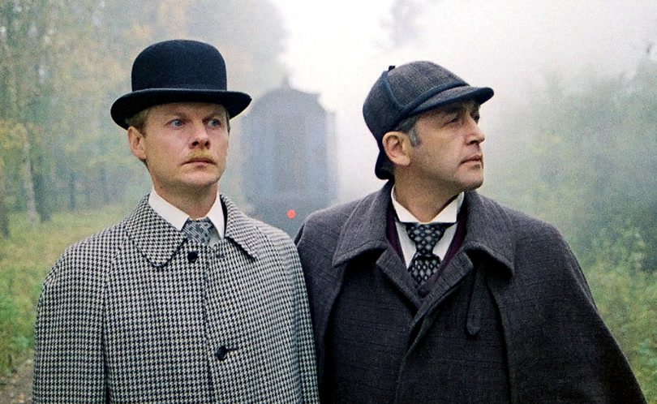
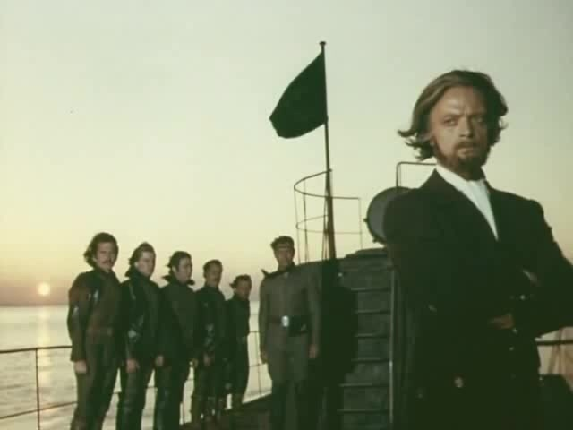
Look and guess. Who are these persons?

Slide 2

Theme: «Bookworms»
Aim: - give a talk about favorite writer
Tasks: - learn new words;
- train listening, reading and speaking skills;
- improve grammar skills in Past Simple.

Slide 3

Revise the vocabulary using the mind map:
Reading
Literature
story
genre
journey
detective
comedy
legend
writer
drama

Slide 4

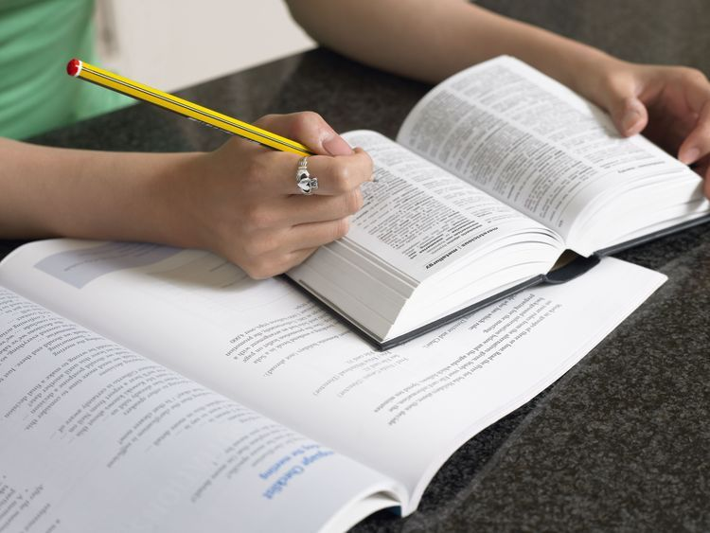

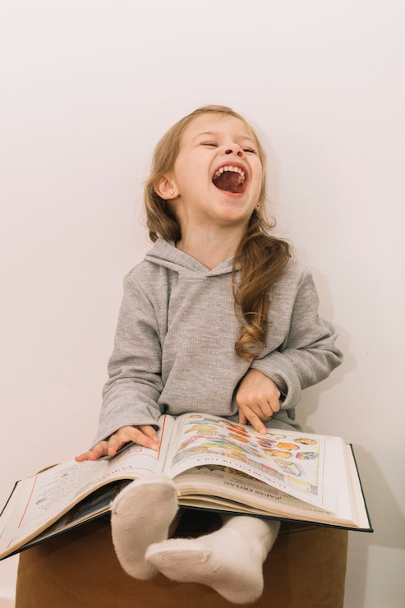
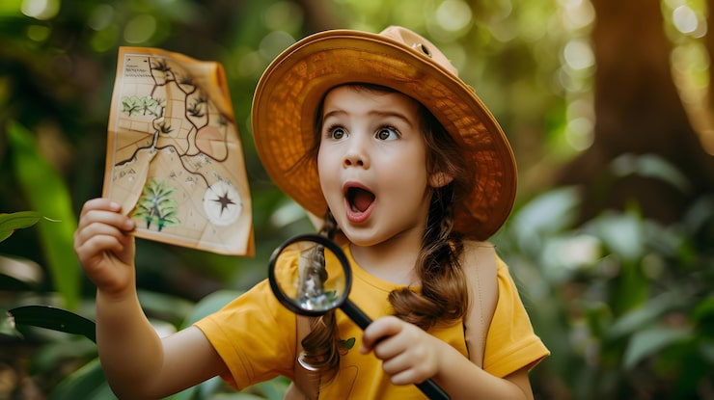
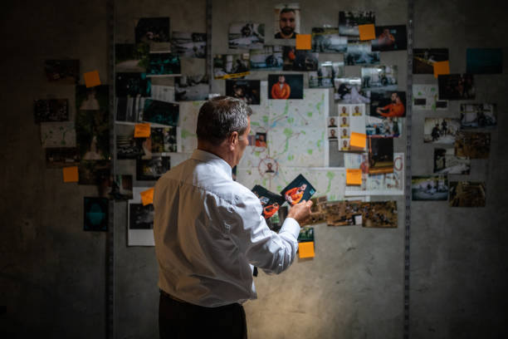
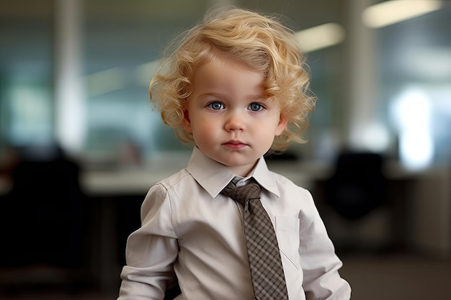
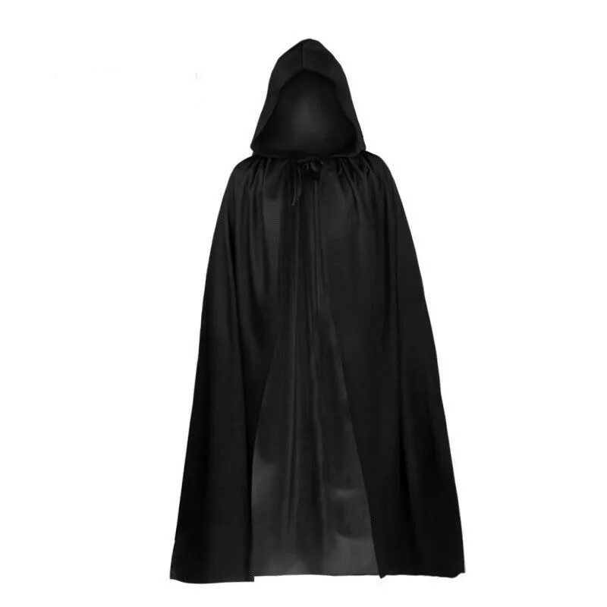
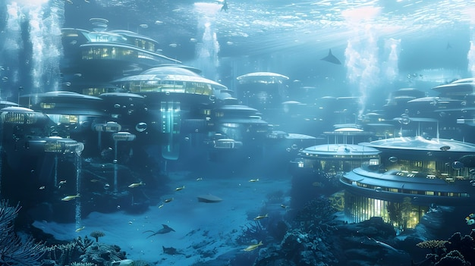
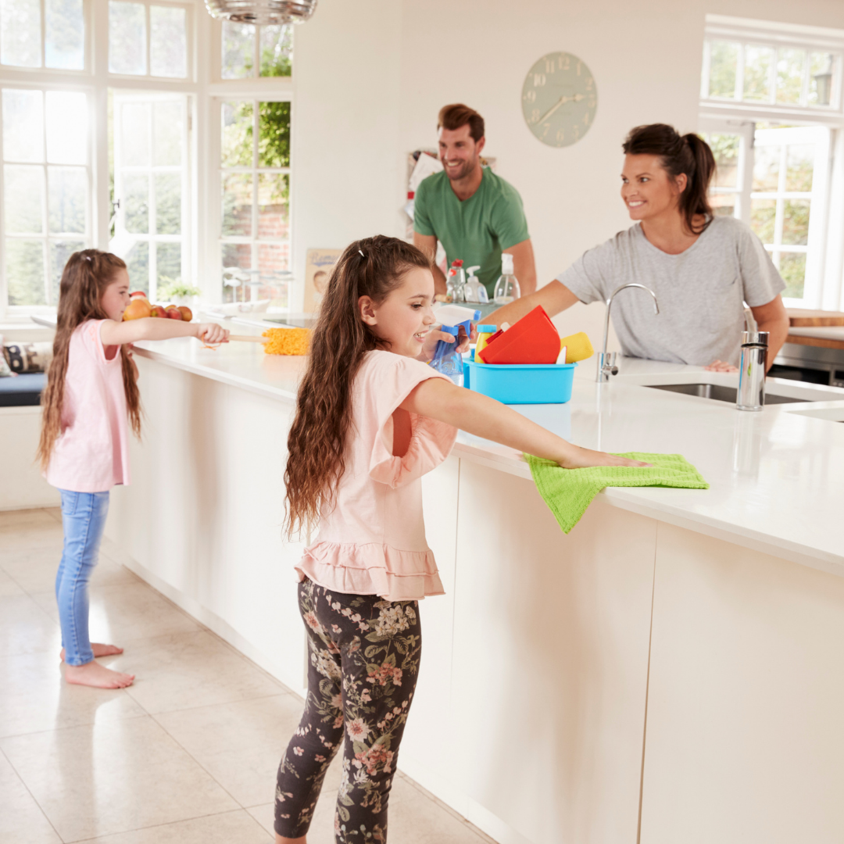

Let`s learn new words! Read, match and translate.
humorous story
psychology
Translate
психология
переводить
mysterious case
investigation
загадочная история
расследование
смешная история
neat appearance
underwater city
опрятная внешность
cape
плащ с капюшоном
obsession with order
magnifying glass
одержимость порядком
увеличительное стекло
подводный город

Slide 5

Read the text and complete phrase:
……solves crimes with a partner?
……always wants to be neat and tidy?
……doesn`t look like a detective?
……wrote adventure novels?
…….travels in a submarine?

Slide 6

Find the synonyms and describe characters:
well known
unusual
amazing
amazing
clever
ordinary
loyal
intelligent
faithful
extraordinary
typical
strange
famous

Slide 7
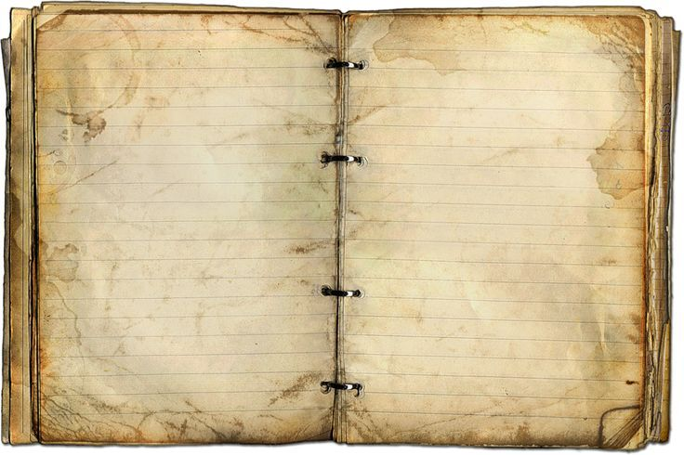
She was…….
He was…….
He was…….
They were…….
He was…….
He was…….

Slide 8
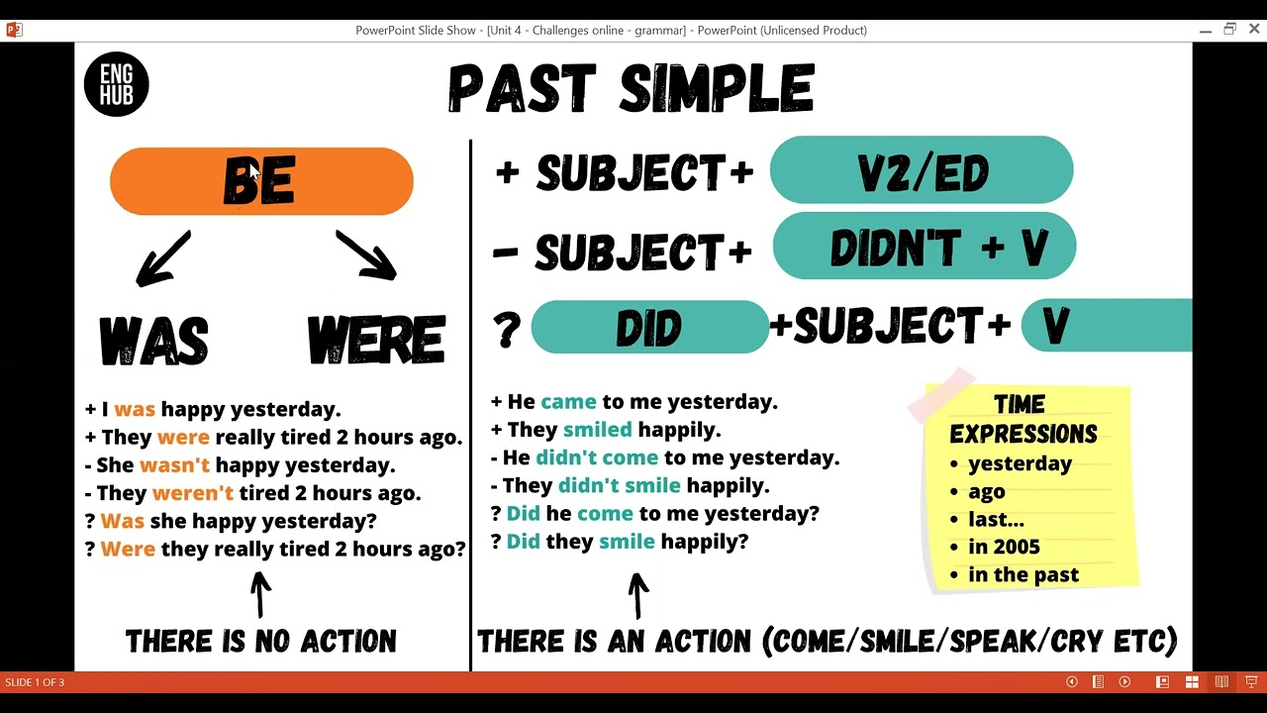
Let`s revise grammar!

Slide 9

Practice grammar skills…
1.Yesterday he his face at a quarter past seven. (to wash)
2. I at school 3 years ago. ( to work)
3. We at university in 1998. ( to study)
4. My mother milk in her childhood. (not to like)
5. Our children football last year. ( to play)
6. You your school? (to like)
7. You at the hospital last week? ( to work)
8. We yesterday. ( not to rest)
9. My friend in America 2 years ago. (to live)
10. You in this house last year? (to live)
11. Where you (to study)?
12. Your mother supper yesterday? (to cook)
13. I my breakfast. (not to cook )
14. You your homework? ( to prepare )
15. I my Granny at the garden. ( to help)
washed
worked
studied
didn`t like
played
Did
like
Did
work
didn`t rest
lived
Did
live
did
study
Did
cook
didn`t cook
Did
prepare
helped

Slide 10


