Slide 1
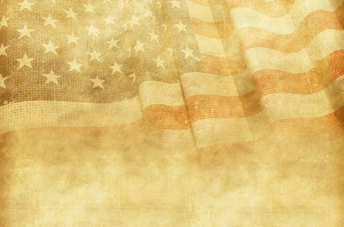
Районный конкурс на иностранном языке «Виртуальная экскурсия»
Тукаев Андрей,
ученик 6-го класса
МКОУ «Карамас-Пельгинская СОШ»
Руководитель: Габитова Татьяна Юрьевна,
учитель английского языка
МКОУ «Карамас-Пельгинская СОШ»
2026 г.

Slide 2
Plan
The history of Washington's Birthday holiday
Celebration of the holiday in different states
Honoring the First President of America in his homeland
Honoring war veterans
A nation that doesn't know its past has no future (M. Lomonosov)
6. List of information sources used

Slide 3
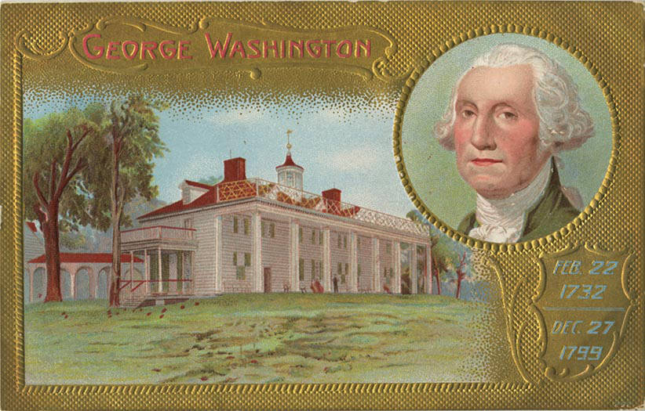
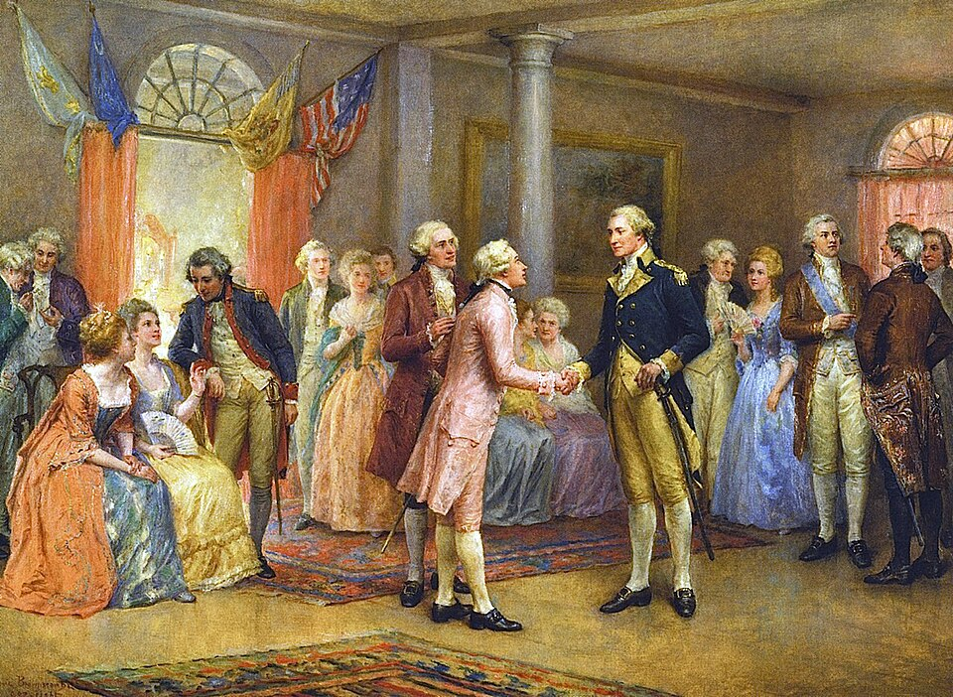
The history of Washington's Birthday holiday
This holiday was started in 1880 and is celebrated on the twenty-second of February, as this was the day the first President of the United States, George Washington, was born. The first celebration of his birthday took place in Richmond, Virginia, where balls and receptions were held.

Slide 4
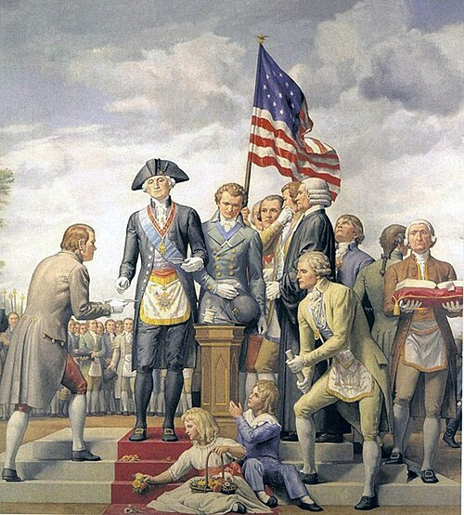
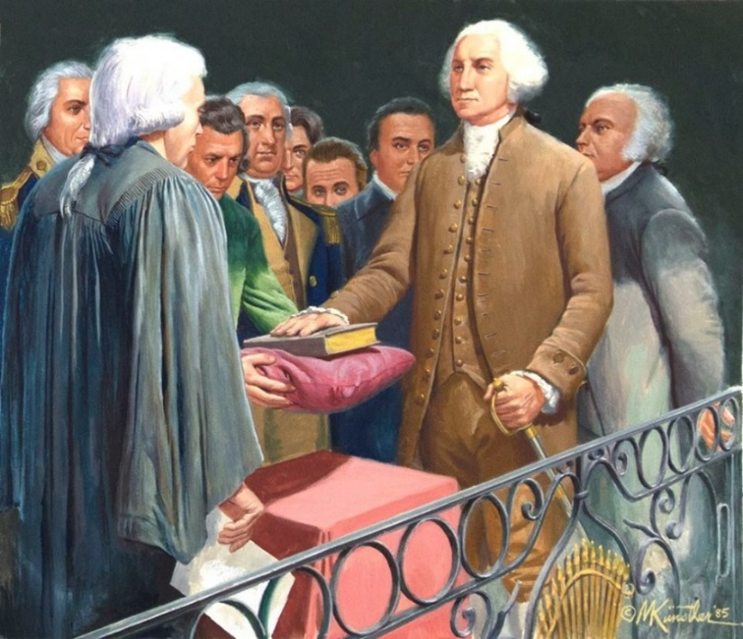
The history of Washington's Birthday holiday
Before becoming president, Washington commanded troops during the war and led the meeting that adopted the U.S. Constitution.

Slide 5
The history of Washington's Birthday holiday
In America, they tried to combine the birthdays of both presidents, Washington and Lincoln, but it didn’t work out. In 1971, the decision was made to celebrate Washington's birthday on the third Monday of February instead of the exact date, resulting in a three-day weekend.

Slide 6
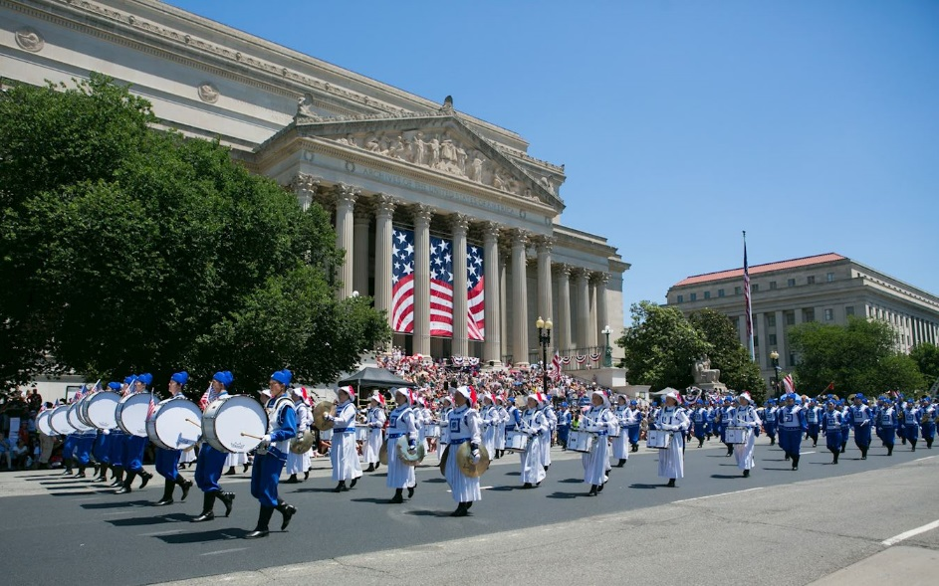
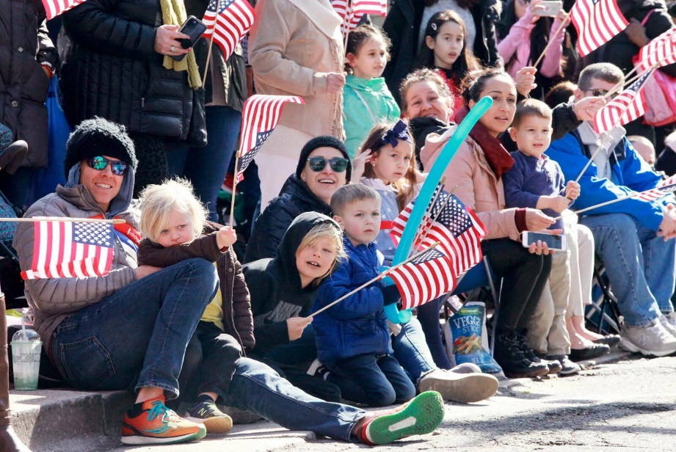
Celebration of the holiday in different states
On this day, various celebrations and performances are held to commemorate important moments in American history.

Slide 7
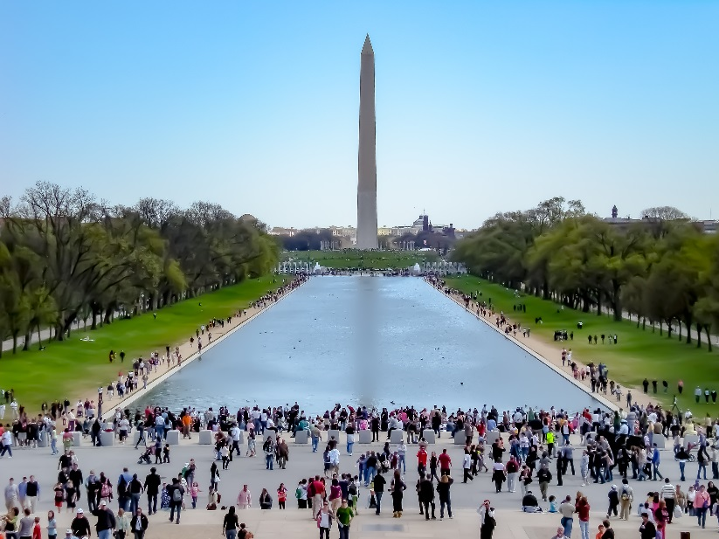
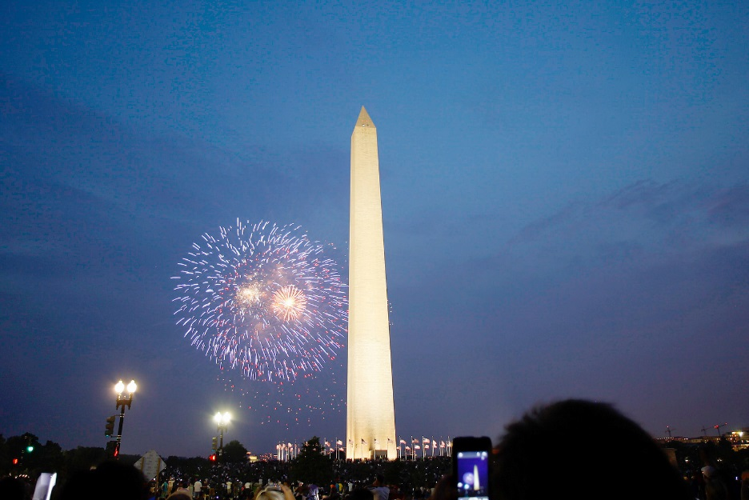
Celebration of the holiday in different states
On this day, Americans often visit the Washington’s Monument

Slide 8
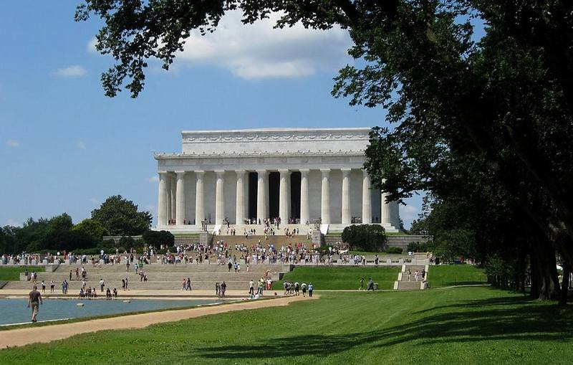
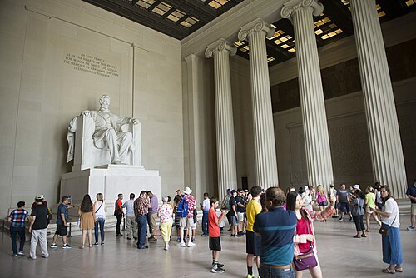
Celebration of the holiday in different states
and Lincoln’s Monument

Slide 9
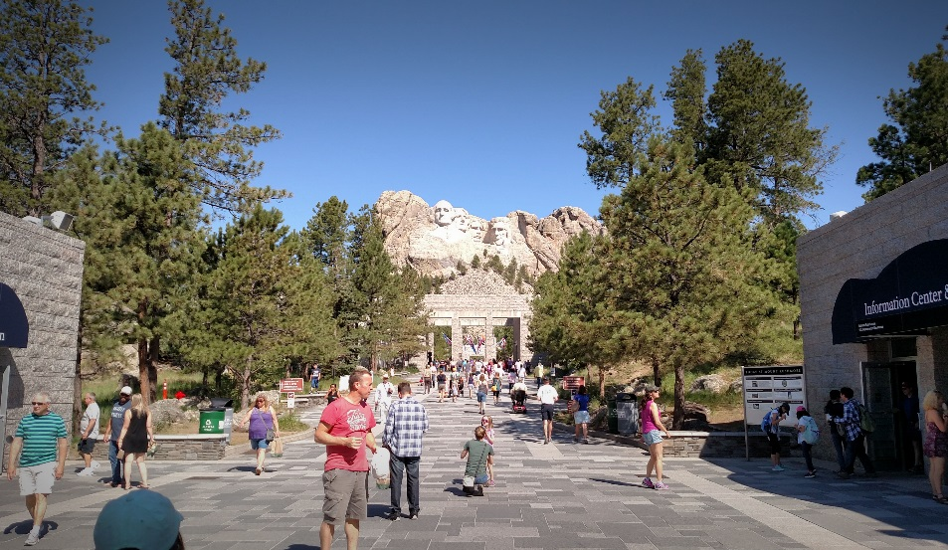
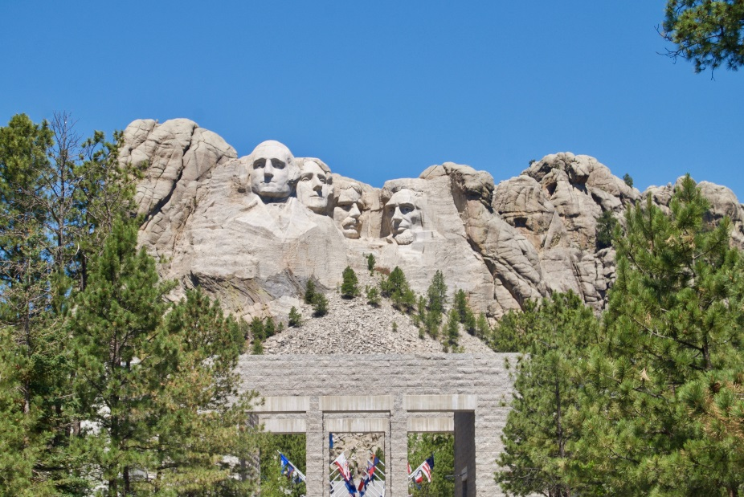
Celebration of the holiday in different states
On this day, Americans often visit the Washington’s Monument or the famous Mount Rushmore, where the portraits of four famous presidents are carved.

Slide 10
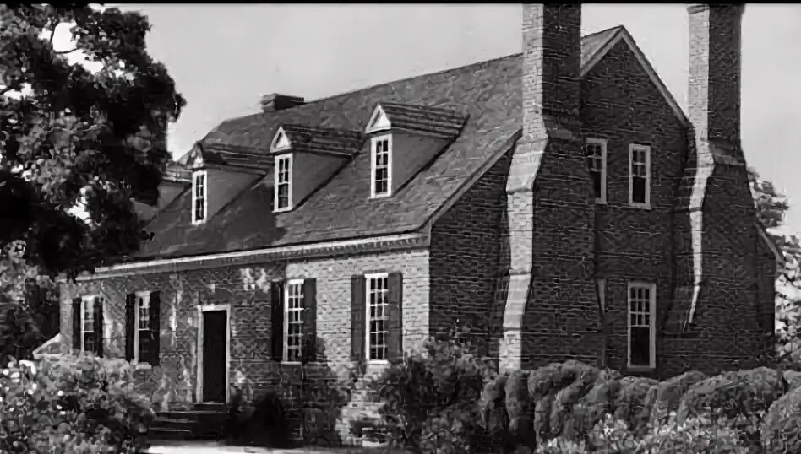
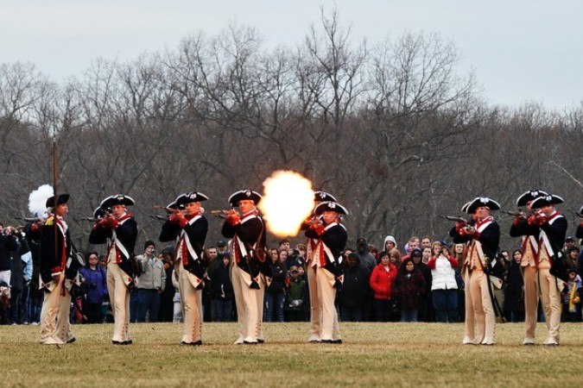
Honoring the First President of America in his homeland
Many people travel to Mount Vernon, the home of George Washington, where his house museum is located. People enjoy fun performances with artists and musicians.

Slide 11
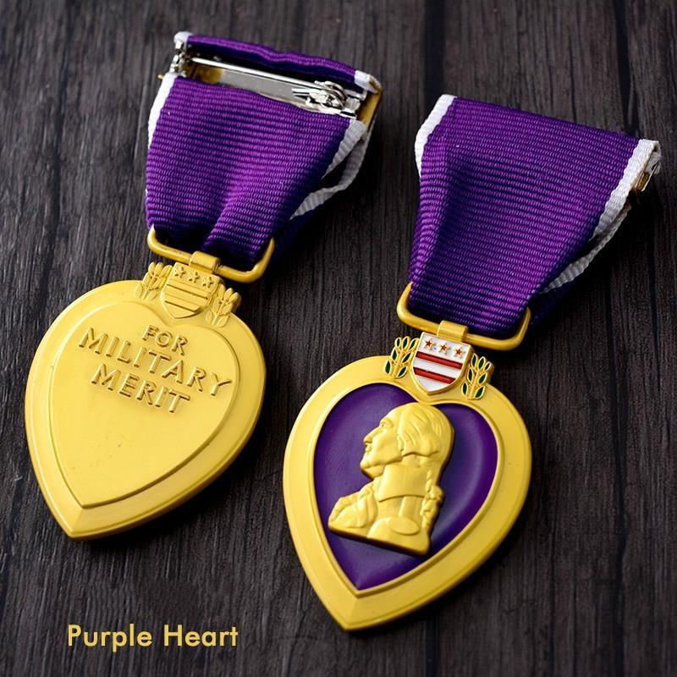
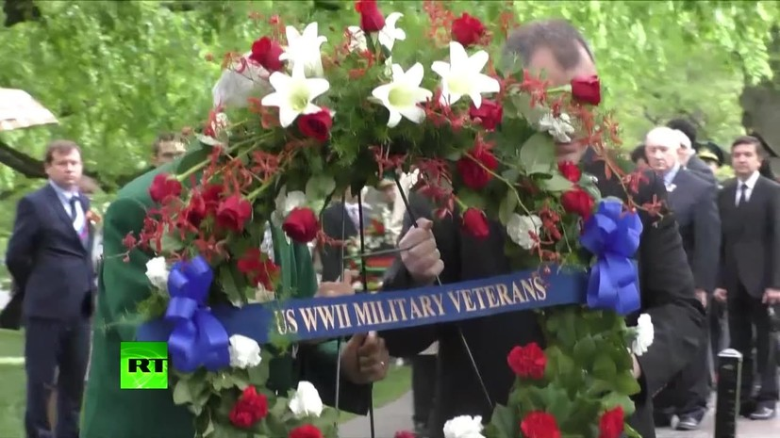
Honoring war veterans
On this day, military veterans are honored, and medals are awarded to soldiers who were injuries during their service. The Purple Heart medal was created for Washington's anniversary. In the capital, flowers are brought to the monuments of Washington and Lincoln.

Slide 12
A nation that doesn't know its past has no future (M. Lomonosov)
Americans remember the history of their country, teach their children to love their country, and honor its traditions. This holiday helps people to understand why it is important to remember history.

Slide 13
List of information sources used
https://lingua-airlines.ru/articles/den-prezidentov-v-ssha/
https://en.wikipedia.org/wiki/Presidents%27_Day
https://www.calend.ru/holidays/0/0/192/
https://www.history.com/articles/presidents-day
https://www.britannica.com/biography/Abraham-Lincoln/Lincolns-family
https://rus.team/holidays/den-prezidentov-v-ssha

Slide 14


