Slide 1
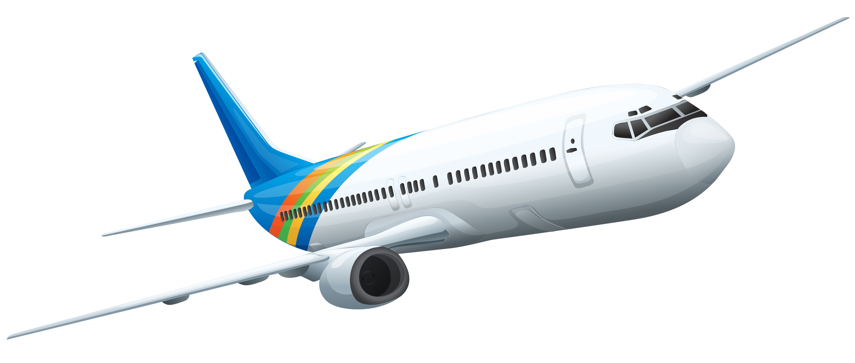



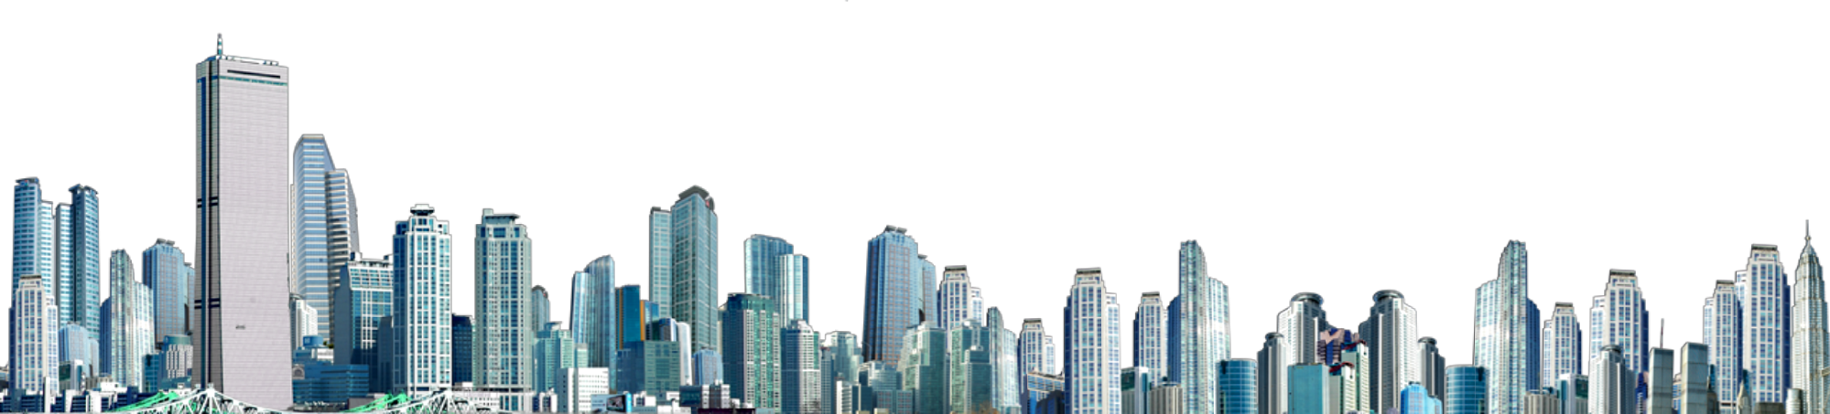
Home and Away
Exploring places around the world

Slide 2
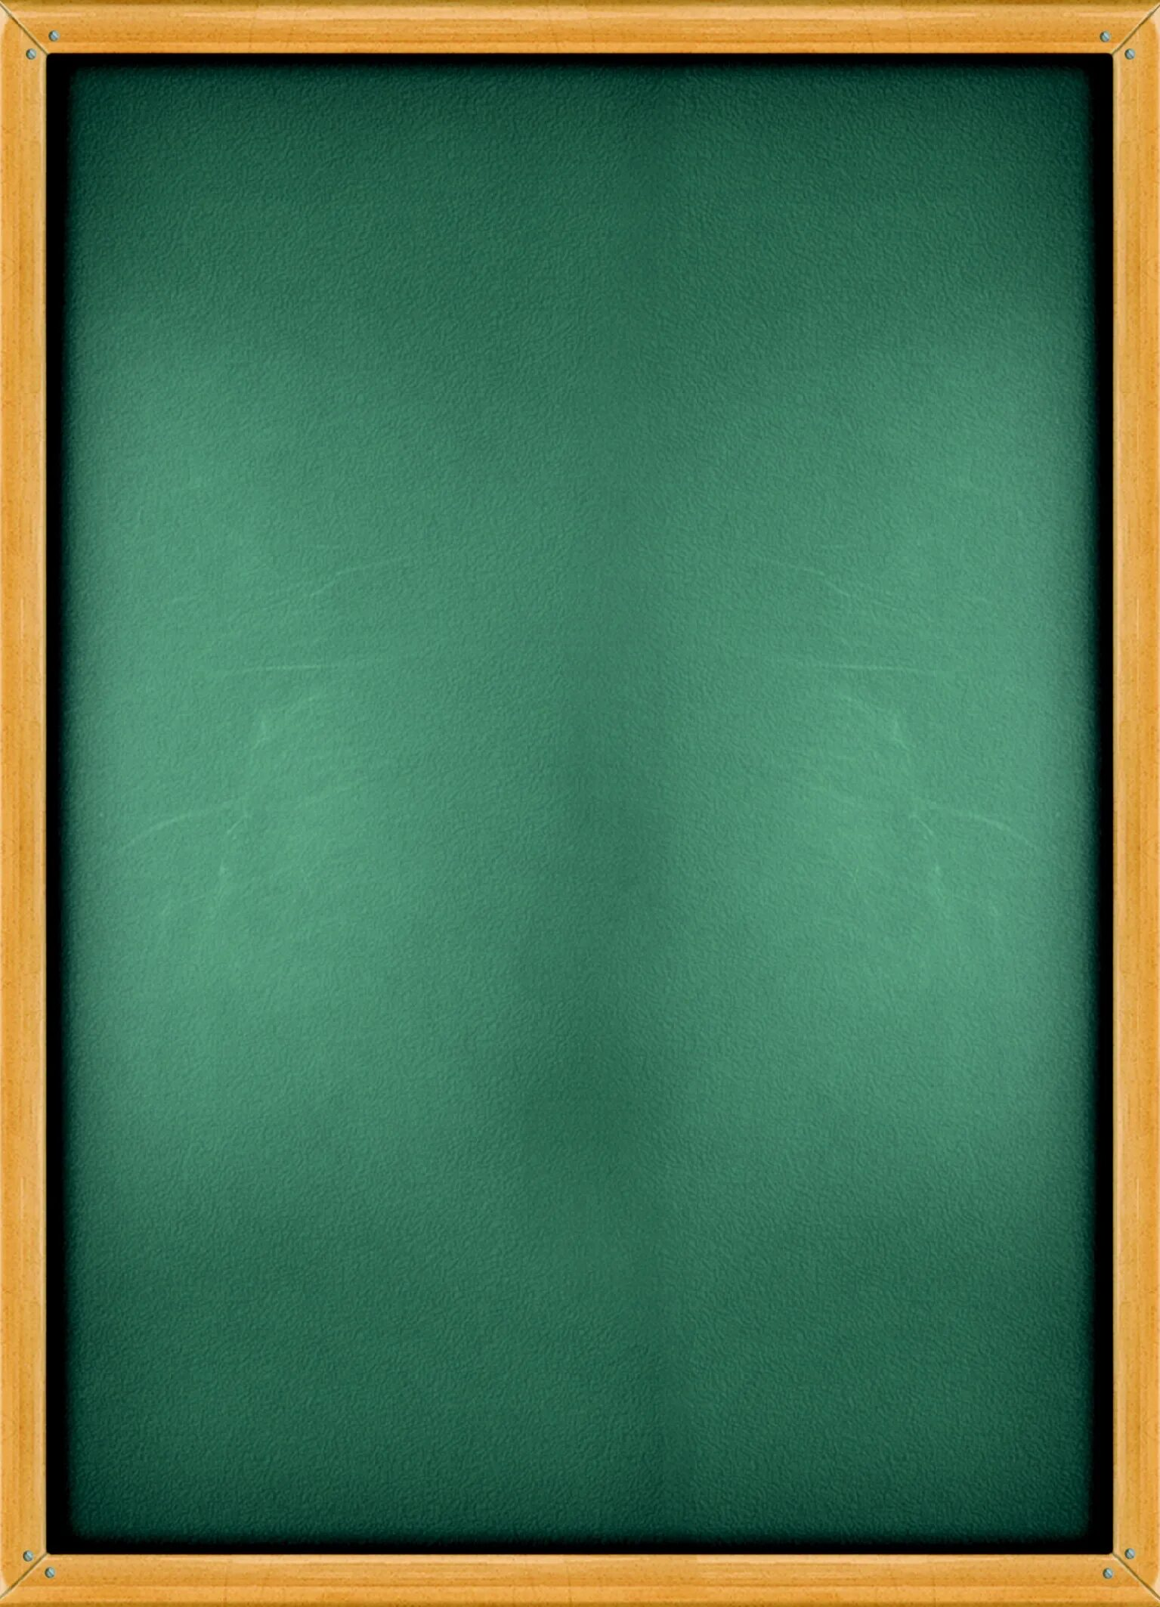
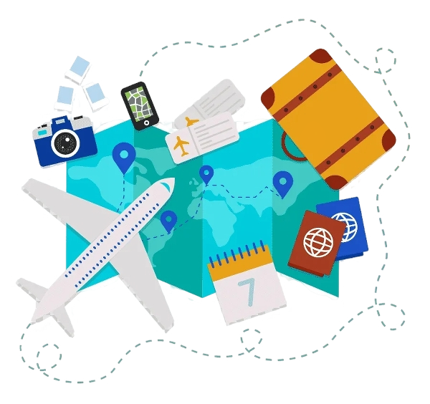
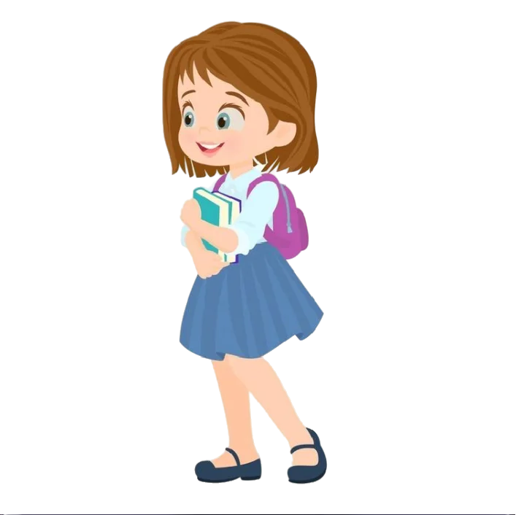
Warm-up
I’m from Russia. My hometown is big and very nice. And I really like to travel!
1. Where are you from?
2. What is your hometown like?
3. Do you like to travell?

Slide 3
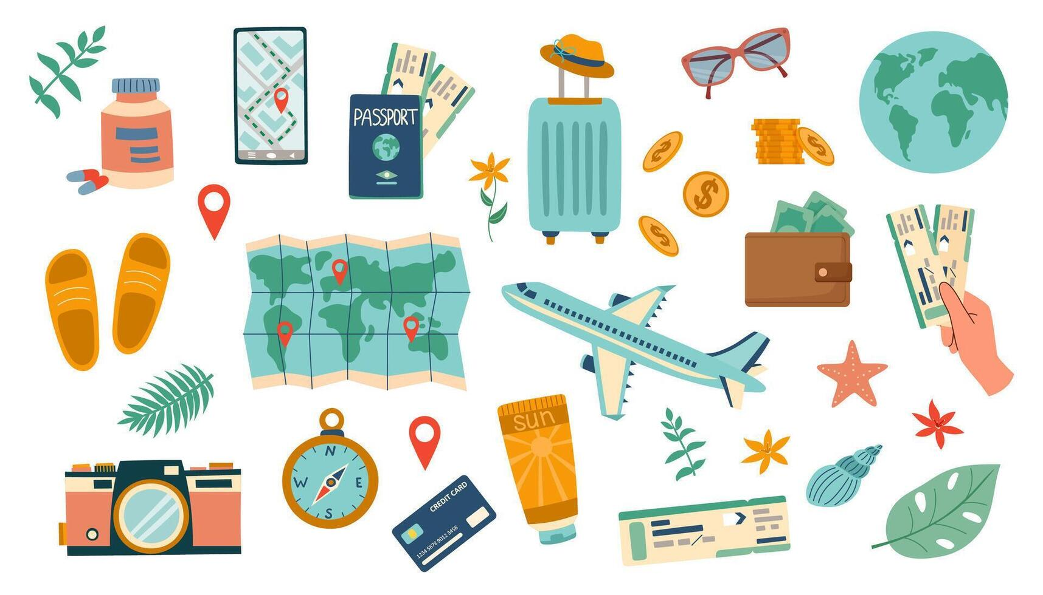
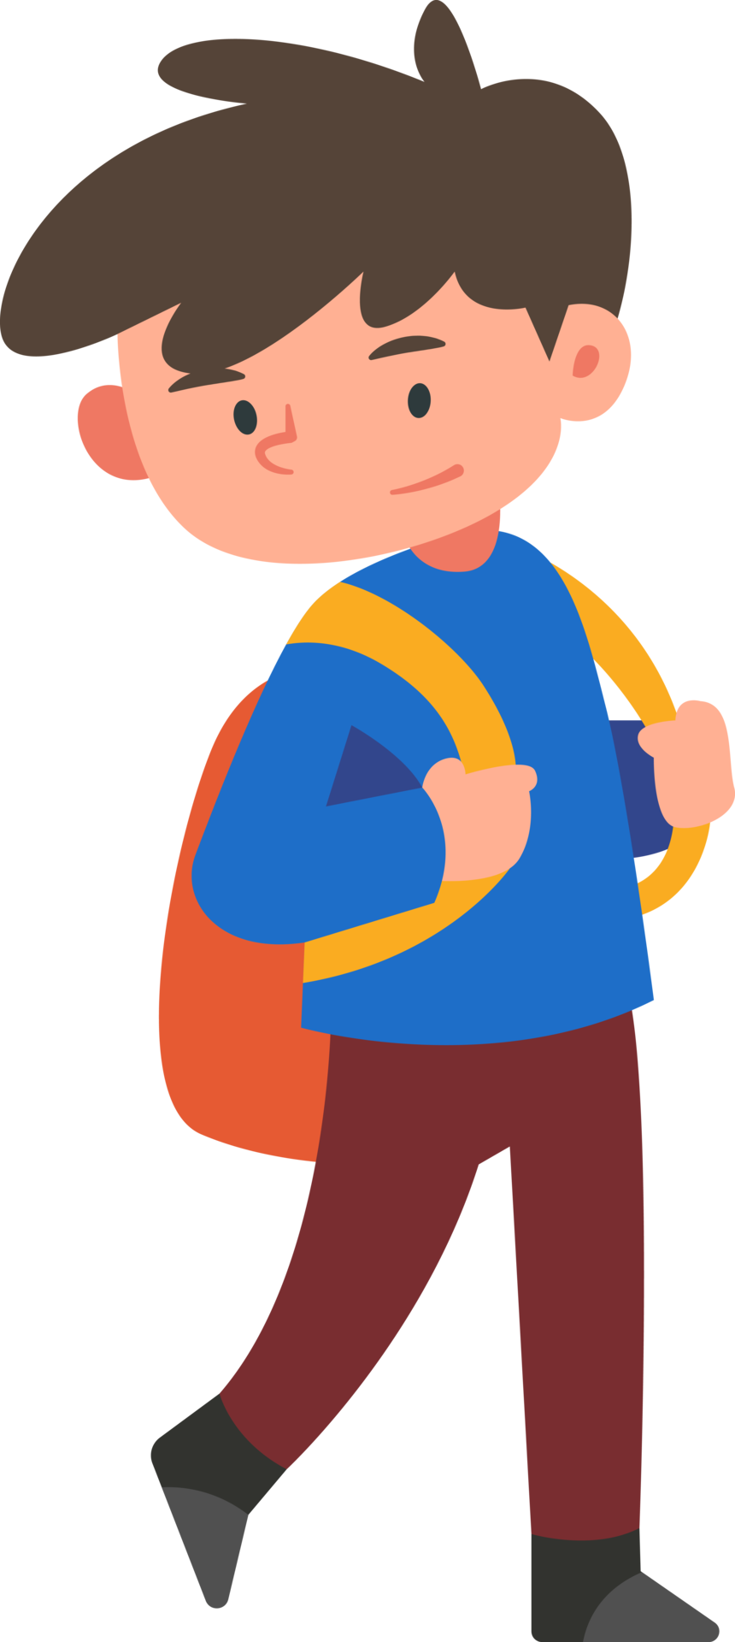
Vocabulary
I saw ancient statues at a museum!
Museum, theatre, streets, places, beaches, buildings, city, town, hotels, etc.

Slide 4
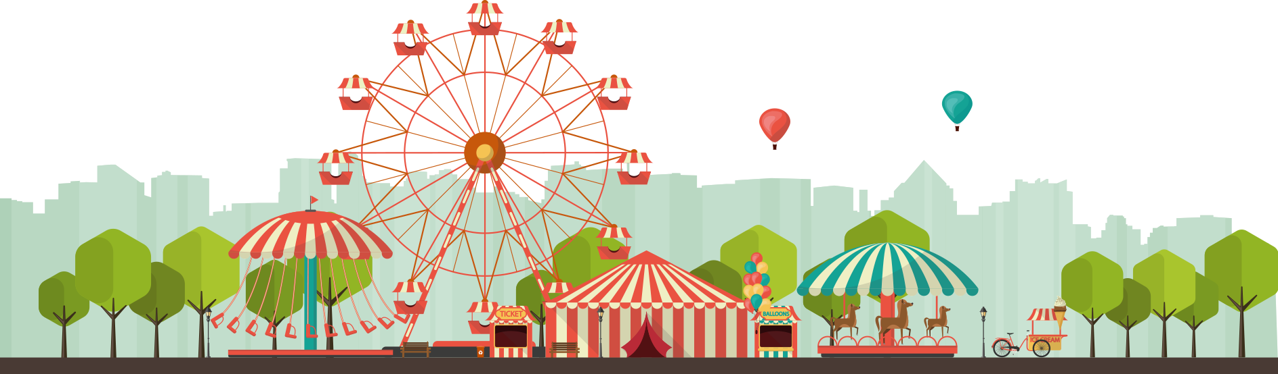
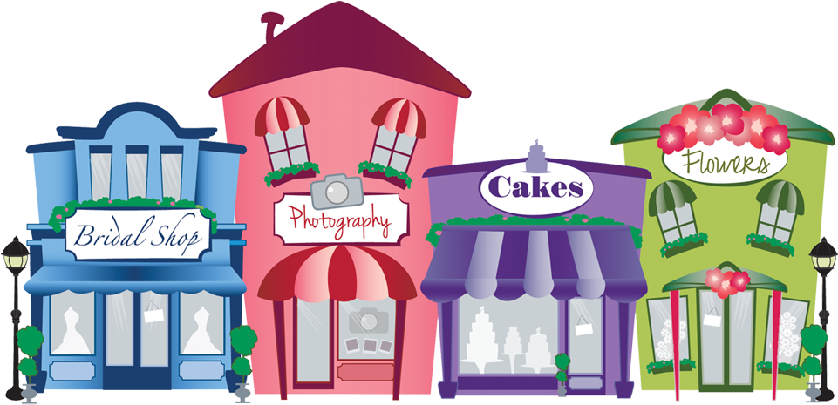
Grammar
There are many shops here.
Cool!
There is / There are
Task: make sentences about your city.
For example:
There is a park in my city.
There are many shops in the city.

Slide 5
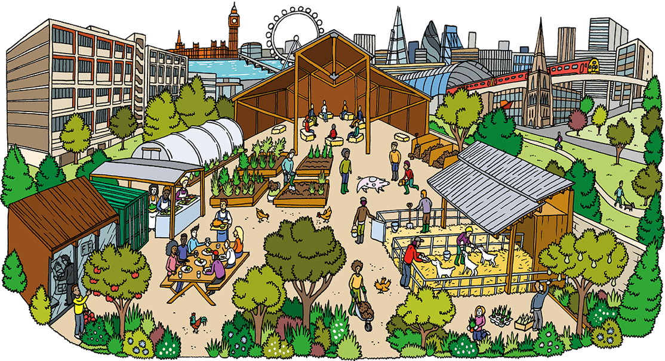
Speaking
Would you like to live here? Why/why not?
Useful words: big, small, noisy, quiet, beautiful, boring

Slide 6
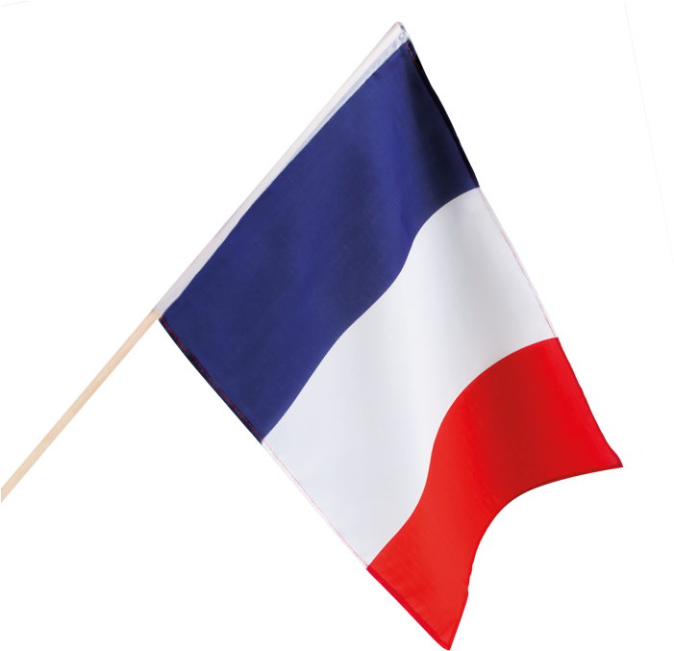
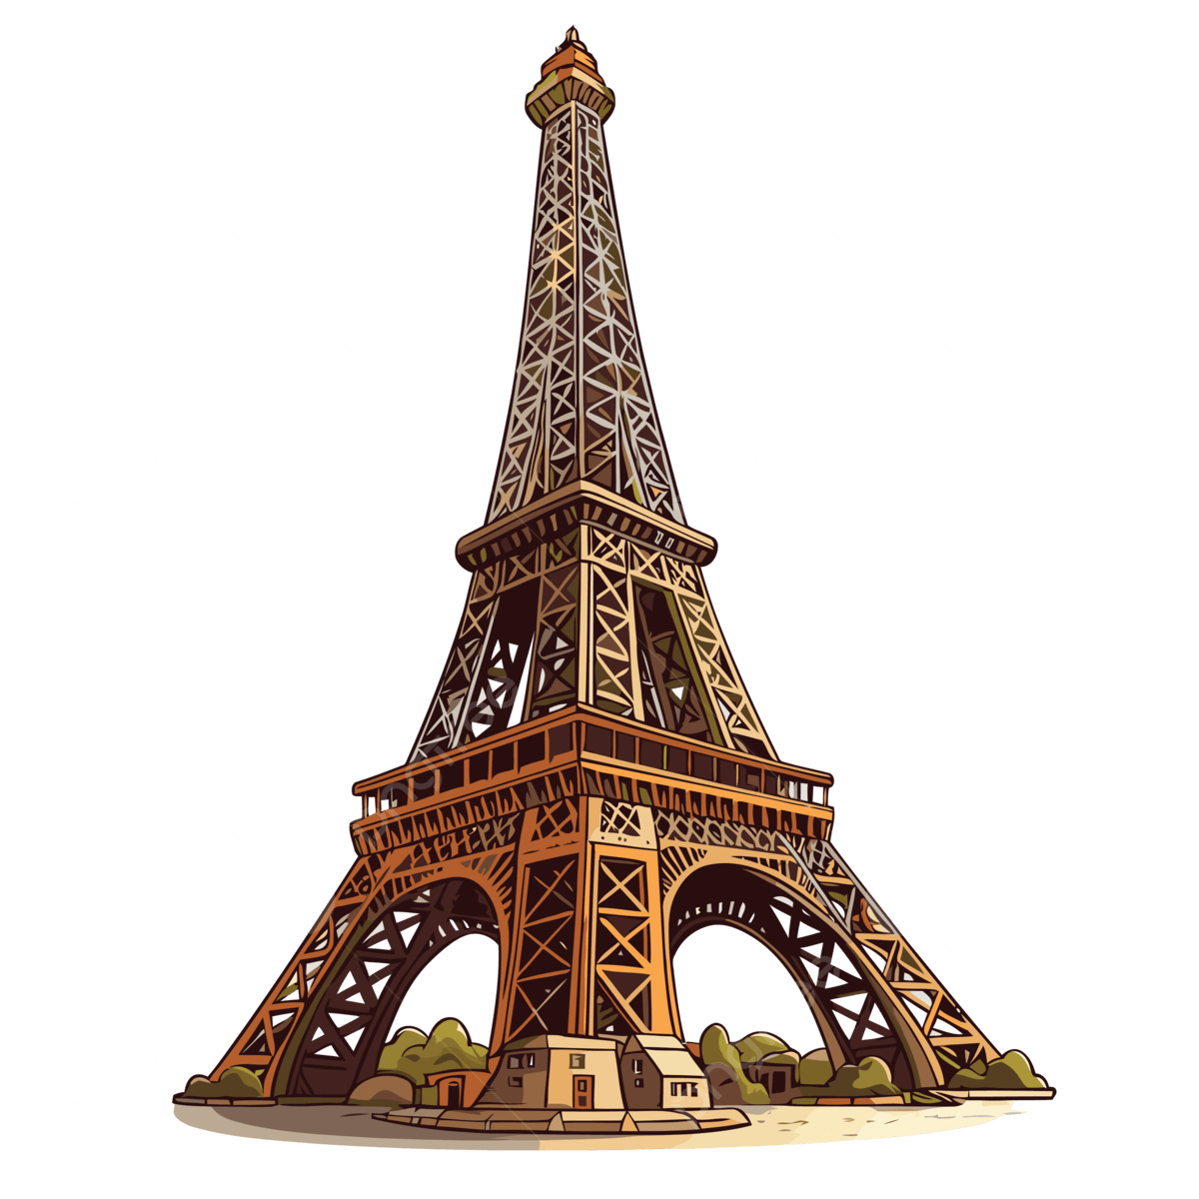

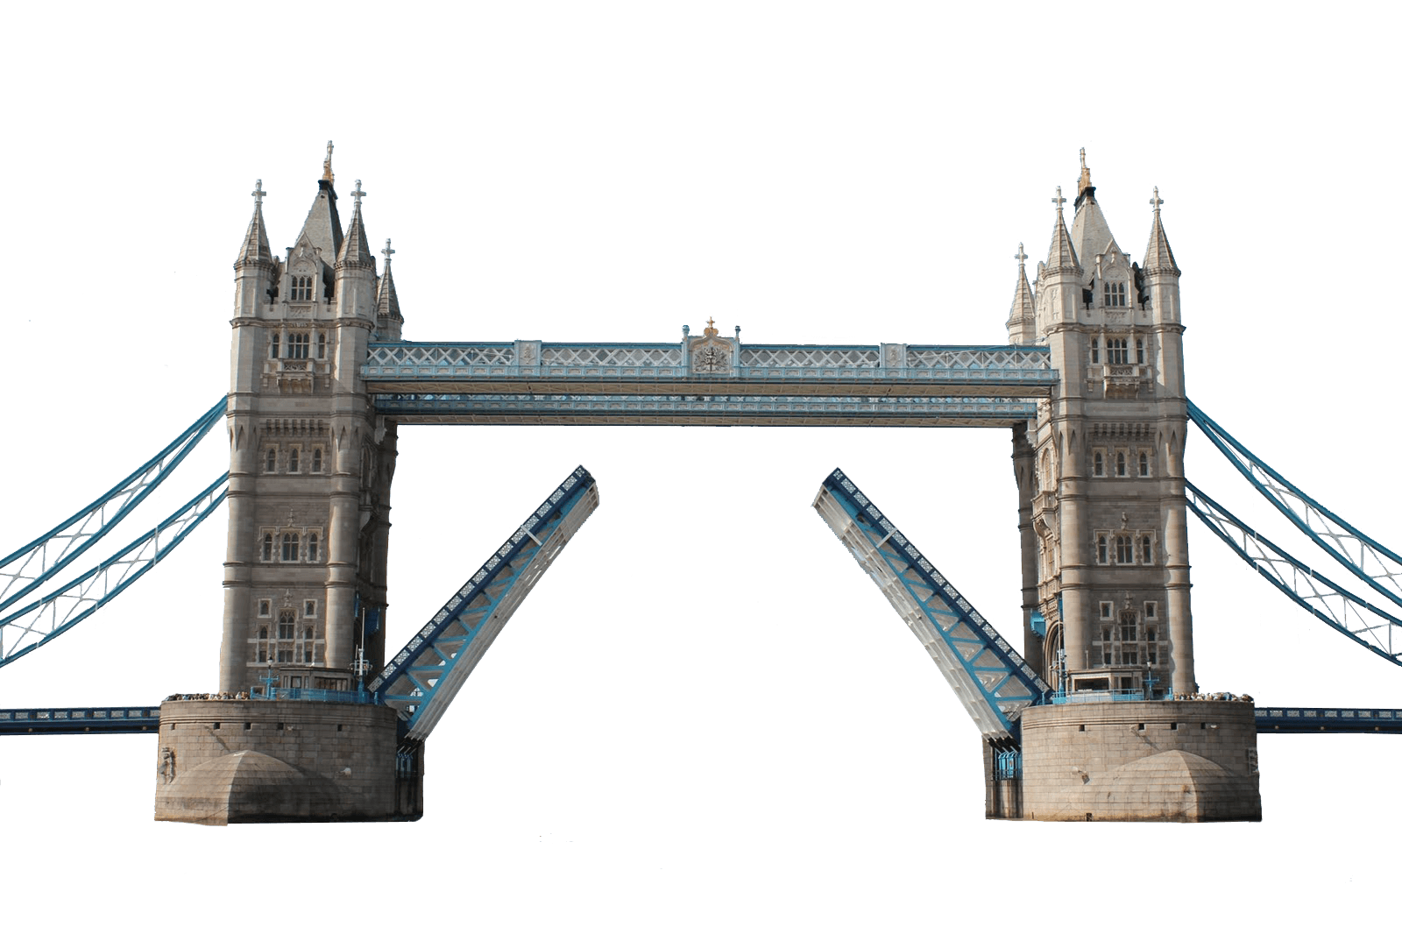
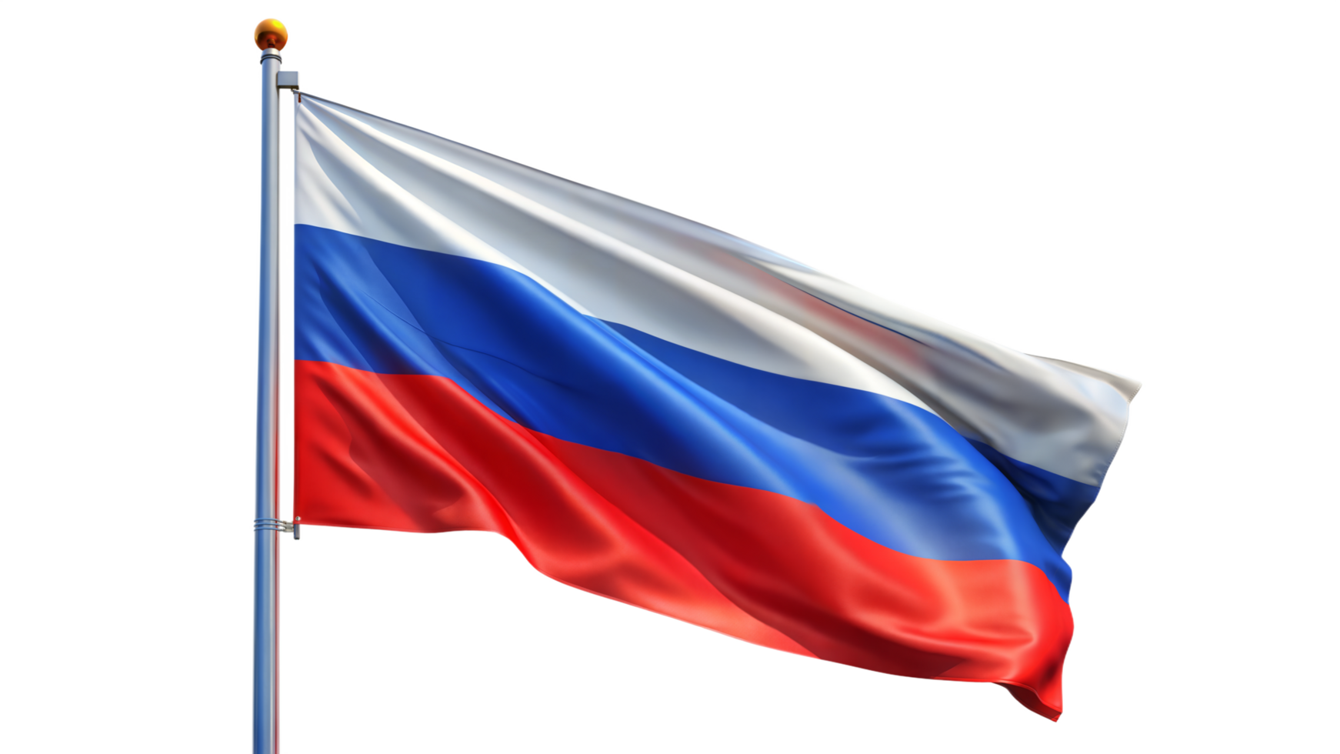
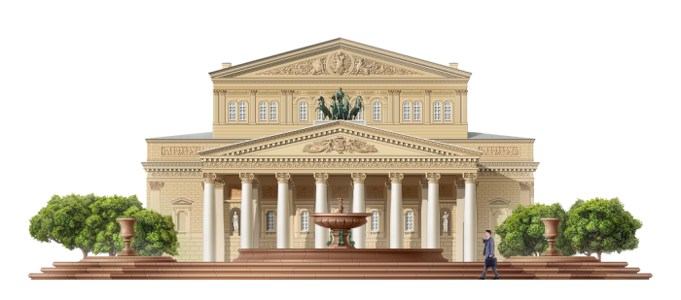
Quiz
Where is the Eiffel Tower?
Where is Tower Bridge?
Where is The Bolshoi Theatre?

Slide 7
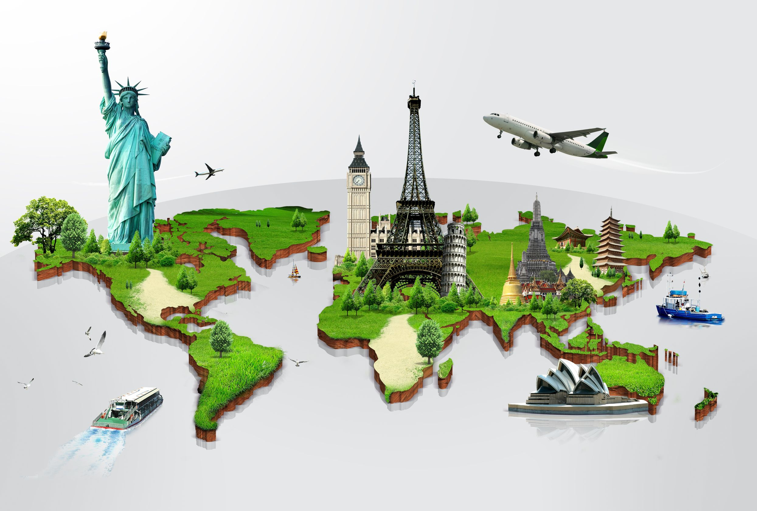
Homework
Make a mini-poster
“The travel of my dream”.
Draw or find a picture and write 5-6 sentences.

Slide 8
Conclusion
The more you travel, the more you learn

