Slide 1
Автор: Левенцева Т.А., учитель английского языка
МОУ «СОШ №23» г. Воркуты
Тренажер устной части ЕГЭ по английскому языку,
10-11 классы
Воркута, 2023

Slide 2
Пояснительная записка
Тренажер предназначен для подготовки учащихся 10-11 классов к выполнению устной части ЕГЭ по английскому языку. Тренажер содержит один вариант заданий, соответствующий демо-версии КИМ ЕГЭ-2025. Может быть использован как шаблон.
Использованные ресурсы:
Логвина А.А., Английский язык. Алгоритмы выполнения типовых заданий ЕГЭ, М., Эксмо, 2018, стр. 178;
Открытый банк заданий ФИПИ, ЕГЭ по английскому, https://ege.fipi.ru/bank/index.php?proj=4B53A6CB75B0B5E1427E596EB4931A2A&qid=F3C670 ;
Фото из личного архива

Slide 3
TEST 0

Slide 4
Imagine that you are preparing a project with your friend. You have found some interesting material for the presentation and you want to read this text to your friend. You have 1.5 minutes to read the text silently, then be ready to read it out aloud. You will not have more than 1.5 minutes to read it.
START TEST

Slide 5
Be ready for the test
seconds
00
01
02
03
04
05

Slide 6
Preparation 1.5 min
The Tiger shark is one of the largest known species of sharks. It can reach length of up to 5.5 metres and weigh over 900 kilos. This shark is really fast and known for swimming 20 miles per hour, while travelling extremely far distances. The Tiger shark gets its name from the black stripes it is born with along its back, like a tiger has. Like many other species of sharks, Tiger sharks have powerful jaws lined with sharp teeth. These teeth are incredibly strong.
During the daytime Tiger sharks are mostly inactive. They hunt during the night. They are solitary. Tiger sharks feed mainly on bony fish, squid, rays, seals and dolphins. But they may attack any shark or human that comes near them.
The Tiger shark is found throughout the world’s coastal temperate and tropical waters, with the exception of the Mediterranean Sea.

Slide 7
Be ready for the answer
seconds
00
01
02
03
04
05

Slide 8
Answer 1.5 min
The Tiger shark is one of the largest known species of sharks. It can reach length of up to 5.5 metres and weigh over 900 kilos. This shark is really fast and known for swimming 20 miles per hour, while travelling extremely far distances. The Tiger shark gets its name from the black stripes it is born with along its back, like a tiger has. Like many other species of sharks, Tiger sharks have powerful jaws lined with sharp teeth. These teeth are incredibly strong.
During the daytime Tiger sharks are mostly inactive. They hunt during the night. They are solitary. Tiger sharks feed mainly on bony fish, squid, rays, seals and dolphins. But they may attack any shark or human that comes near them.
The Tiger shark is found throughout the world’s coastal temperate and tropical waters, with the exception of the Mediterranean Sea.

Slide 9
Be ready for the next task
seconds
00
01
02
03
04
05

Slide 10

Preparation 1.5 min
Task 2. Study the advertisement.
You are considering visiting an aquarium and now you’d like to get more information. In 1.5 minutes you are to ask four direct questions to find out about the following:
location
ticket price
taking pictures
souvenir shop
You have 20 seconds to ask each question.

Slide 11
Be ready for the answer
seconds
00
01
02
03
04
05

Slide 12
Answer 20 sec
location

Slide 13
Answer 20 sec
ticket price

Slide 14
Answer 20 sec
taking pictures

Slide 15
Answer 20 sec
souvenir shop

Slide 16
Be ready for the next task
seconds
00
01
02
03
04
05

Slide 17
Task 3. You are going to give an interview. You have to answer five questions. Give full answers to the questions (2-3 sentences). Remember that you have 40 seconds to answer each question.
START TASK

Slide 18
Be ready for the answer
seconds
00
01
02
03
04
05

Slide 19
Schools of the future (F3C670)
What do you think schools will look like in some twenty years?
What kind of teachers will work at these schools?
What subjects will be taught at these schools?
How different will these schools be from today’s school?
Will it be boring or fun to study at the school of the future? Why?
Click to check the questions

Slide 20
Be ready for the next task
seconds
00
01
02
03
04
05

Slide 21
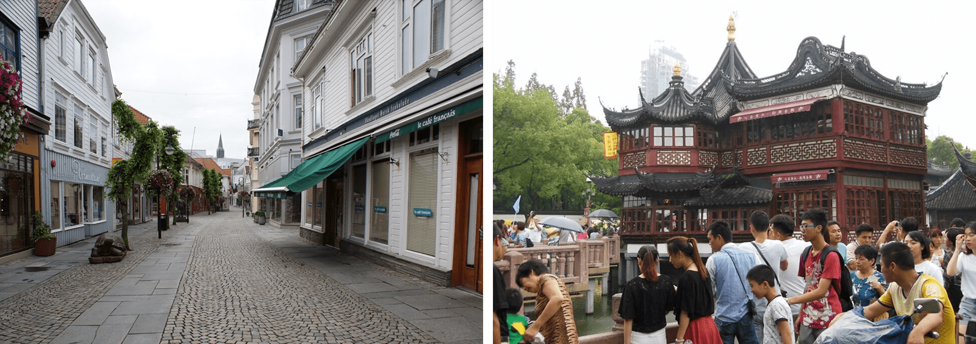
Preparation 2.5 min
Task 4. Imagine that you and your friend are doing a school project “Travel Destinations”. You have found some photos to illustrate it but for technical reasons you cannot send them now. Leave a voice message to your friend explaining your choice of the photos and sharing some ideas about the project. In 2.5 minutes be ready to:
explain the choice of the illustrations for the project by briefly describing them and noting the differences;
mention the advantages (1-2) of the two places to travel to;
mention the disadvantages (1-2) of the two places to travel to;
express your opinion on the subject of the project – which place you would prefer to travel to and why.
You will speak for not more than 3 minutes (12-15 sentences).
You have to talk continuously.

Slide 22
Be ready for the answer
seconds
00
01
02
03
04
05

Slide 23
Answer 3 min
Project “Travel Destinations”
explain the choice of the illustrations for the project by briefly describing them and noting the differences;
mention the advantages (1-2) of the two places to travel to;
mention the disadvantages (1-2) of the two places to travel to;
express your opinion on the subject of the project – which place you would prefer to travel to and why.

Slide 24
Well done!
☺

