Slide 1
American Civil War
Prepared by student: Pogorelov Sergey

Slide 2
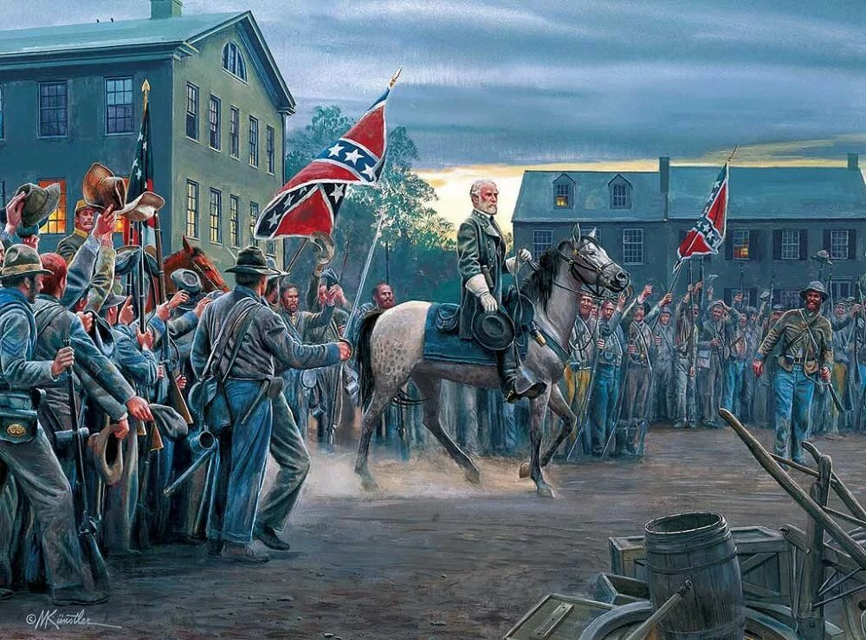
The American Civil War (1861–1865) was a civil war in the United States of America. It is sometimes called "The War Between the States." Thirteen Southern wanted to leave the United States of America. They formed the Confederate States of America, also called "the Confederacy". They wanted the Confederate States of America to be its own country, separate and independent from the United States.

Slide 3
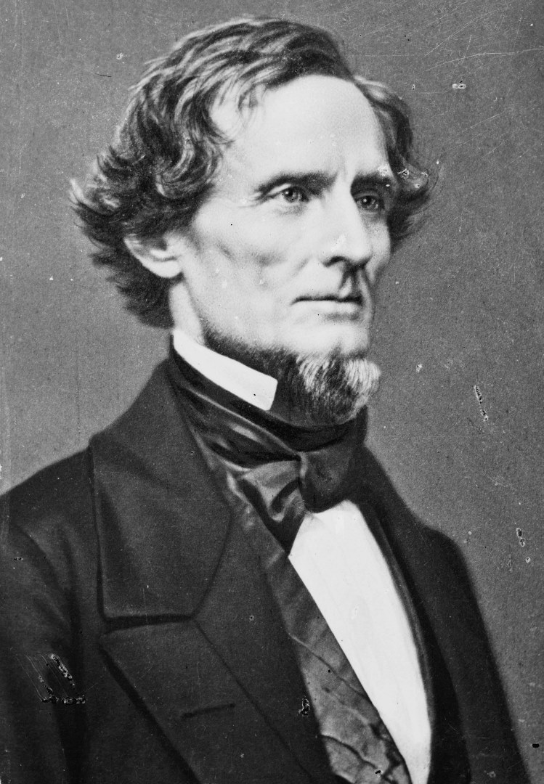
Jefferson Davis was chosen as president of the Confederacy. The U.S government and the states that remained loyal to it were called the Union. The Union is sometimes called "the North". E Most of these states were in the North. Five states where slavery was legal also supported the Union. These were called the "border states".

Slide 4
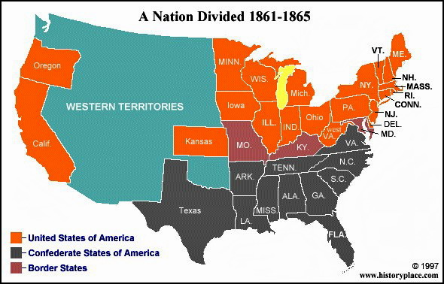

Slide 5
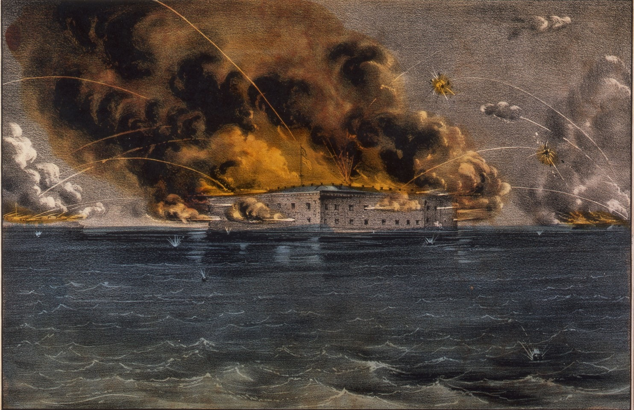
Fighting started when the Confederates bombarded Fort Sumter, a Union Army fort. Lincoln then asked the Union states to raise soldiers to fight the Confederates.
The Confederate States claimed that they owned all forts and other federal buildings in the South. Fort Sumter was in South Carolina - one of the Confederate States. However, the fort was controlled by the Union. On April 12, 1861, Confederate forces attacked the fort. They forced the Union soldiers inside the fort to surrender.
After this, President Lincoln asked every Union state for volunteers to join the Union Army. Quickly, four more southern slave states joined with the Confederates instead of supplying forces to fight them.
The blockade by the United States Navy stopped the Confederacy from selling its cotton and other goods. It also made it harder for them to buy weapons and military supplies.

Slide 6
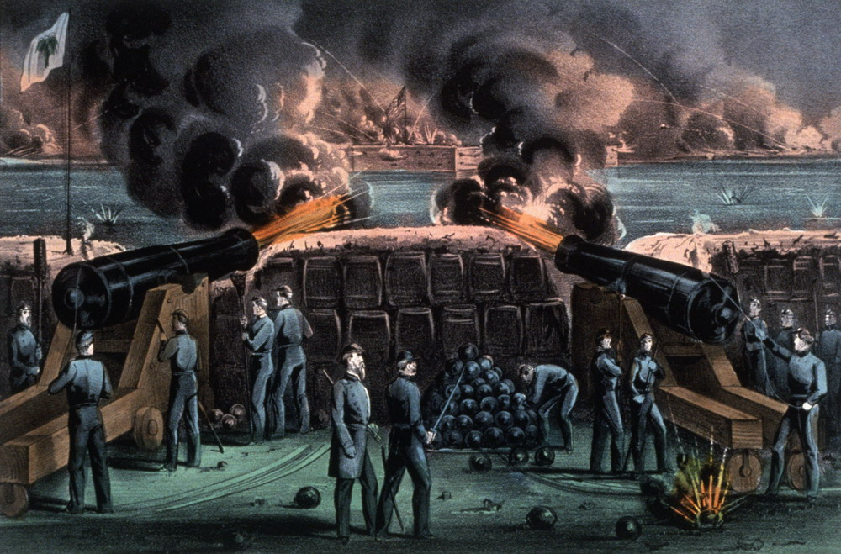
The first collision occurred on April 12, 1861. It was the battle of Fort Sumter that prompted the Declaration of war by the Union against the Confederacy. Lincoln, in response to aggression from the South, declared a General mobilization.
On July 16 of that year, the battle of Blackburn's Ford began and the Union army was defeated there. Five days later, the battle of Bull Run took place (then there were several other battles), where the Union soldiers were again defeated.

Slide 7
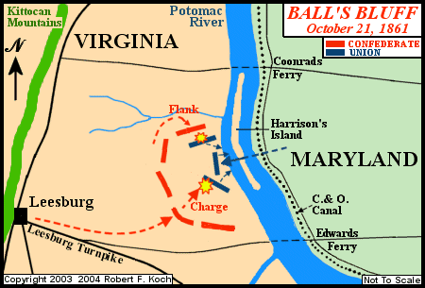
Battle of Ball's Bluff

Slide 8
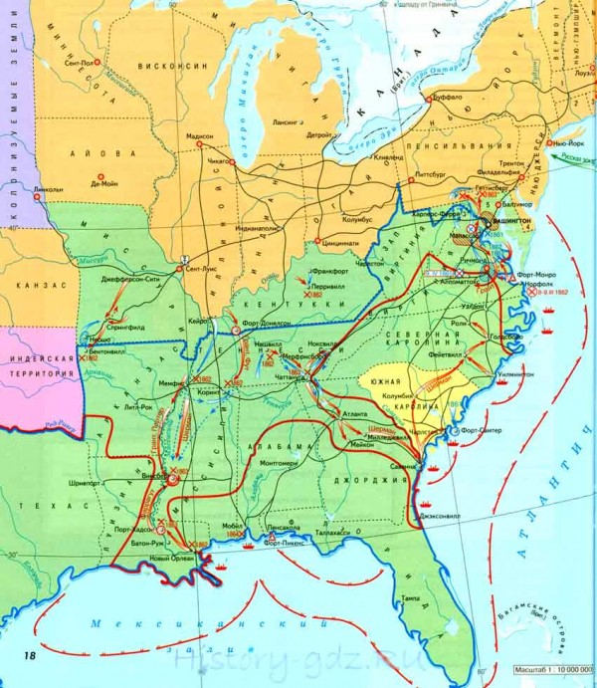

Slide 9
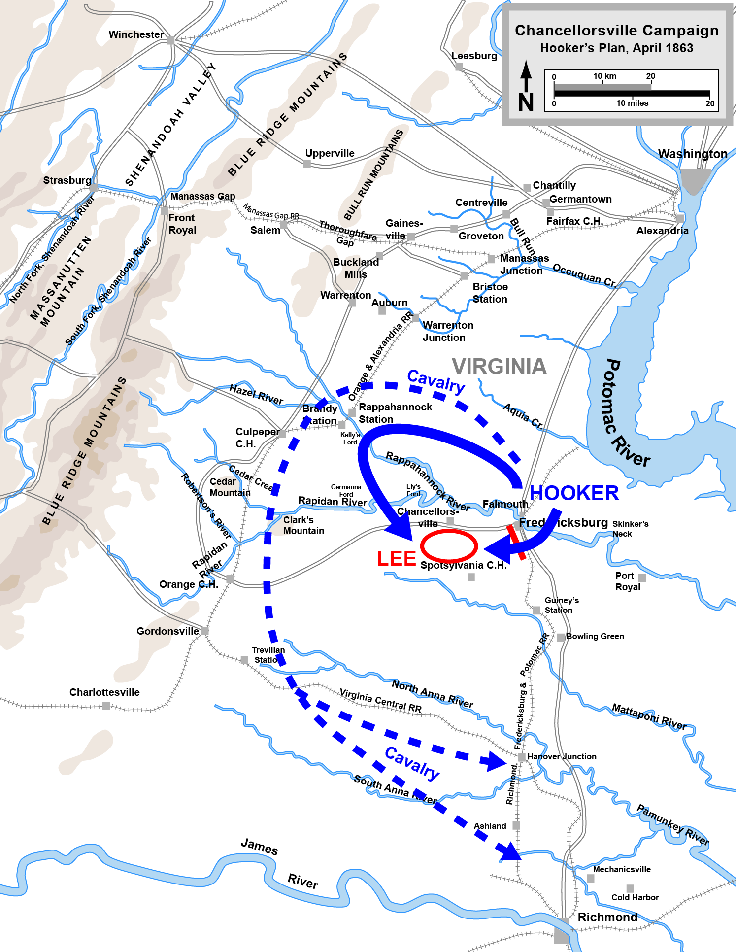
In may 1863, the northerners suffered a disastrous defeat by General Lee's army at the battle of Chancellorsville. In early July of the same year, the southern army suffered more losses at the battle of Gettysburg and was forced to retreat.

Slide 10
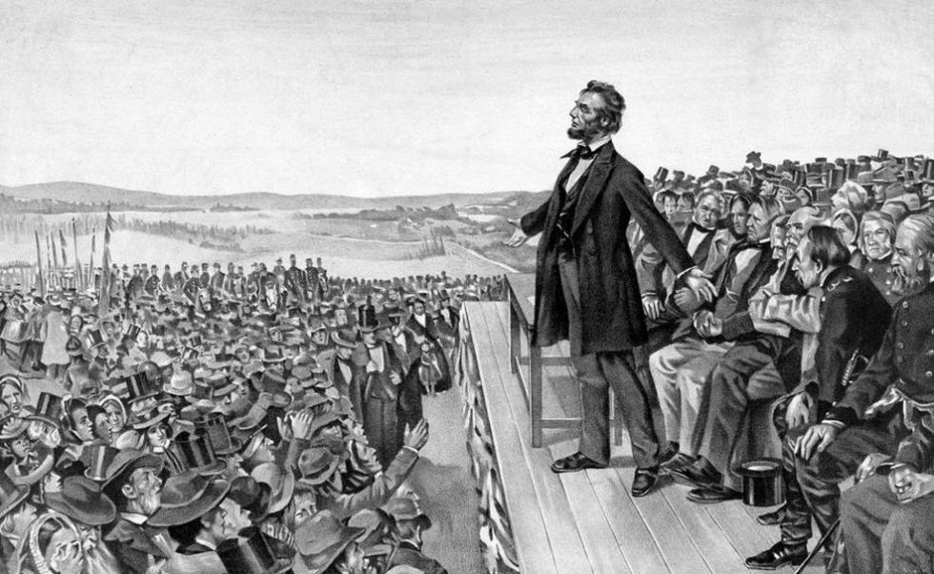

Slide 11
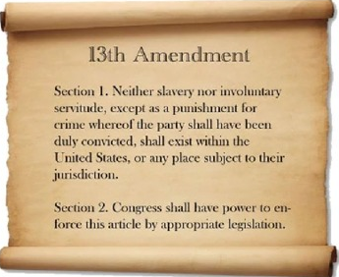
* 13-я поправка гласила, что рабство не допускается нигде в Соединенных Штатах. На этом завершилась работа по провозглашению эмансипации.
* 14-я поправка четко указала, что все люди, родившиеся в Соединенных Штатах, являются гражданами с равными правами.
* В 15-й поправке говорилось, что люди в Соединенных Штатах не могут быть лишены права голоса из-за своей расы.

Slide 12


