Slide 1
Tools, equipment, machine tools
Нефёдова Светлана Геннадьевна,
преподаватель
ГАПОУ СО «Серовский политехнический техникум»
город Серов

Slide 2
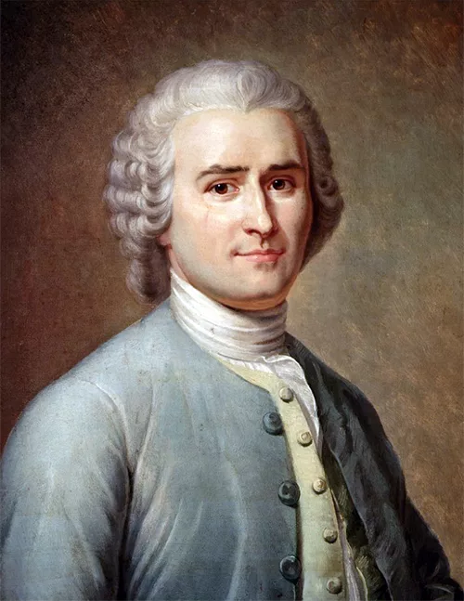
Read the quote and tell if you agree or disagree with it
An hour of work will teach more than a day of explanation.
Jean-Jacques Rousseau

Slide 3
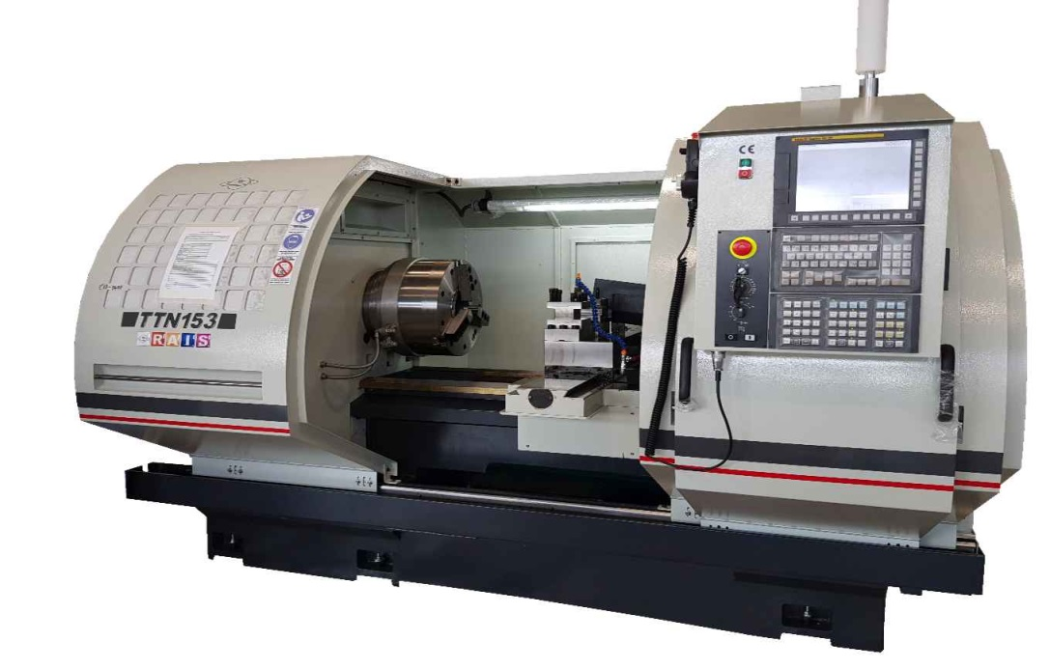
Let’s revise the vocabulary connected with types of machines
https://learningapps.org/watch?v=pfdgaue7322

Slide 4

Read the text and fill in the gaps
https://learningapps.org/watch?v=phszzarb522

Slide 5
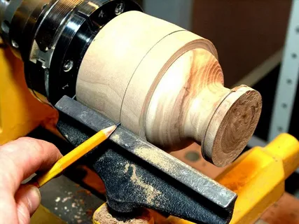
This item is made by …
https://learningapps.org/watch?v=puzkf4gyc25

Slide 6
Let’s revise the grammar. Fill in the gaps
Глагол-сказуемое употребляется в форме ____________
страдательного залога,
если подлежащее подвергается действию со стороны другого лица или предмета.

Slide 7
Let’s revise the grammar. Fill in the gaps
Present Simple Passive
I am/ He, she, it is/ We, you, they are + V3
Past Simple Passive
I, he, she, it was/ We, you, they were + V3
Future Simple Passive
I, he, she, it, we, you, they will be + V3

Slide 8
Open the brackets. Use Present, Past, Future Simple Passive
The mail usually (to load) into the train.
The mail is usually loaded into the train.
The mail (to load) into the train yesterday.
The mail was loaded into the train yesterday.
I think, the mail (to load) into the train tomorrow.
The mail will be loaded into the train yesterday.

Slide 9
Open the brackets. Use Present, Past, Future Simple Passive
The telephone (to invent) by Alexander Bell.
The telephone was invented by Alexander Bell.
In the next 20 years, the cure for cancer (to develop) by Russian scientists.
In the next 20 years, the cure for cancer will be developed by scientists.
The workers regularly (to talk) about safety rules.
The workers are regularly talked about safety rules.

Slide 10
Let’s discuss a couple of questions at the end of the lesson. Tell us, what do you think?
Is it difficult to work on the machine tools?
Many people say about CNC machines: “Installed, configured and forgot”. Do you agree with these words?

Slide 11

We continue to practice your skills next lesson

