Slide 1
WOODWORKING

Slide 2
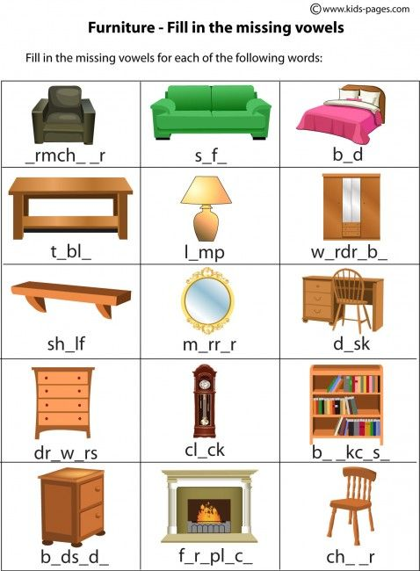

Slide 3
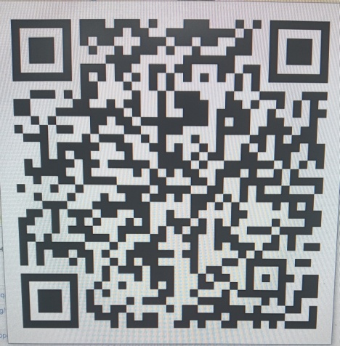
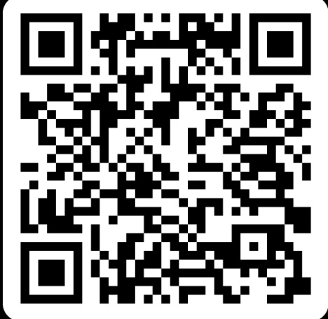
Ссылки на онлайн-игры
https://quizizz.com/admin/quiz/homework/670c7bfaa6ba7a62a0f5ec00
https://learningapps.org/display?v=ppqdji0k524

Slide 4
Woodworking test
А. Найдите и выпишите лишнее слово.
1) apron, goggles, gloves, tool
2) mallet, saw, upholstery, plane
3) jack plane, sawdust, hammer, router
4) noise, table saw, lathe, sander
В. What tree has thin branches and a white outer layer of bark that comes off in thin stripes?
1) an aspen 2) a willow 3) a birch 4) a pin

Slide 5
Woodworking test
С. What is a small tree that produces bright red berries.
1) an acacia 2) a rowan 3) a birch 4) a pine
D. What is the name of a land­scape covered by a dense growth of trees?
1)a sapling 2) a grove 3) a forest 4) an old growth forest
E. What is a tall tree that has thin sharp leaves called needles that do not fall off in winter?
1) an aspen 2) a willow 3) a birch 4) a pin

Slide 6
Checking the test
A. 1 – tool 2 -upholstery3 – sawdust 4 -noise
B- 3
C - 2
D- 3
E -4

