Slide 1
The World We Live In

Slide 2
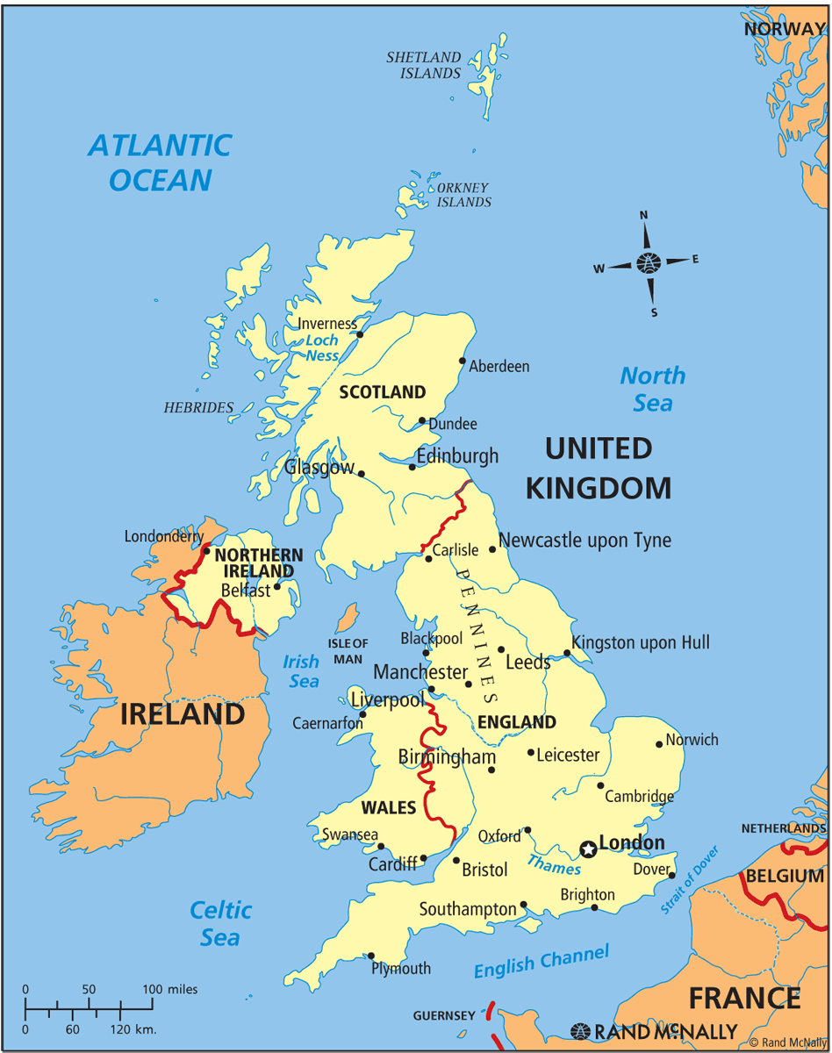
Вопрос №1.
From anywhere in the UK, you'll never be too far from it! No matter where you stand - you will never be further than 80 miles away from it.
What is it?

Slide 3
Вопрос №2.
It is a story about a boy who didn’t want to become a grown up. He could fly and had a lot of adventures.
Who is he?

Slide 4
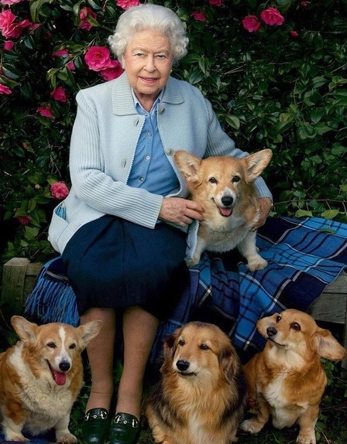
Вопрос №3.
There were more than 30 dogs during the years of the reign (правление) of Queen Elizabeth II.
What is the breed (порода) of her dogs?

Slide 5
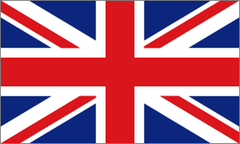
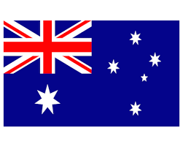
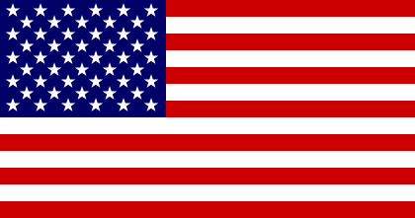
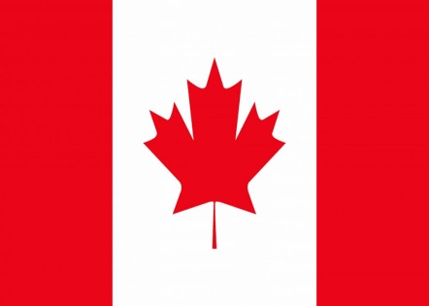
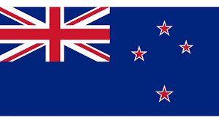
Вопрос №4.
Match the countries and their flags
The United States of America
The United Kingdom
Australia
New Zealand
Canada
A)
В)
С)
D)
E)

Slide 6
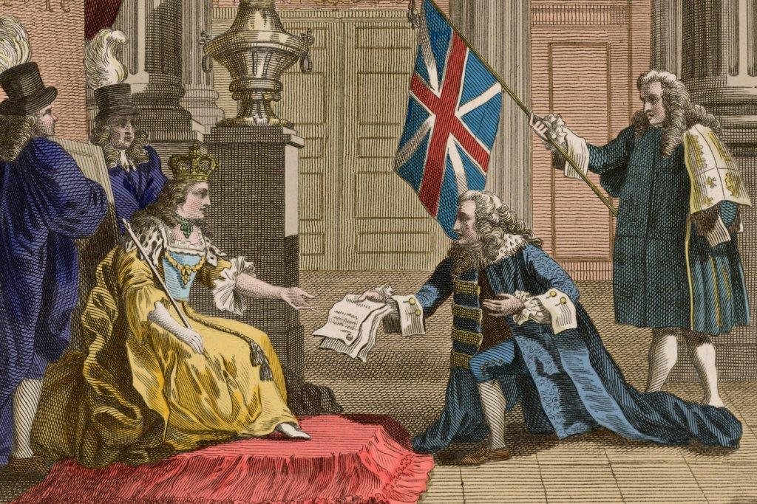
Вопрос №5.
What was the official language of England from 1066 to 1362?

Slide 7
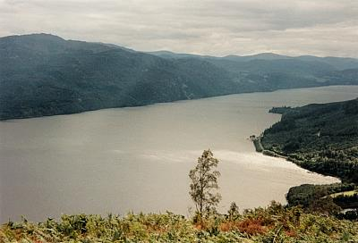
Вопрос №6.
In what part of Great Britain is the famous lake Loch Ness situated?

Slide 8
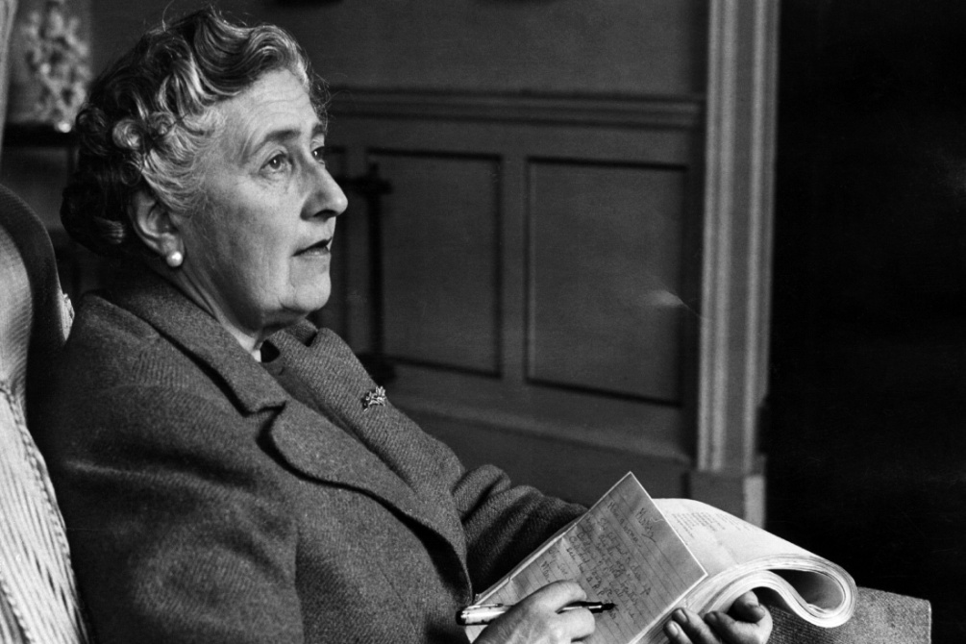
Вопрос №7.
Who were the most famous detectives of Agatha Christy’s stories?

Slide 9
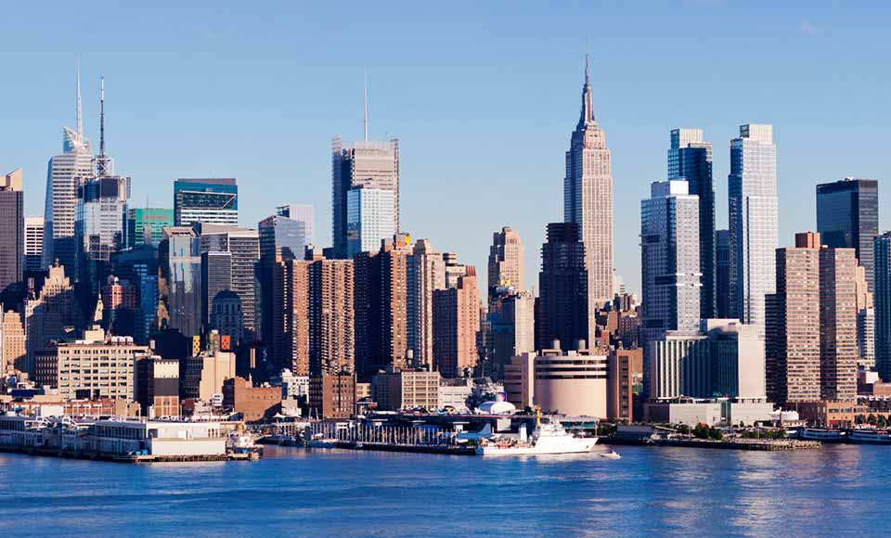
Вопрос №8.
What is the second most common language in the USA?

Slide 10
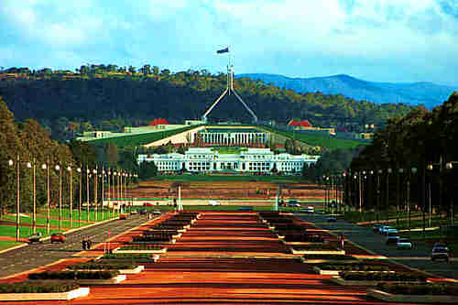
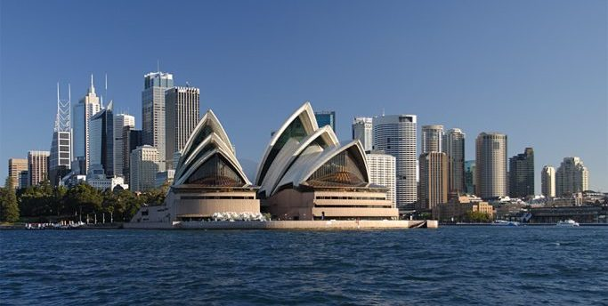
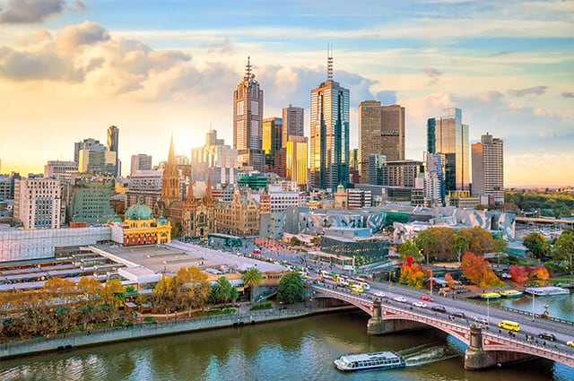
Вопрос №9.
The capital of Australia is __________
(A) Canberra.
(B) Melbourne.
(C) Sydney.
(D) Brisbane.

Slide 11
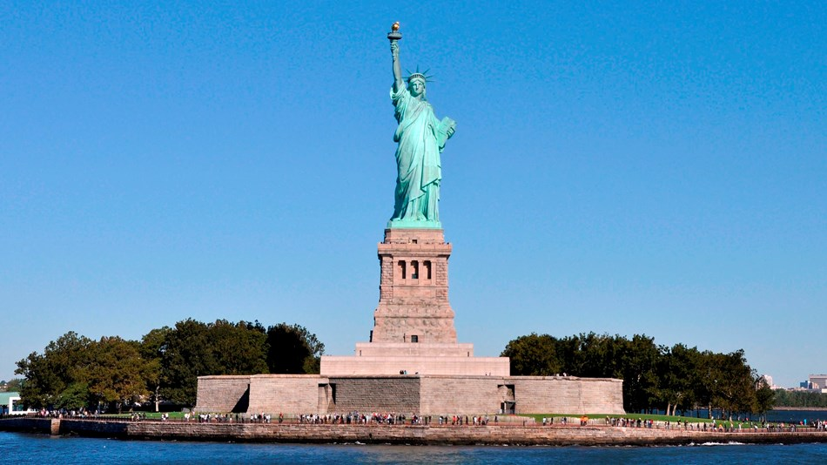
Вопрос №10.
The Statue of Liberty was made in __________
(A) the USA.
(B) Britain.
(C) France.
(D) Germany.

Slide 12
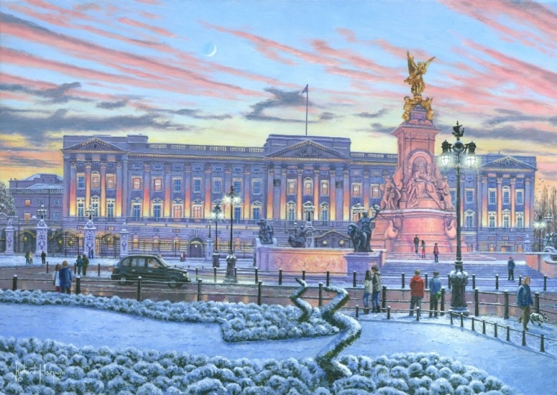
Вопрос №11.
It is the official London home of the British monarch (king or queen). It is the oldest royal residence in the world that is still being used by the royal family.

Slide 13
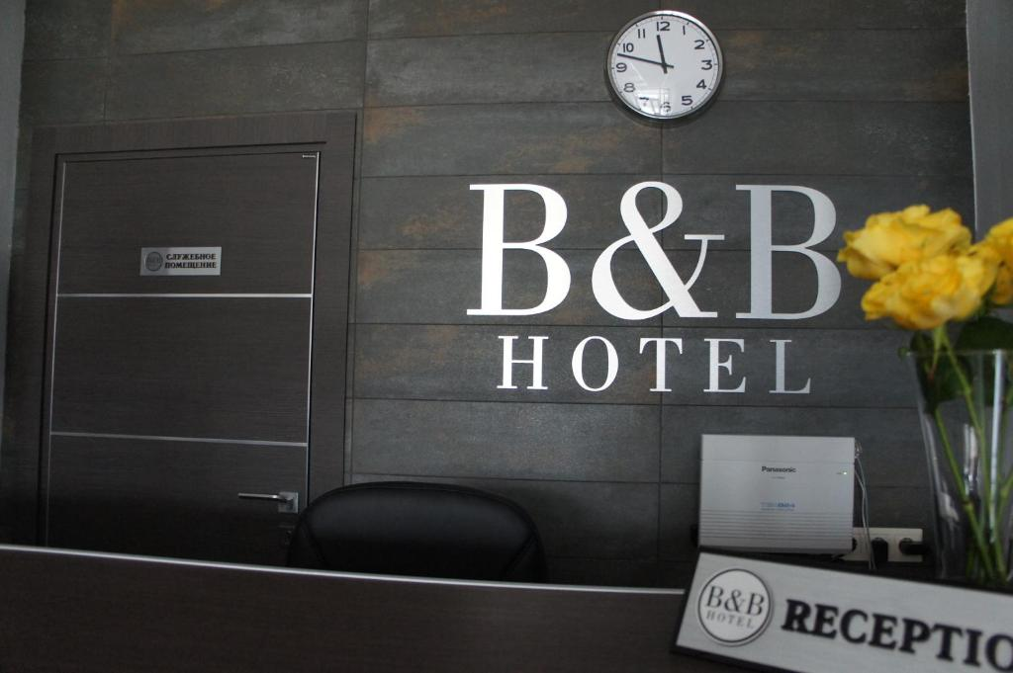
Вопрос №12.
«B&B» is the abbreviation of the hotel where you can spend the night and eat something in the morning.
What is the full name of this hotel?

Slide 14
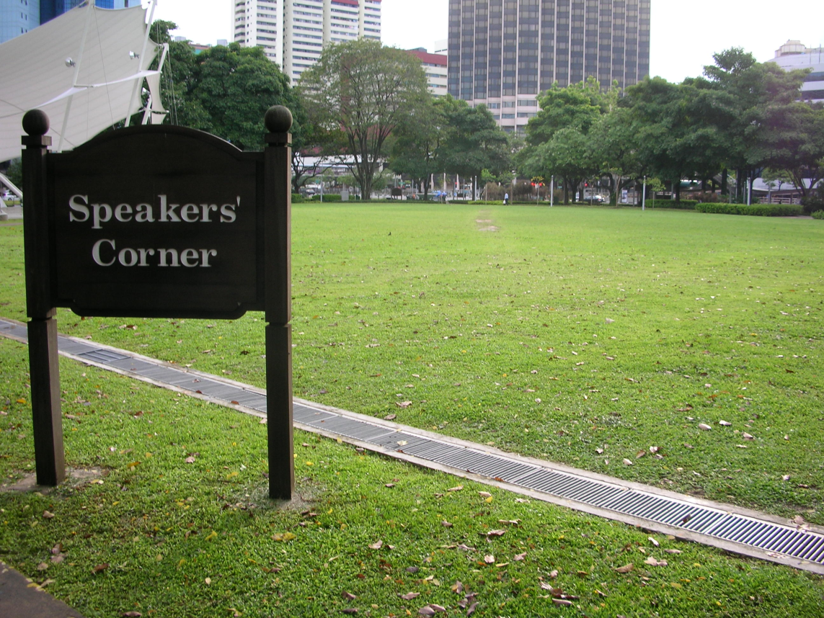
Вопрос №13.
People come to this place to speak about everything and discuss any problem. This place is called “Speaker’s corner”.
Where is it situated?

Slide 15
Вопрос №14.
They call it “Stars and stripes” in the USA.
Its official day is June 14.
What is it?

Slide 16
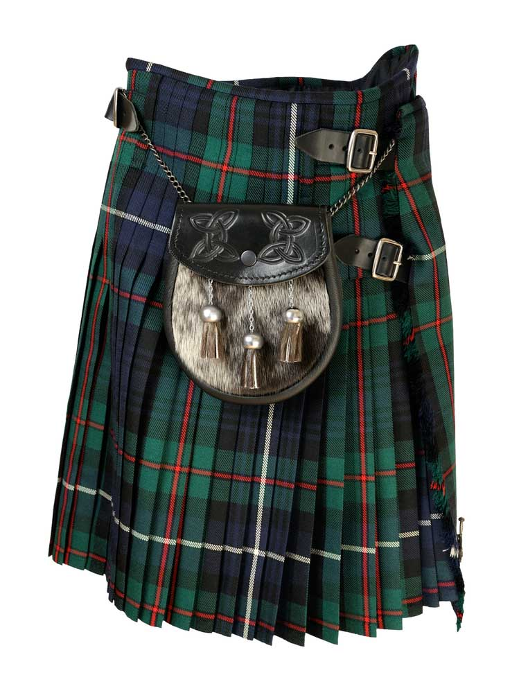
Вопрос №15.
You know that the skirt is called “kilt” in Scotland.
What is “tartan”?

Slide 17
Вопрос №16.
In Russian this vehicle is called “двойная палуба”.
Name it in English.

Slide 18
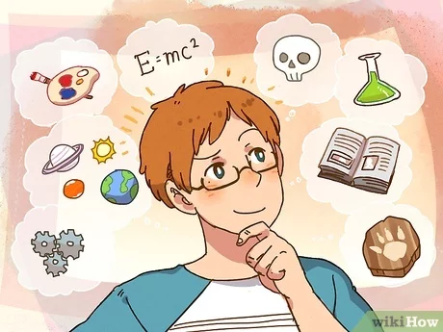
Вопрос №17.
Lemon – лимон,
Bank – банк,
Orange – оранжевый,
Alphabet – алфавит,
Intelligent - ?

Slide 19
Вопрос №18.
It can be red, yellow, black and green.
It can be in liquid and dry form. The English love it very much.
What is it?

Slide 20
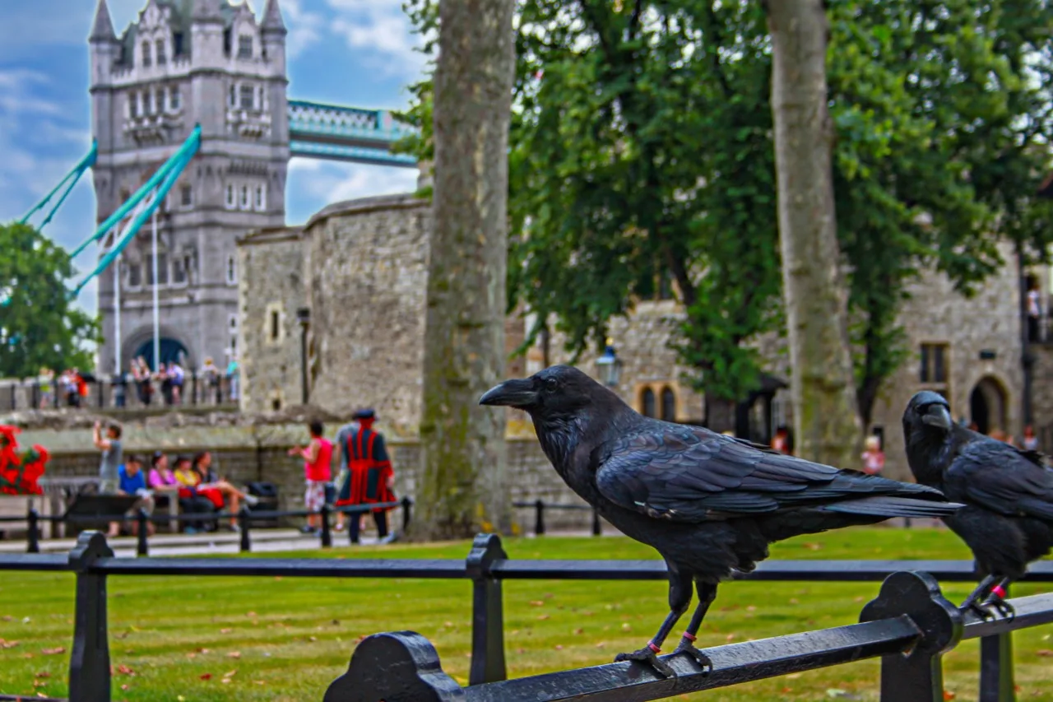
Вопрос №19.
The black ravens living in the Tower represent the prosperity of Britain.
How many ravens should live in the Tower, according to the legend?

Slide 21
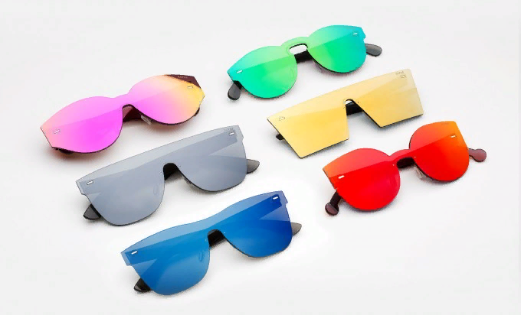
Вопрос №20.
The first glasses with painted glasses - yellow and green - appeared in the middle of the nineteenth century in England.
They protected the eyes from…

Slide 22
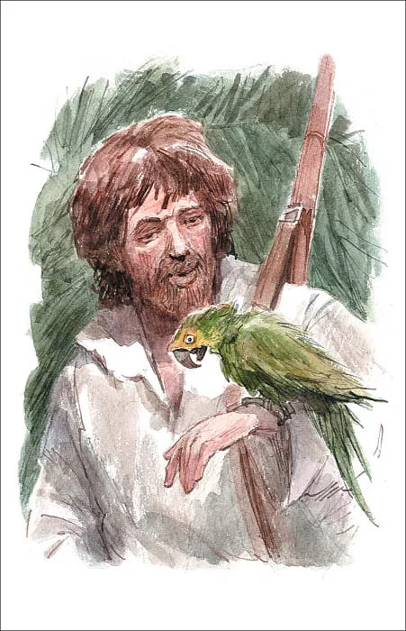
Вопрос №21.
Who is the most famous traveler in England?

Slide 23
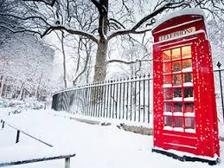
Вопрос №22.
He is often the main character of commercials of American food companies in the cold season.
Who is he?

Slide 24
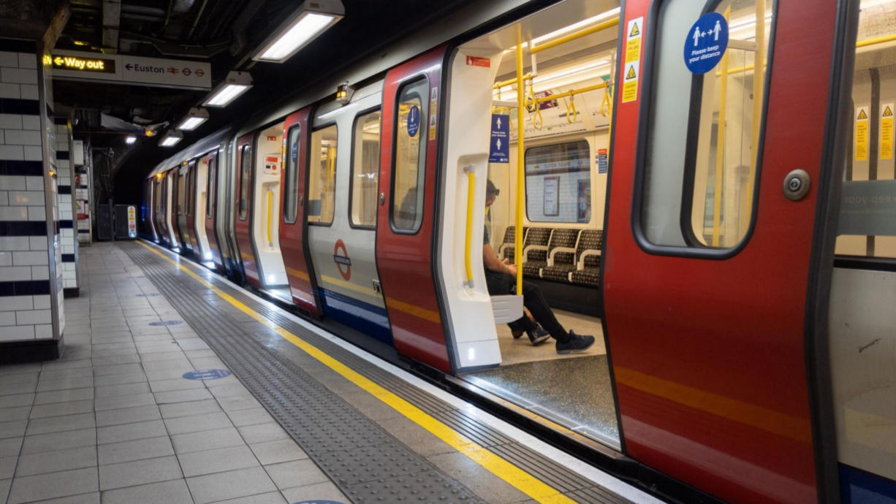
Вопрос №23.
People always lose this thing in the underground. According to the statistics they find nearly 80000 of it annually.
What is it?

Slide 25
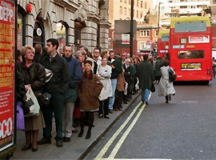
Вопрос №24.
This unusual profession is called “waiter in …” and is paid up to 20$ per 1 hour.
Name this profession.

Slide 26

Вопрос №25.
What does the abbreviation “TGIF” mean?

Slide 27
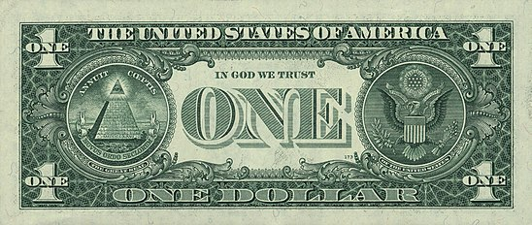
Вопрос №26.
Name the moto of the USA. It is on the banknote.

Slide 28
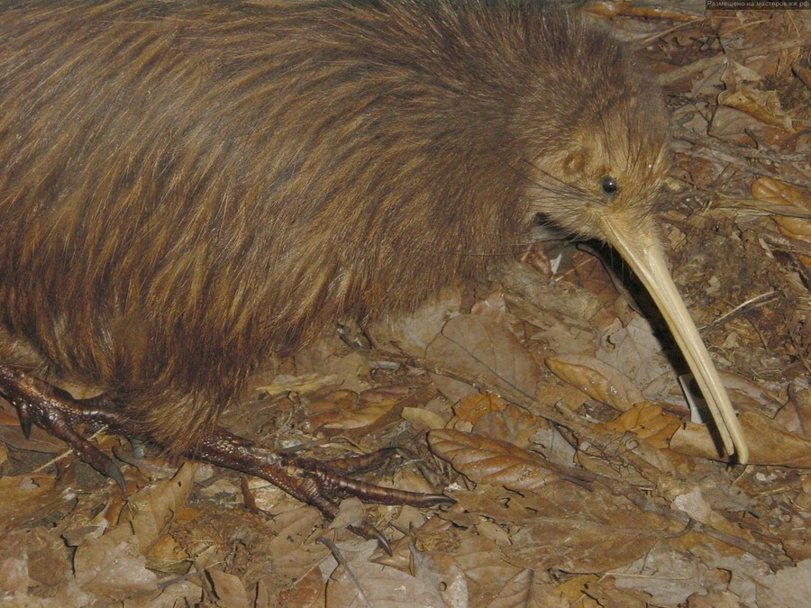
Вопрос №27.
This fruit and bird is famous in New Zealand.
What is it?

