Slide 1
ИСПОЛЬЗОВАНИЕ РЕГИОНАЛЬНОГО КОМПОНЕНТА НА УРОКАХ АНГЛИЙСКОГО ЯЗЫКА

Slide 2
ЦЕЛЬ ДАННОЙ РАБОТЫ ЗАКЛЮЧАЕТСЯ В ОСВЕЩЕНИИ ВОПРОСА ОБ ИСПОЛЬЗОВАНИИ РЕГИОНАЛЬНОГО КОМПОНЕНТА НА УРОКАХ АНГЛИЙСКОГО ЯЗЫКА

Slide 3
Актуальность выбора темы обусловлена тем, что учащиеся должны знать не только страну изучаемого языка, но и страну, край, район, в котором они живут. Часто ребята знают о стране изучаемого языка больше, чем о своей собственной стране, своем крае. Актуальность выбора темы обусловлена тем, что учащиеся должны знать не только страну изучаемого языка, но и страну, край, район, в котором они живут. Часто ребята знают о стране изучаемого языка больше, чем о своей собственной стране, своем крае. Преподавание иностранного языка на современном этапе является не только введением учеников в мир иноязычной культуры, но и осмысленным пониманием ими родной культуры, что важно в процессе становления личности, формирования мировоззрения, в культурном развитии детей.

Slide 4
Содержание регионального компонента образования призвано способствовать формированию у обучающихся духовно-нравственных ориентаций, развитию их творческого потенциала. Обучение в региональном компоненте строится на основе преемственности поколений, уникальности природной и культурно-исторической среды.

Slide 5
Содержание регионального компонента может быть введено в действующую федеральную программу различными способами:
- при изучении отдельных тем курса преподаватель может спланировать специальные уроки или фрагменты, посвященные изучению родного края.
- региональный компонент может быть выделен в отдельную группу уроков, основанную на комплексном изучении особенностей родного края.

Slide 6
Целью использования - регионального компонента является изучение региона и существующих здесь достопримечательностей, культуры и традиций - создание педагогических условий для успешной социализации личности в условиях региона

Slide 7
В связи, с чем ставятся следующие задачи:
1. Способствовать формированию личности, умеющую достойно представлять себя и свою Родину.
2.Формировать у обучающихся чувство уважения к традициям, обычаям, культурным ценностям народов.
3. Научить читать аутентичные тексты с целью извлечения информации о родном крае, быте, культуре, истории своего региона.
4. Научить создавать авторские тексты о себе, своём селе, городе, традициях и обычаях своего края.
5.Создать условия для овладения обучающимися самостоятельной, групповой, проектной, исследовательской работой на уроках английского языка.

Slide 8
В ходе проекта должны быть решены следующие задачи: - дать основы знаний о регионе; раскрыть значимость окружающего мира для жизнедеятельности человека; - пробудить познавательный интерес к родному краю; - сформировать культурологический потенциал.

Slide 9
Предлагаемый материал будет полезен учителям, они могут использовать его для привлечения внимания обучающихся к родному краю в процессе преподавания английского языка. Предлагаемый материал будет полезен преподавателям, они могут использовать его для привлечения внимания учащихся к родному краю в процессе преподавания английского языка. Данная работа также поможет лучше узнать свой край, проникнуться любовью к родной земле.

Slide 10
Материал для реализации регионального компонента на уроках английского языка на 1-2 курсах СПО Материал разработан преподавателем Чмиль Н.В.
Огапоу «Белгородский машиностроительный техникум»

Slide 11
Belgorod region

Slide 12
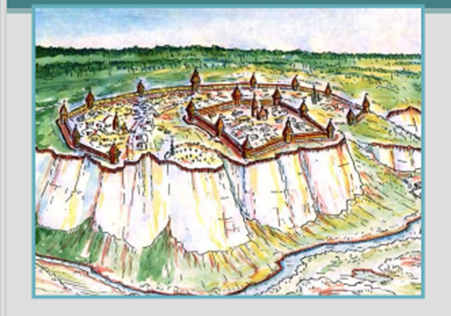
Belgorod is one of the oldest towns in the country. It has a long and interesting history, which dates back to the ancient times. People settled on the Seversky Donets River in the Stone and Bronze Ages. The first settlements of the Slavs were established there approximately in the 11-th century. Belgorod is first mentioned in the chronicles in the year 1237. Originally it was a very small settlement of the Slavs atop the chalky hil overlooking the Seversky Donets River, which was then a deep and navigable river. The White Hill gave its name to the future fortress town into which the little settlement had grown up by the 16-th century. In 1596, under Tsar Fyodor, a fortress was built on the south boundary of the Russian State. It was of great strategic importance as it repulsed the attacks of the Tatar and Mongol Hordes. The fortress "whitetown" was founded by the Russian army chiefs (voevodes) Princes Michael Nosdrevaty and Andrew Volkonsky on June 16, 1596. That's why June 16, 1596 is considered to be Belgorod's birthday.

Slide 13
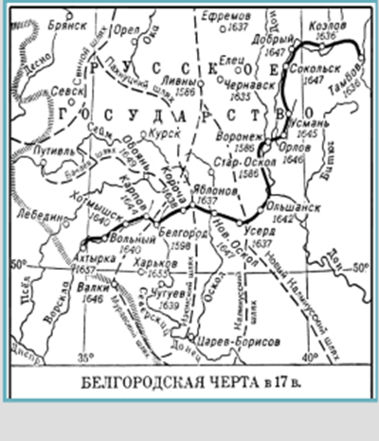
After the Polish and Lithuanian invasion of 17-th century Belgorod was destroyed and all its wooden buildings were burnt. In 1626 the new fortress of Belgorod was built on the left bank of the Seversky Donets River, opposite the old site.
Gradually Belgorod grew stronger and in 1727 it became the chief administrative centre of the region, comprising the Belgorod, the Oryol and the Kursk provinces with their 33 towns and cities and a population of 1.146 000 inhabitants. In 1766 many wooden houses, mainly in the central part of Belgorod were burnt by fire. Two years later a general plan for reconstruction was approved by Katherine II. According to this plan the streets of Belgorod became straight and regular.

Slide 14
After the October Revolution and the Civil War which was a hard period in the life of the Belgorod district the town began to restore and develop its economy and agriculture. Many factories, plants, powerstations, houses were built, collective and state farms were organized.

Slide 15
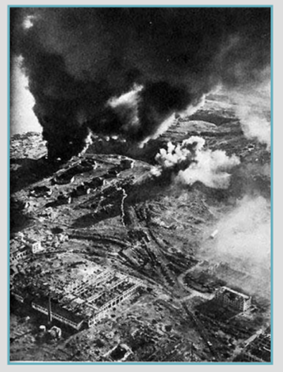
On June 22, 1941 the Great Patriotic War broke out.
The fascist invaders came twice to occupy Belgorod in the course of three years. For the first time Belgorod was occupied on October 24, 1941 after a heavy battle at the village of Streletskoye in which the Red Army was defeated. But the inhabitants of Belgorod couldn't stand this. They were not terrified. They organized partisan detachments on occupied territory and began to fight courageously against the fascist aggressors.

Slide 16
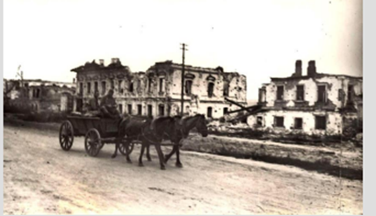
The German fascists returned to Belgorod and remained in it till the summer of 1943 when a great battle was fought at Prokhorovka.
More than 4mil. men, over 69.000 guns, 13.000 tanks, 12.000 aircrafts, took part in the fighting, which lasted 50 days and nights (July 5 -August 23, 1943). This battle of Kursk Bulge was one of the greatest battles in the Great Patriotic War" and World War II as a whole. Hitler's operation "Citadel" ended in failure. The enemy lost half a million soldiers and officers, 1.500 tanks, 3.000 guns, more than 3.700 aircrafts. The victory in the battle of Kursk Bulge was of great importance as it was a turning point in the Great Patriotic War.

Slide 17
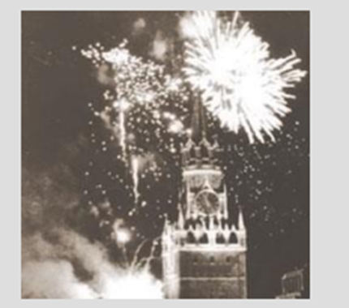
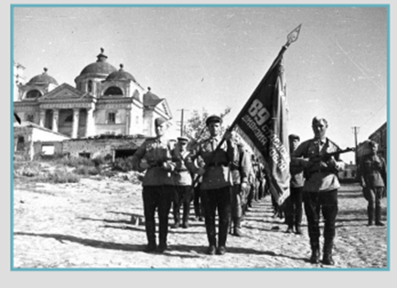
On August 5, 1943 Moscow fired a salute in honour of the liberation of Belgorod and Oryol for the first time during the war years. Belgorod is justly called the "Town of the First Salute". Since then it became a tradition to mark every victory of the Red Army by firing salute in its honour. Belgorod was razed to the ground during the Great Patriotic War. When the Red Army entered Belgorod it found there only 150 inhabitants alive out of 34.500 before the War. The town lay in ruins. As soon as Belgorod was liberated restoration work began. The inhabitants of Belgorod began to reconstruct the destroyed industrial enterprises, many new ones were built up, agriculture was reorganized. Blocks of beautiful buildings rose up in the town and thousands of people moved into new homes.

Slide 18
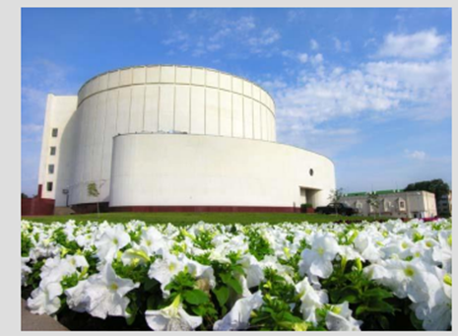
To commemorate the battle of Kursk Bulge the Kursk Bulge Diorama Museum was opened in the centre of Belgorod on August 3,1987. It is the biggest in Russia, more then 1005 square metres.

Slide 19
Nowadays Belgorod is one of the administrative, industrial and cultural centers of the Russian Federation in the South of the Black Earth Zone. Its population is about 300.000 people and its area is 300 square kilometers. Belgorod is an educational center of the region. The are: Belgorod State University, the Technological University of Building Materials, the Cooperative University, t he Agricultural Academy, the Institute of Culture and the Institute of Jurisprudence. Belgorod has a lot of secondary educational establishments.

Slide 20
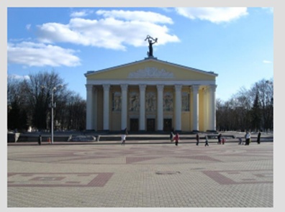
The heart of the town is Sobornaya Square. It's the place of mass demonstrations, festivities and meetings. In the Square there is a monument to the heroes of the Great Patriotic War with the eternal flame burning at the tomb. There is the Administration Building also in the Square and opposite it there is the Drama Theatre, named after the great Russian actor Michael Shchepkin.
There are 49 monuments and about 50 memorial places telling the citizens of Belgorod and the visitors about the historical events, the feats of arms and of labor of townspeople.

Slide 21
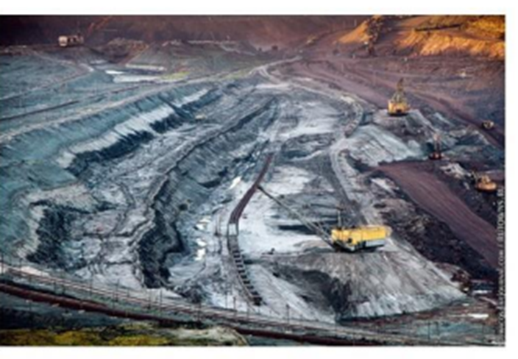
The Kursk Magnetic Anomaly is the vastest territory rich in iron ore in the world. It is situated within the Kursk, Belgorod and Orlov Regions. . The Kursk Magnetic Anomaly (KMA) was first discovered in 1773 by the Russian astronomer and academic Pyotr Inokhodtsev while preparing the maps of the General Land Survey( Генеральное межевание) Serious investigations were continued under the leadership of Ivan Gubkin in 1920-1925. Industrial development of the KMA deposits began in 1952 with the opening of the experimental Gubkin Mine at the Korobkovskoe deposit. . In 1972, 20.5 million tons of commercial iron ore was extracted in the KMA.

Slide 22
famous people

Slide 23
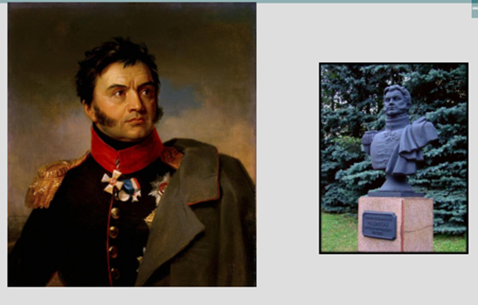
Belgorod has been birthplace of many famous people known to all the country: poet and publicist, officer V.F. Raievskiy, whose family estate was in the village of Hvorostianka (now the village of Raievskoie, Goubkinskiy area). A participant of the Patriotic War of 1812, he was awarded a golden sword for courage. In 1825, the Decembrist Raievskiy was sentenced to death, but then exiled to Siberia. In 1856 Raievskiy was amnestied, but this freedom-loving man stayed in Siberia until his death.

Slide 24
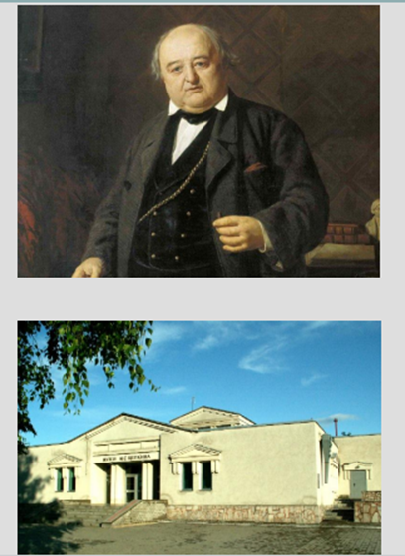
The great actor M.S. Shchepkin was the pride of Russian theatre. He was born in the village of Krasnoie (now in the Yakovlevskiy area) in a serf family. Shchepkin spent many years in provincial acting companies, suffered the severities and humiliations of migratory life, remaining a serf of the court of Wolkenstein. Only in 1822 was he redeemed on money collected by progressive people and invited to work to the Moscow Theatre (since 1824 — the Maly Theatre). Shchepkin dedicated 40 years of his life to this theatre. In Belgorod a street and local theatre are named after Shchepkin; a monument to the great actor is erected at the entrance to the theatre. There is a Shchepkin museum in the village of Krasnoie.

Slide 25
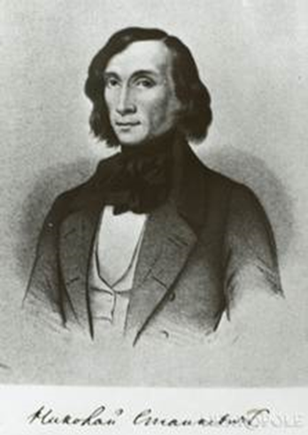
Nikolai Vladimirovich Stankevich (1813-1840), a famous Russian cultural figure, was born into a wealthy landowner family in the Voronezh province. Stankevich spent the first years of his childhood in complete lordly will, in the middle of the countryside. At the age of 10, he was sent to the Ostrogozhsk school, and then to the Voronezh noble boarding school. In 1830, Nikolai Stankevich entered Moscow University and soon became the center of a whole circle of young people, whom he attracted with his feminine, tender and painfully sensitive nature and his lively and receptive mind. The popular professors of the Moscow University of that time, Nadezhdin and Pavlov, had the strongest influence on Stankevich, instilling in him with their lectures a love for aesthetics and German philosophy. At the end of his university course, Stankevich left for the countryside, but neither in his personal nor in his public life did he find sufficient incentives for active work there. Returning to Moscow in 1835, Nikolai Vladimirovich resumed his previous theoretical studies and completely devoted himself to them. He diligently studied German philosophy, made plans for literary works, but the developed consumption forced him to abandon his scientific activities and leave first for the Caucasus, and then abroad. Abroad, Stankevich resumed his studies in philosophy; in Berlin he listened to lectures by Werder, Renne and others, and here he became close to Granovsky. In 1839 he moved to Italy, where he died at the age of 27.

Slide 26
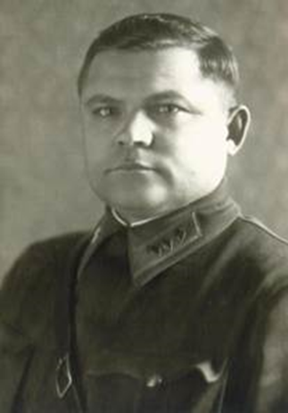
NIKOLAI FEDOROVICH VATUTIN
Born on December 16, 1901 in the village of Chepukhino, Valuysky district, Voronezh province (now the village of Vatutino, Belgorod region) into a large peasant family. He graduated from four classes of the Zemstvo school, where he was considered the first student.
During the Civil War (1920) he was mobilized into the Red Army, took part in the battles in the Lugansk region. In October 1922 he was sent as a platoon commander to the 23rd Rifle Division.
At the very first exercises, Vatutin showed a talent for strategy and in January 1924 he entered the Kyiv Academy of Command Staff. In 1926, he was transferred to the Moscow Military Academy named after M.V. Frunze.
In 1937, Vatutin was appointed deputy chief of staff of the Kyiv military district, and a year later, chief of staff. His predecessors in these positions were shot during the period of mass repression in the army.
In 1939 he was already deputy chief of the General Staff; in February 1941 he was awarded the Order of Lenin.

Slide 27
WELCOME TO BELGOROD REGION
AND THANKS FOR YOUR ATTENTION!

