Slide 1
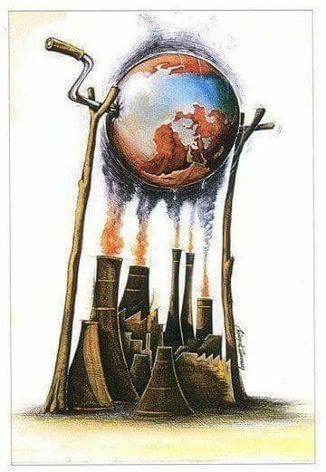
GREENHOUSE
EFFECT

Slide 2
Цель – развитие навыков аудирования и совершенствование навыков говорения
Задачи:
Определить тему урока
Использовать новые лексические единицы в своей речи
Заполнить пропуски недостающими словами из видео сюжета
Ответить на вопросы по теме

Slide 3

NEW WORDS
To propose - предлагать
Scholar – ученый, исследователь
To absorb - поглощать
To accumulate - накапливать
To trap – поймать в ловушку
Trapped – застрявший, пойманный
Ray - луч
Increase - увеличение
To reduce - сократить
To reuse – использовать повторно
To recycle - перерабатывать

Slide 4
TASK : fill in the gaps
Greenhouse effect was first proposed by a French _____.
The greenhouse effect is a warming of earth’s ________
The gases _____ energy from the sun.
Sun ______ enter the earth’s atmosphere.
The earth’s surface ________ the energy from the sun.
Most of energy remains _______ in the atmosphere.
Negative human activities add _____ greenhouse gases.
The increasing amount of greenhouse gases causes ____ ____.
We should buy energy ______ products.
Trees ______ carbon dioxide.

Slide 5

Task: answer the questions
When was the notion “greenhouse effect” proposed?
What is greenhouse effect?
How are harmful gases in the atmosphere called?
What is a positive influence of greenhouse effect?
What can happen without the greenhouse effect?
How do sun rays reach the earth’s atmosphere?
How is global warming caused?
What stopped the natural process and balance of energy and heat in the environment?
What is the reason of the earth’s temperature increase?
How can we help the earth?

Slide 6
Speaking: make a conclusion about greenhouse effect using all your notes
РЕФЛЕКСИЯ – What was the most difficult task for you? What was the most interesting task?

