Slide 1


Quiz
Computers and information technologies
Answer the questions and be the winner!
Be the first!
Good luck!

Slide 2

A software program to view web pages is
A
C
www
adware
B
D
browser
hardware

Slide 3
A system for communicating without wires over a computer network is
A
C
the Internet
modem
B
D
Wi-Fi
application

Slide 4
A defect in a program that prevents it from working properly is
A
C
a bug
a mistake
B
D
an error
a fault

Slide 5
A kind of computer memory is
A
C
remember
cache
B
D
image
file

Slide 6
Connection for attaching devices to computers is
A
C
screen
Wi-Fi
B
D
modem
USB

Slide 7
Information that you create and share on a computer is
A
C
flash card
data
B
D
CD
document

Slide 8
The main storage device inside a computer is
A
C
floppy disk
folder
B
D
hard disk
DVD

Slide 9
To take information off the Internet and store it on your computer
A
C
download
upgrade
B
D
upload
search

Slide 10
A software application which displays unwanted advertisements on your computer while in use is
A
C
spam
spamware
B
D
adware
hardware

Slide 11
The main page or opening page that appears when you visit a web site
A
C
home
site
homework
B
D
home page
home browser

Slide 12
Information on the times and dates you have visited web sites is
A
C
memory
cookies
B
D
bug
data

Slide 13
To compress a file so that it occupies less space in storage
A
C
save
zip
B
D
mix
download

Slide 14
How old is the Internet?
A
C
54 years
40 years
B
D
45 years
50 years

Slide 15
iPad is
A
C
a tablet PC
a laptop
B
D
a desktop PC
a notebook

Slide 16
Are you smart students?
A
C
No!
Yes!
B
D
I don’t know…
Maybe…

Slide 17
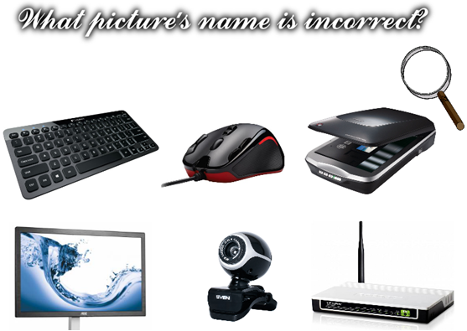

Slide 18


