Slide 1

"Стратегии подготовки к спонтанному монологическому высказыванию (задание 4 ЕГЭ): парадокс или здравый смысл?".
Журавлева Татьяна Анатольевна, учитель английского языка
МБОУ «СОШ №3 с УИОП им. Г. Панфилова» Анжеро-Судженского ГО

Slide 2
Как-то я сморозил глупость
И абсурдное сказал,
Это же не мыслей узкость —
Виноват во всём астрал.
Прилетело мне спонтанно
И слетело на язык…
Я негаданно-нежданно
Выражаться не привык.
Я привык работать мозгом
И отмерить много раз —
Исправлять бывает поздно
Кривизну слетевших фраз.
Чтобы что-то сделать мудро,
Поработай… отложи…
Филигранно мысль наутро,
Обработав, покажи —
Чтобы думы наших грустных,
В размышленьях, вечеров
Слух ласкали, если устно,
И бумагу жгло перо.
© Лев Иовлев
Объект контроля задания 4 усной части ЕГЭ
по английскому языку
– способность спонтанно продуцировать связное
монологическое высказывание
+
КРИТЕРИАЛЬНОСТЬ
=
ПАРАДОКС

Slide 3

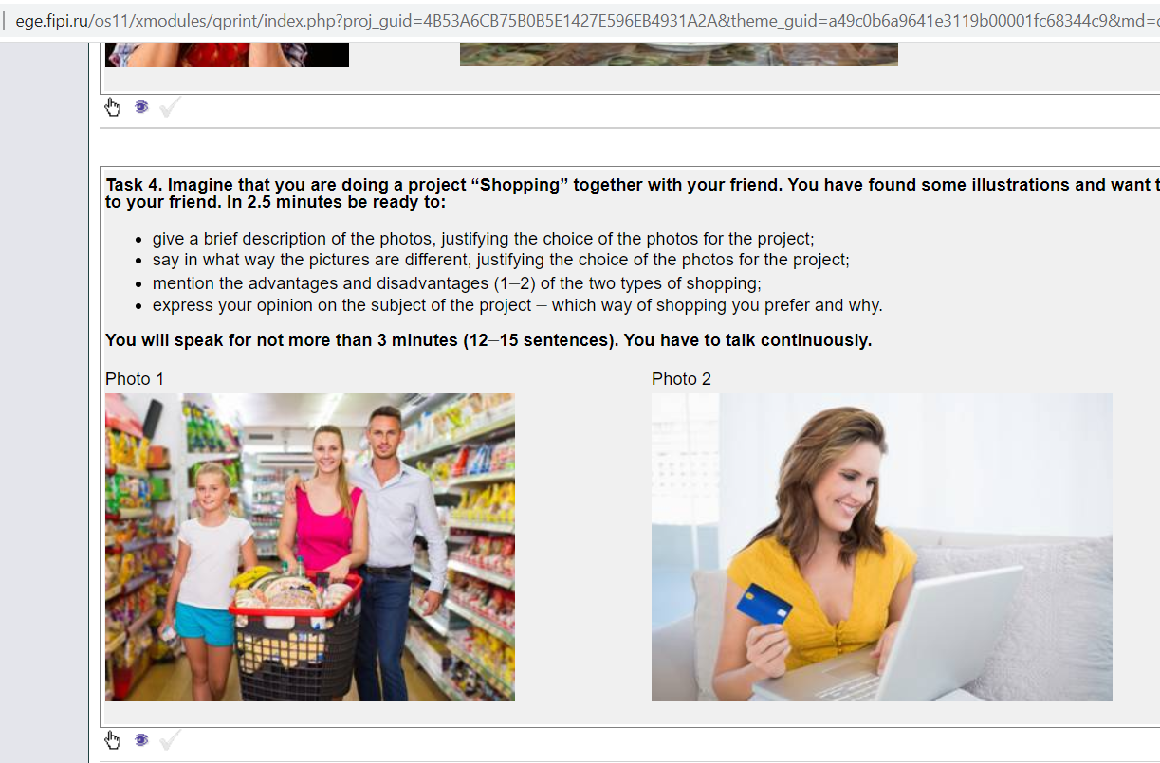
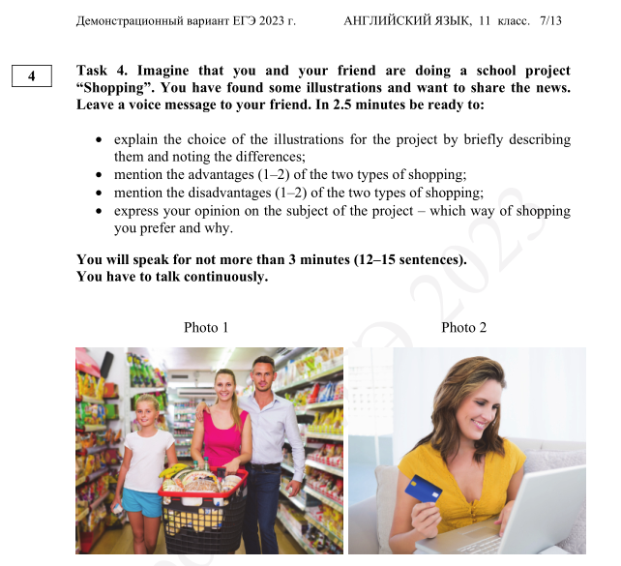
Can you identify the FAKE?

Slide 4
Во введении и заключении оценивается наличие коммуникативной составляющей,
адресность высказывания. В начале монолога необходимо поприветствовать друга,
обратившись по имени, напомнить о совместном проекте, упомянув тему, сообщить
новость о том, что автор нашел две фотографии для иллюстрации проекта.
Необходимо кратко описать каждую фотографию с точки зрения связи с темой проекта.
Так, не следует включать подробное описание внешности человека, если это не помогает
раскрыть тему. И, напротив, важно акцентировать внимание, например, на описании
одежды, если тема связана с климатическими условиями разных мест планеты.
В описательной части используется Present Continuous, Present Participles.
Далее следует упомянуть о различиях фотографий в свете темы проекта.
Постарайтесь максимально точно и ёмко их выразить.
Единство заключается в теме, а расхождения удачно формулировать существительными
или отглагольными существительными. Например, recycling as a way to save the environment
– planting as a way to help the Earth/ reading newspapers as a way to get information –
surfing the net as a sourse of news.
Используйте синонимы, перифраз, средства логической связи.
Dealing with good sense

Slide 5
В следующей части говорим о преимуществах и недостатках ранее указанных явлений,
феноменов, способов, вариантов. Логично будет обращение к «перекрестной» схеме
типа comfortable but expensive – cheap but tiresome, gives a chance of ... /doesn`t let us.
То есть необходимо расширить запас антонимов.
При выражении своего мнения очень важно точно ответить на вопрос, не подменяя
грамматические конструкции и лексическое содержание.
Так, если экзаменуемого спрашивают, хотел ли он получать новости из газеты,
не нужно говорить о том, что он любит просматривать сайты.
Второй частью вопроса является «почему», его также нельзя оставить без внимания.
В заключении логично заканчиваем сообщение с надеждой на обратную связь,
последующие контакты.
Dealing with good sense

Slide 6
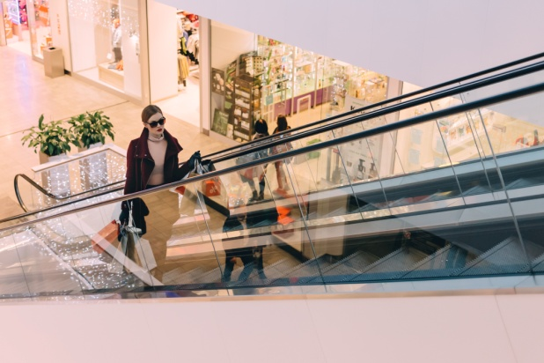
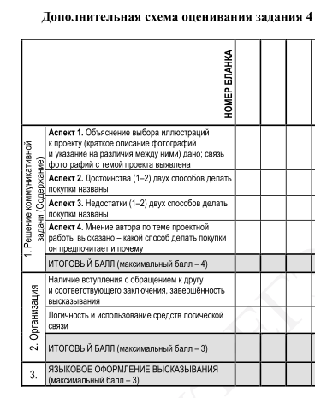
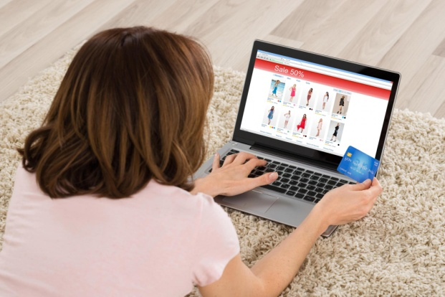
Criteria are in focus

Slide 7
Примерный вариант ответа
Introduction. Hi, Ann! Do you remember about our project “Shopping”?
I`ve found some pictures to illustrate it. – Критерий 2.1
Description (who, where, what he/she is doing, what is in the background). Difference.
- I think (Критерий 2.2), the first picture works well for our project as is shows
a woman standing on an escalator of a shopping mall.
She is holding shopping bags in her hands. There are boutiques in the background.
- The second picture suits the project because there is a girl sitting at her computer.
We see (Критерий 2.2), she is doing online shopping at home
as she is holding a credit card in her hand and there is an online catalogue
on the screen of the laptop.
- Though (Критерий 2.2) both photos illustrate shopping, they are different.
The first picture depicts shopping in a mall
whereas (Критерий 2.2) the second one presents online shopping. - Критерий 1.1
Advantages and disadvantages. The two types of shopping have both advantages and
disadvantages.
Shopping in a mall is good due to the fact that you can try clothes on but it`s tiresome.
Shopping online, on the contrary (Критерий 2.2), is relaxing, you don`t spend much time on it,
but you have no chance to touch the thing you want to buy. Критерии 1.2, 1.3
Personal opinion. To tell you the truth (Критерий 2.2), I prefer to shop in a mall
because for me it`s important to see if a thing fits and suits me well. Критерий 1.4
Conclusion. Well (Критерий 2.2), that`s all I wanted to discuss with you. Talk to you later, bye.
– Критерий 2.1.

Slide 8

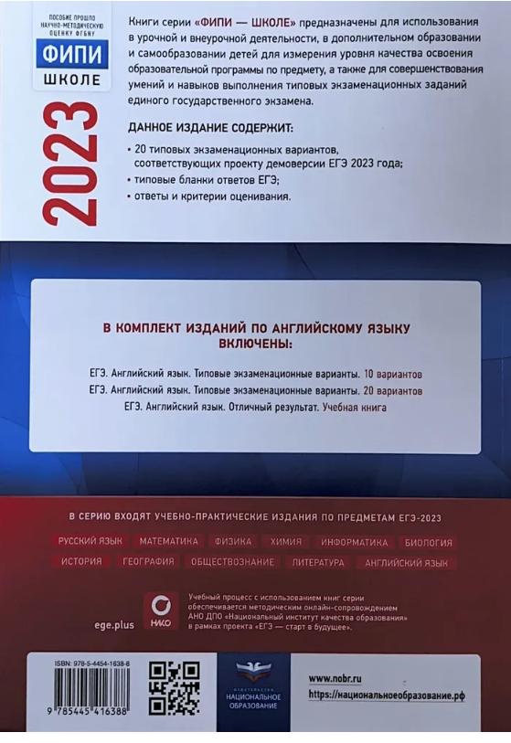
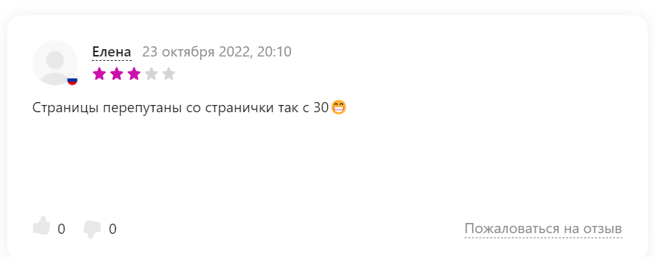
Can be helpful

Slide 9

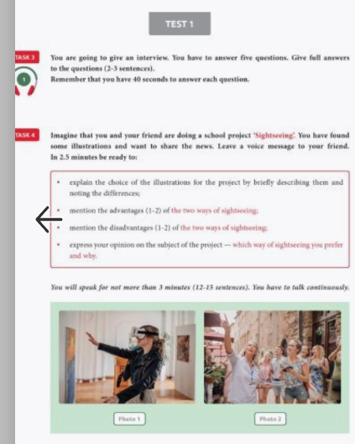
A reliable resourse

Slide 10
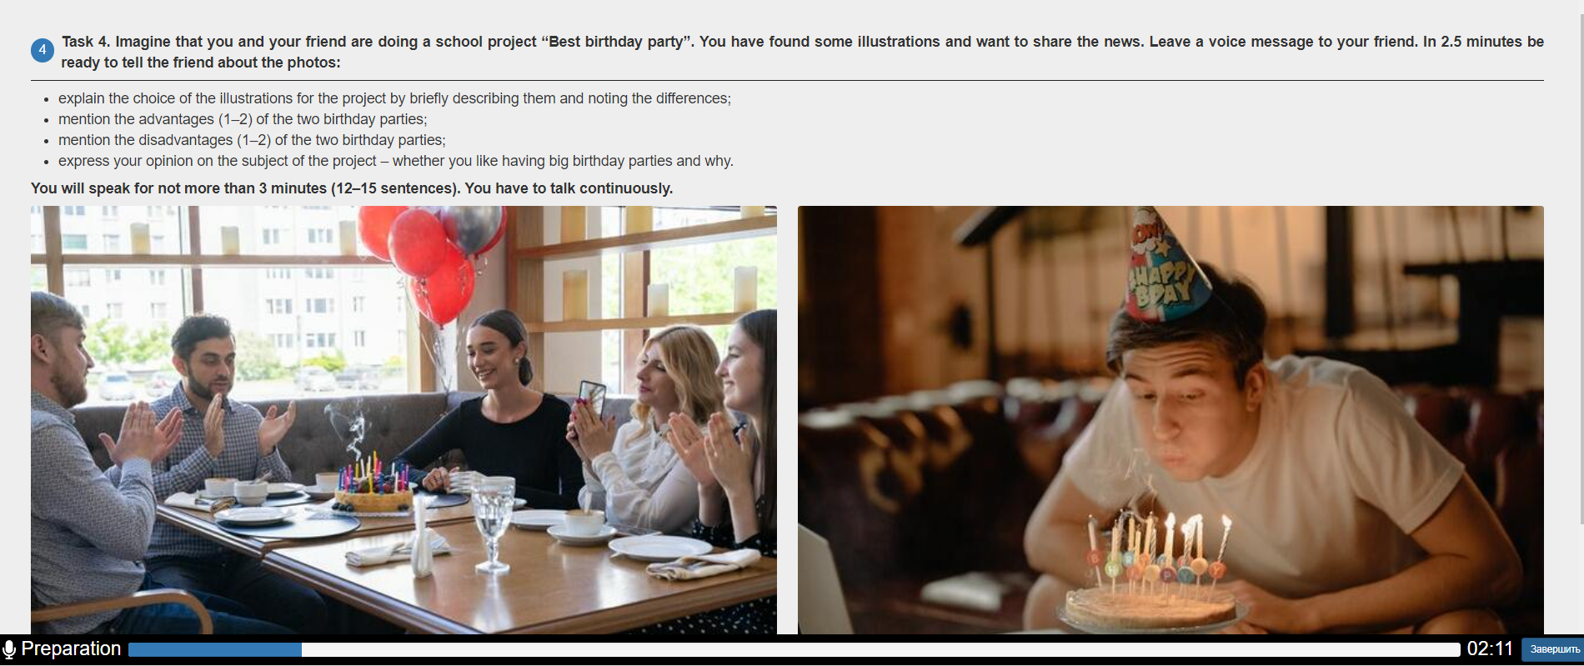
https://speaking.svetlanaenglishonline.ru/
Be grateful – it`s for FREE!

Slide 11
Task 4. Imagine that you and your friend are doing a school project
“Best birthday party”. You have found some illustrations and want to share the news.
Leave a voice message to your friend. In 2.5 minutes be ready to:
What is the subject of the project?
2. Having big birthday parties
1. The best birthday party
3. Celebrating Birthday
with a big company
alone
• express your opinion on the subject of the project – whether you like having big birthday parties and why

Slide 12
1. He is blowing candles on the special cake.
His guests are clapping hands, probably,
they are congratulating him, making a toast.
There are balloons in the background.
The atmosphere is festive. Everyone is smiling.
2. Though both photos illustrate celebrating
birthdays, they are different.
3. The first picture depicts a big birthday party
with a companywhereas the second one
presents having Birthday alone.
4. I think, the first picture works well for our
project as is shows a birthday man surronded,
I guess, by his friends and relatives in a cafe.
5. He is blowing candles on his cake.
He is wearing a funny hat on his head.
He is alone at home, I believe, trying
to make a holiday for himself.
6. The second picture suits the project because
there is a birthday man too.
• explain the choice of the illustrations for the project by briefly describing
them and noting the differences;
Vocabulary is in focus

Slide 13
The two types of shopping have both advantages and disadvantages.
Shopping in a mall is good due to the fact that you can try clothes on but it`s tiresome.
Shopping online, on the contrary, is relaxing, you don`t spend much time on it,
but you have no chance to touch the thing you want to buy.
Now, it`s your turn
• mention the advantages (1–2) of the two birthday parties;
• mention the disadvantages (1–2) of the two birthday parties.
The two types of ... have both advantages and disadvantages.
... is good due to the fact that you can ... but it`s ... .
... , on the contrary, is ... , but you have no chance to ...
Does it work?

Slide 14
• express your opinion on the subject of the project – whether you like having big birthday parties and why
Trying to mislead ...
1. Talking about me, I don`t like having big birthday parties.
2. Personally, I enjoy having big birthday parties
since I appreciate my relatives and friends` attention
3. As for me, I`d like to have a big birthday party
as I love being surrounded by close and dear people.
4. Personally, I prefer celebrating birthdays alone because I`m an introvert.
5. As for me, I don`t like to have big birthday parties as I can`t stand noise.

Slide 15
I appreciate your attention!
Hope, it has been helpful...
Teach from the heart!
Have a good day!

