Slide 1



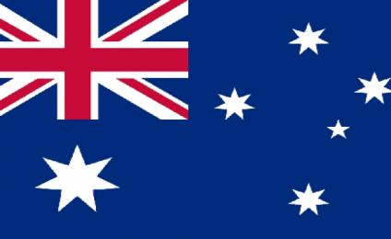
Автор:
Лупандина Анна Константиновна, учитель английского языка
МОУ «СОШ №3 г.о. Стрежевой» Томской области
2022г
English-Speaking Countries

Slide 2
The UK | 100 | 200 | 300 | 400 | 500
The USA | 100 | 200 | 300 | 400 | 500
Australia | 100 | 200 | 300 | 400 | 500

Slide 3
The UK 100
What is the name of
the British flag?

Slide 4
The answer
The Union Jack

Slide 5
The UK 200
What country is not the part of the UK?

Slide 6
The answer
England
India
Scotland
Northern Ireland

Slide 7
The UK 300
What is the most famous symbol of London?

Slide 8
The answer
Big Ben
the Statue of Liberty
Tower

Slide 9
The UK 400
What is the longest river in Great Britain?

Slide 10
The answer
The Thames
The Severn

Slide 11
The UK 500
What was the name of Shakespeare’s theatre?

Slide 12
The answer
The Bolshoi theatre
The Globe

Slide 13
The USA 100
Who discovered
America?

Slide 14
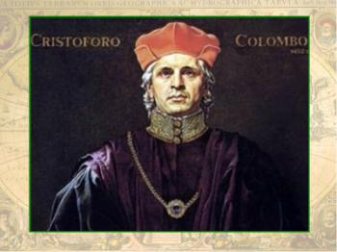
The answer
Amerigo Vespucci
James Cook
Christopher Columbus

Slide 15
The USA 200
How many stars are there on
the American flag?

Slide 16
The answer
67
50

Slide 17
The USA 300
How do we call
American money?

Slide 18
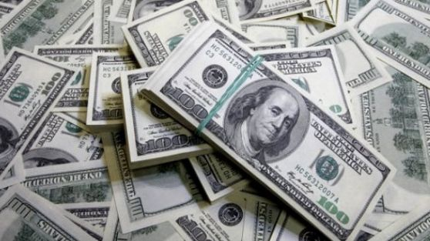
The answer
dollar
euro

Slide 19
The USA 400
Who is the president
of the USA now?

Slide 20
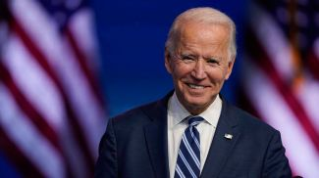
The answer
Joe Biden
Hillary Clinton
Ronald Reagan

Slide 21
The USA 500
What is the capital
of the USA?

Slide 22
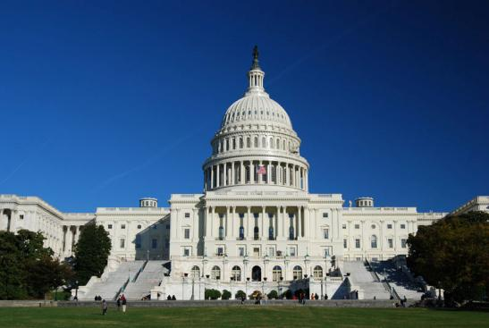
The answer
New York
Washington DC

Slide 23
Australia 100
What is the capital of Australia?

Slide 24
The answer
a) Melbourne
b) Canberra
c) Sydney

Slide 25
Australia 200
When do Australians celebrate Christmas?

Slide 26
The answer
a) In winter
b) In spring
c) In summer

Slide 27
Australia 300
What is the most famous animal of Australia?

Slide 28
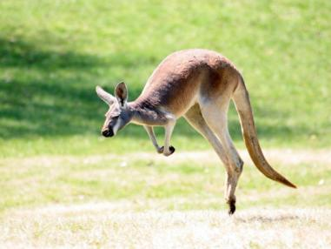
The answer
a) elephant
b) kangaroo
c) hare

Slide 29
Australia 400
Who discovered Australia?

Slide 30
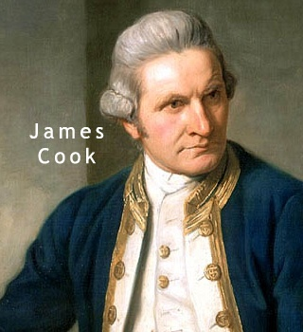
The answer
a) Vasco da Gama
b) James Cook

Slide 31
Australia 500
Name the Australian bird that can not fly but runs fast?

Slide 32
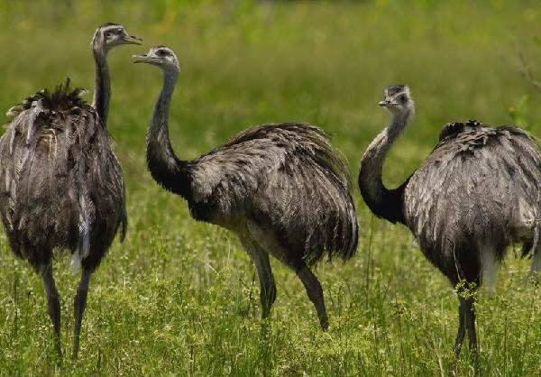
The answer
a) cock
b) emu
c) hummingbird

Slide 33
Использованные источники
http://www.thewallpapers.org/photo/40880/Colorful-010.jpg
http://www.worldatlas.com/webimage/countrys/samerica/easterisland/eapics/timelinepics/james_cook.jpg
- Джеймс Кук
The Union Jack -Union Flag or the Union Jack.
https://givnost.ru/straus-emu-ptica-opisanie-osobennosti-obraz-zhizni-i-sreda-obitaniya-emu/– эму
http://images.alarabiya.net/fc/c3/640x392_46877_181131.gif -флаг Австралии
https://yandex.ru/images/search?rpt=simage&noreask=1&source=qa&text=Джо%20Байден&stype=image&lr=11352 - Джо Байден

