Slide 1
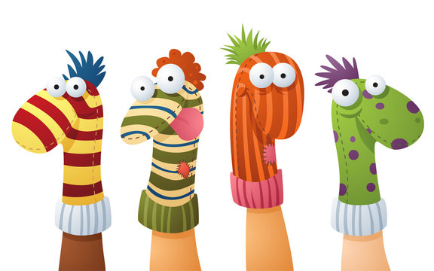

Puppet show

Slide 2
Fill in the missing letters
Educ_te
Gl_ve
_lue
Mari_net_e
P_p_et
Ru_be_
W_oden
Educate
Glove
Glue
Marionette
Puppet
Rubber
Wooden

Slide 3
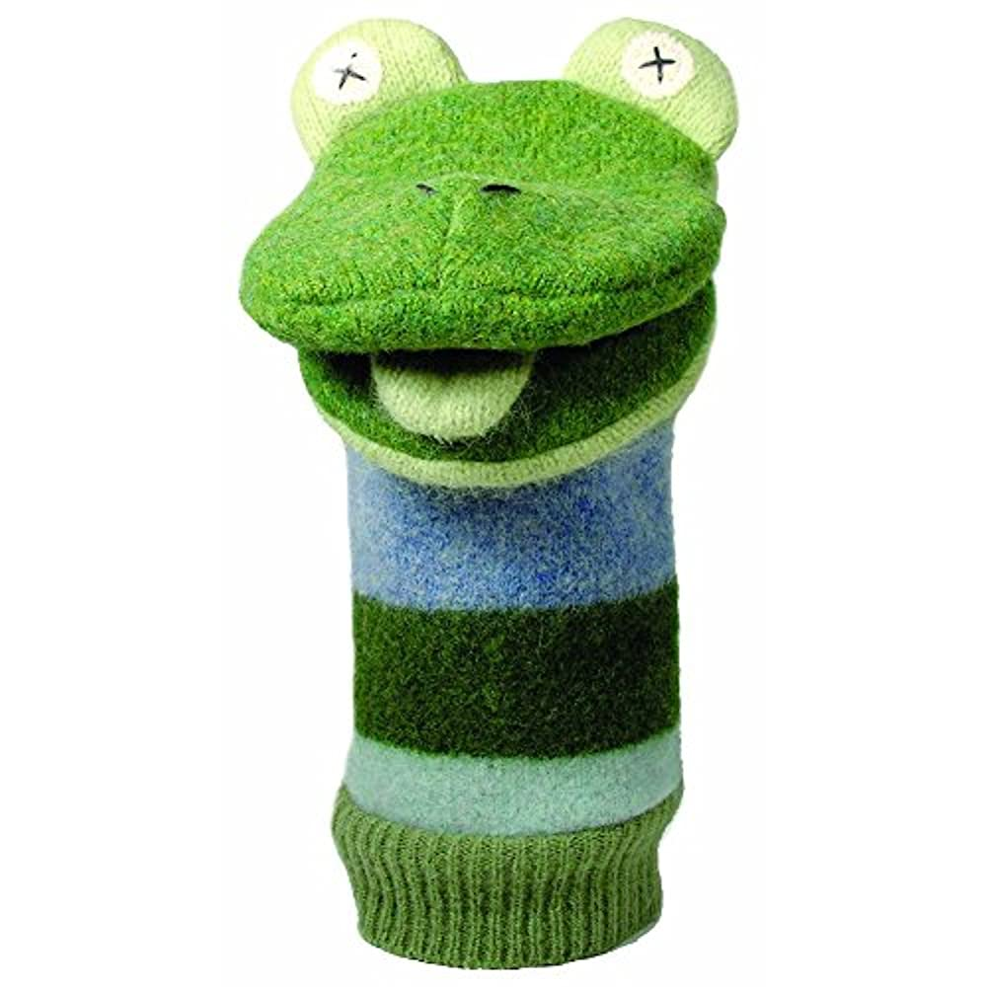
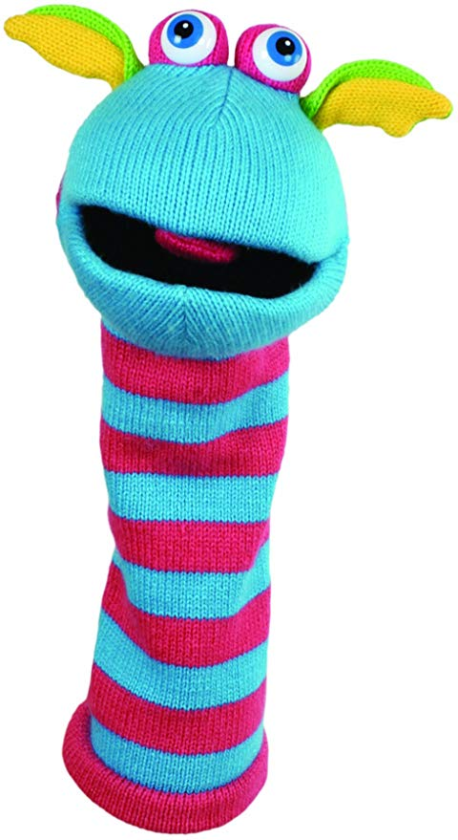
Everyone loves puppets !!!
Puppets are fun.

Slide 4
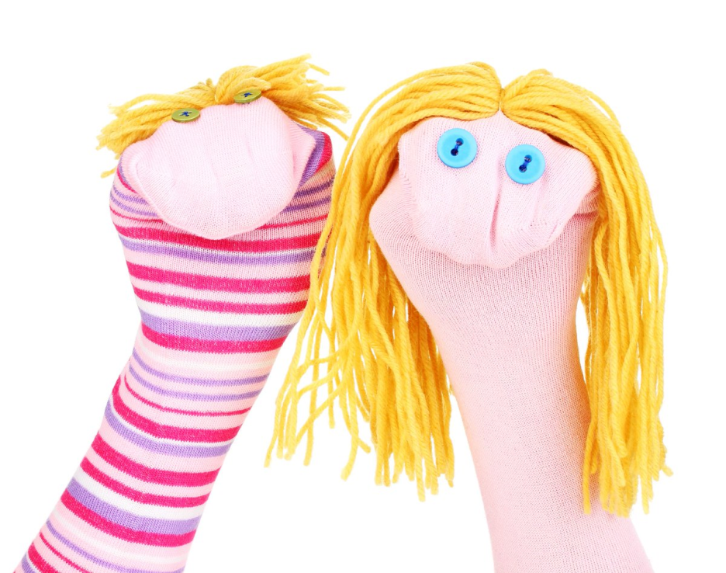
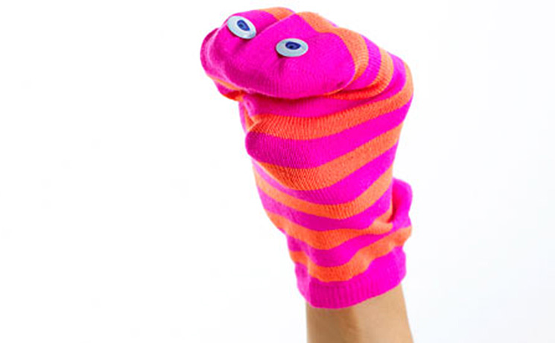
Types of puppets
Glove puppets are one of the easiest types of puppets to make.
Glove puppets

Slide 5
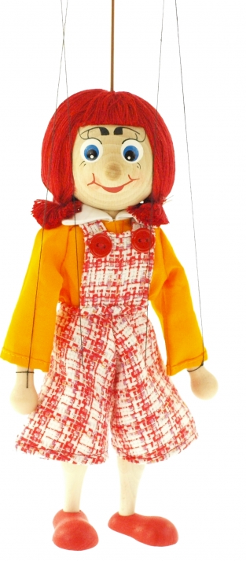
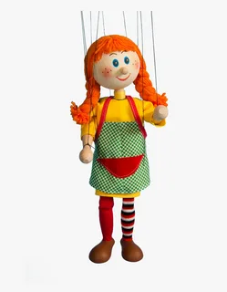
Marionettes
The marionette is a more difficult puppet to make and to use.
marionettes

Slide 6
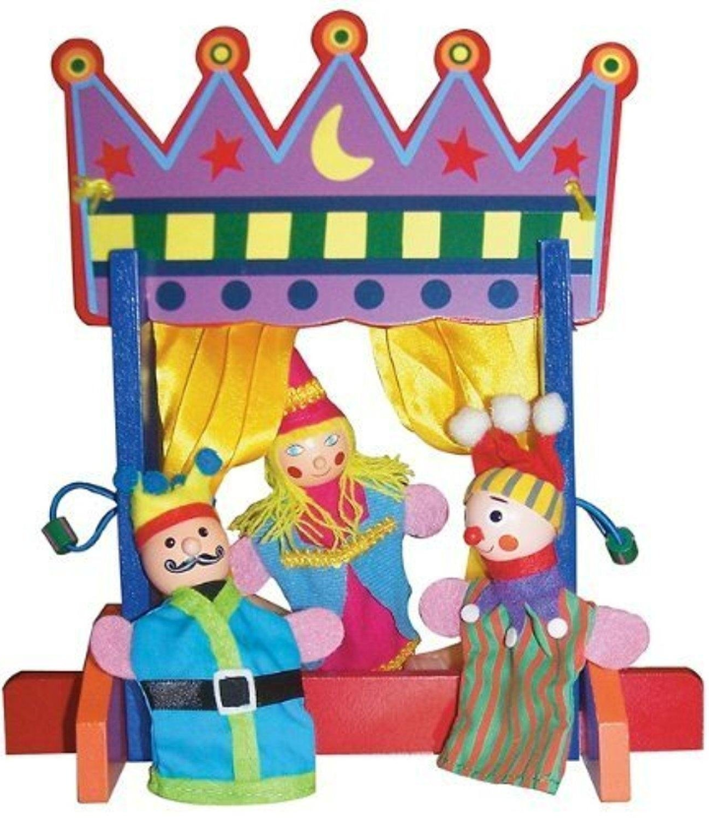
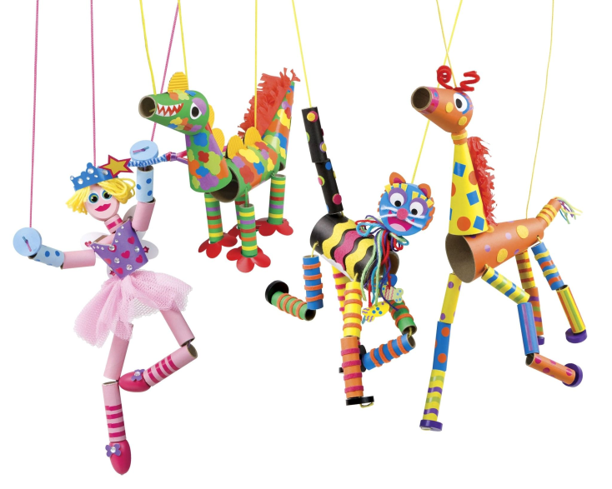
how can we use puppets ?
We can use puppets to educate or to tell stories.

Slide 7
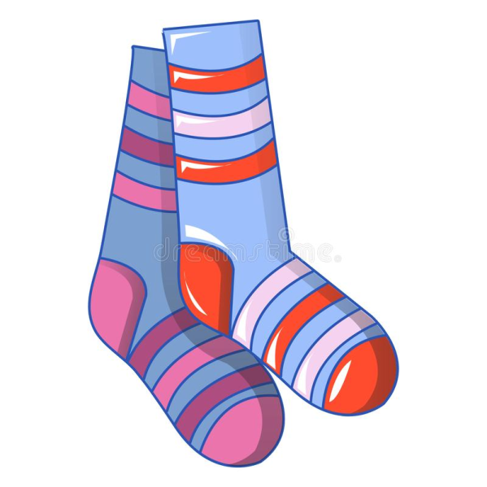
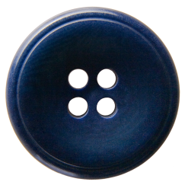

Make a Sock Puppet
You need
A sock
Two buttons
Wool
Glue
scissors

Slide 8
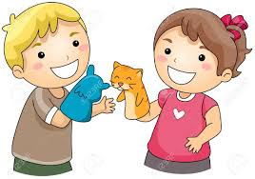
      Use your puppets to act out a story.

Slide 9

Thank you for work

