Slide 1
Квест по английскому языку для 7-8 классов THE BOY WHO LIVED
Составила учитель английского языка
ГБОУ школы № 523 Колпинского района Санкт-Петербурга Стретенская А.Ю

Slide 2
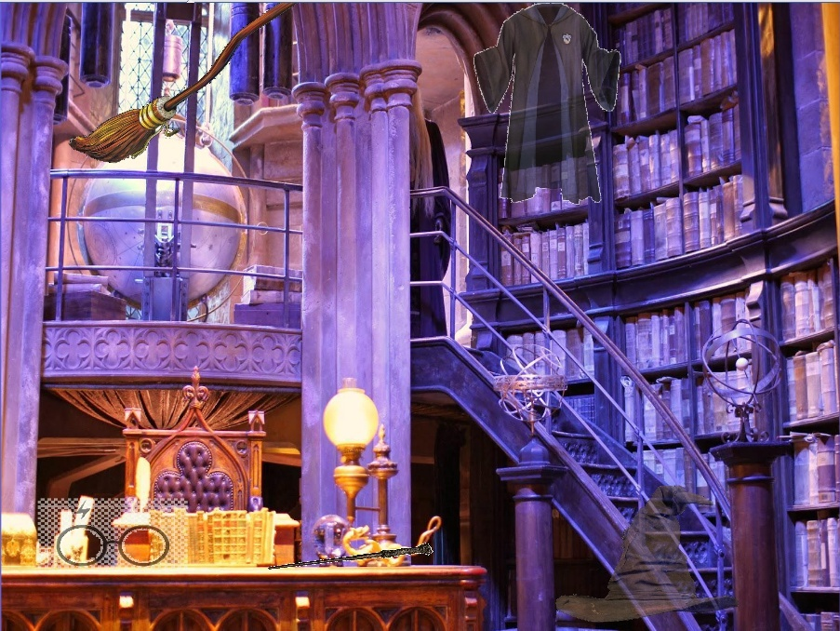


Hello, my dear friends! I’m a Spirit of Hogwarts.
There are six Horcruxes (крестражи) in this room
Find all of Horcruxes, click on them and do the task.
Then you can ask the Sorting Hat what Hogwarts House would you be in
Notes:
Цель: найти все спрятанные предметы и пройти все испытания. После этого учащиеся смогут узнать на какой факультет Хогвартса они могли бы попасть. Клик на предмет отправляет вас на слайд с заданием.

Slide 3
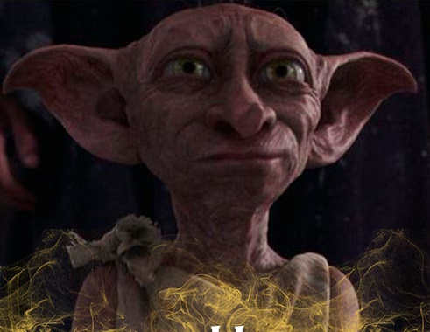
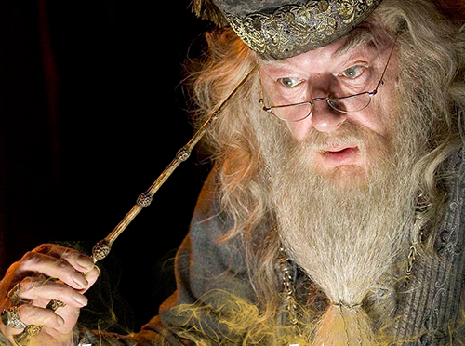

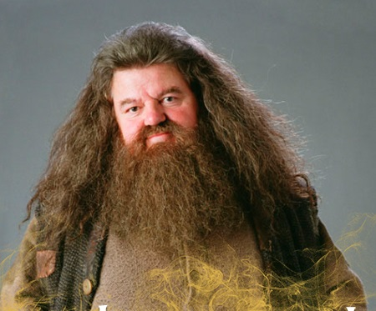
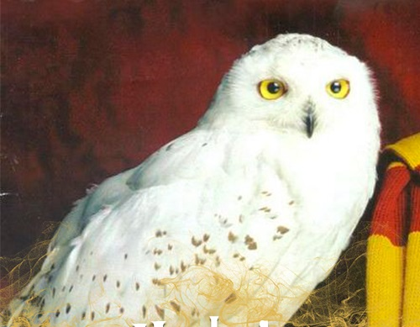
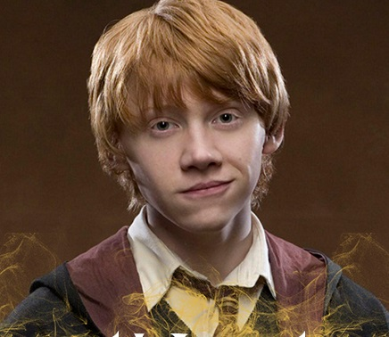
Match the names with the pictures
1
2
Dobby
3
4
HARRY’S FRIENDS
Hermione Granger
Rubeus Hagrid
Albus Dumbledor
5
6
Hedwig
Ronald Wesley

Slide 4


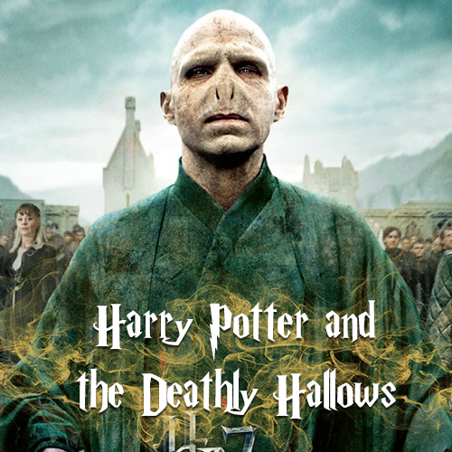
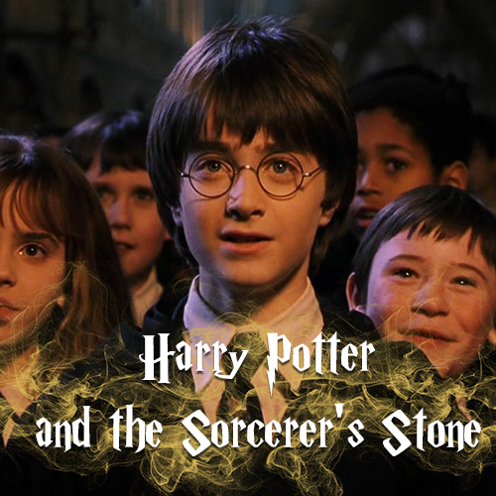
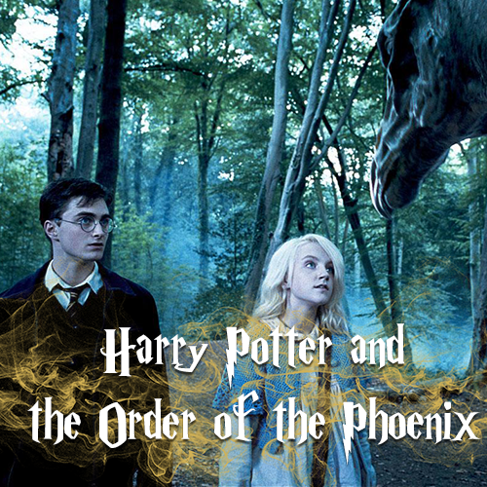


SEQUELS

Slide 5
WATCH THE VIDEO AND GUESS THE SEQUEL
1
2
3
4

Slide 6
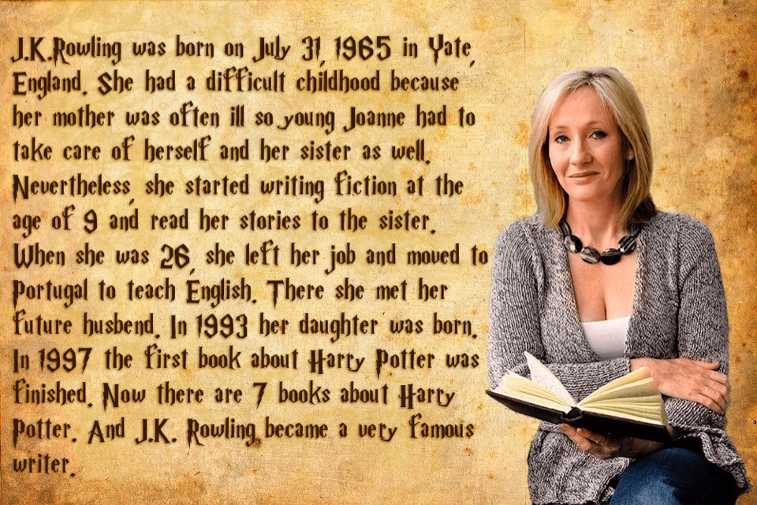
https://learningapps.org/5345841
AUTHOR

Slide 7
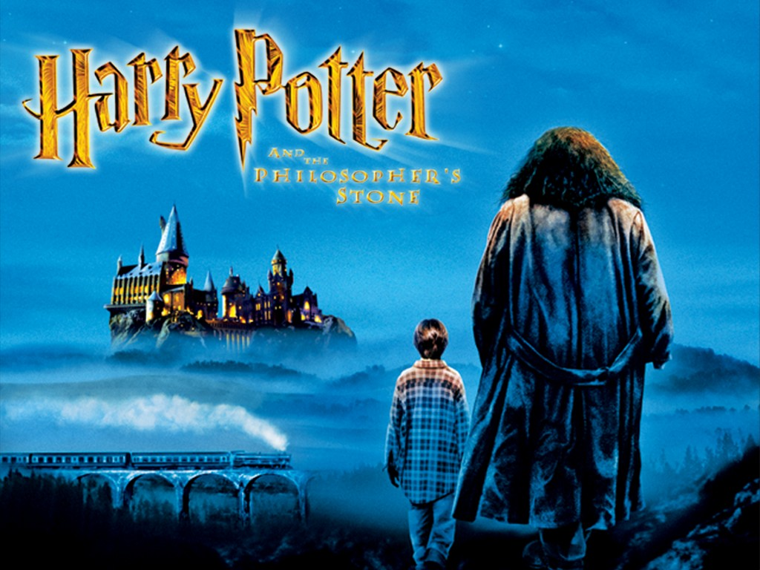
Video “Arrival at Hogwarts”
http://www.youtube.com/watch?v=SafKm0tsSOw
Now complete the story by writing the verbs in the correct form.
The train (1) ________ (stop) and all the students (2) ___________ (get off) and (3) _________ (walk) to the lake. They (4) _________ (see) a giant castle and Harry Potter (5) _______ (look) up and (6) _________ (see) the moon. There (7) ________ (be) boats on the lake and all the students (8) ________ (go) across the water in the boats. They (9) _________ (arrive) at Hogwart’s and (10) ________ (go) up a big staircase. There (11) _________ (be) a witch waiting for them. Neville (12) _________ (lose) his frog. They (13) _________ (walk) into the Great Hall and (14) _______ (see) the night sky and hundreds of candles. Harry (15) ________ (sit) on the stool and the Sorting Hat (16) _______ (tell) him to join Gryffindor House.
STOPPED
GOT OFF
WALKED
SAW
LOOKED
SAW
WERE
WENT
ARRIVED
WENT
WAS
LOST
WALKED
SAW
SAT
TOLD

Slide 8

Video “The Sorting Ceremony” - https://www.youtube.com/watch?v=z4K2F_OALPQ
¤ Who chooses the house you go to ?
Professor Dumbledore Professor MacGonagall the Sorting Hat
¤ Who goes first ?
Draco Malfoy Hermione Granger Harry Potter
¤ Right or Wrong ?
The Sorting Hat finds it difficult to choose a House for Harry. R W
The Sorting Hat thinks Harry has no courage. R W
The Sorting Hat thinks Harry has talent. R W
Harry wants to go to Slytherin. R W
Harry is happy to go to Gryffindor. R W

Slide 9
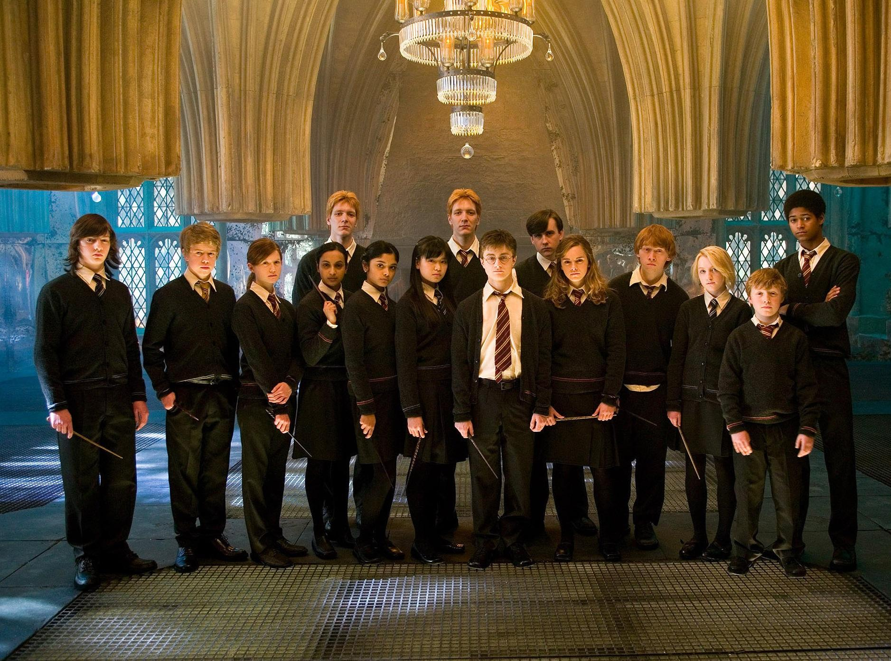






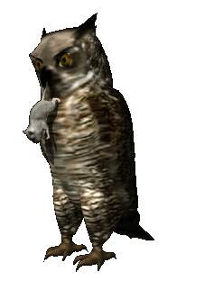

www.vk.com/egppt
I must find the Sorcerer’s stone!
We are learning how to make a spell.
I can make a magic potion.
I transformed him in a cat.
I’ve got a new broom.
I miss my parents.
We want to play Quidditch.
I love our teacher!
REPORTED SPEECH
I want Harry to ask me out.
Harry is my hero!
My owl has brought me a letter today.
Why do I have to stay in this school?
Harry is my best friend.
I don’t understand this spell.
Сlick and report the sentences.

Slide 10


Slide 11

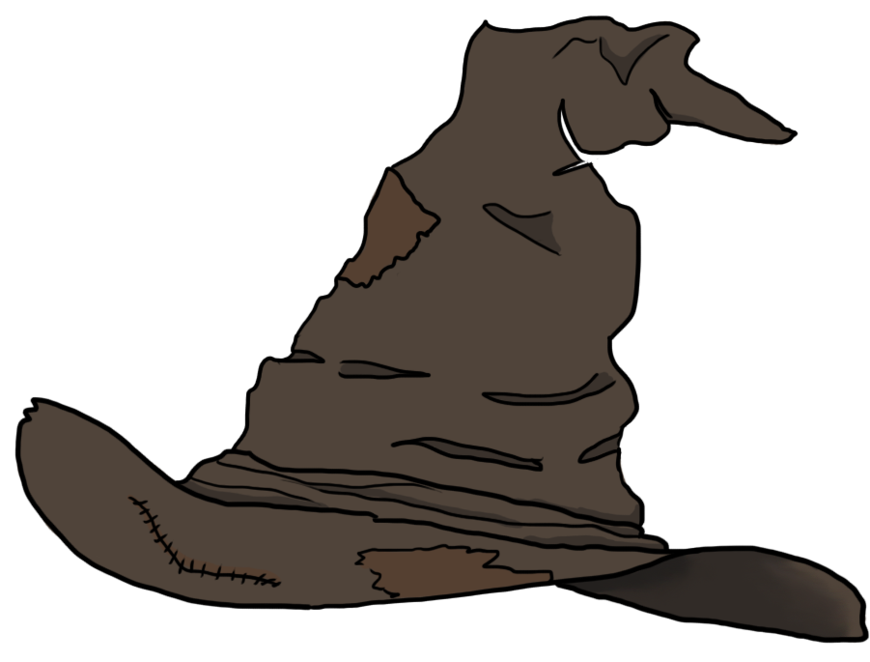
1
Choose the number of coat of arms
3
2
4

Slide 12
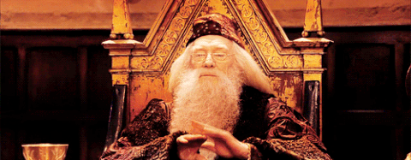
GREAT CHOICE!

Slide 13
список источников
http://www.vk.com/egppt
https://www.youtube.com/watch?v=z4K2F_OALPQ
http://www.youtube.com/watch?v=SafKm0tsSOw
https://learningapps.org/5345841
https://drive.google.com/file/d/1h2X4g8gQ27FcVOfr-NV5WCHrmAtumgid/view?usp=sharing
https://drive.google.com/file/d/1mVvjemXgL5CyRxdXlERC9Om7SvgxNEV_/view?usp=sharing
https://drive.google.com/file/d/17axwxvIMxOOeNDq0gstKZQI9l4QhcS_J/view?usp=sharing
https://drive.google.com/file/d/1wjSBsKVq5j2FCCzlmYk5jS__sl044Ul-/view?usp=sharing

Slide 14
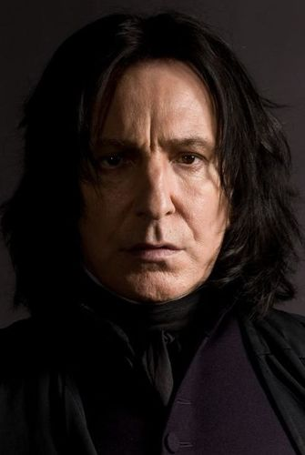
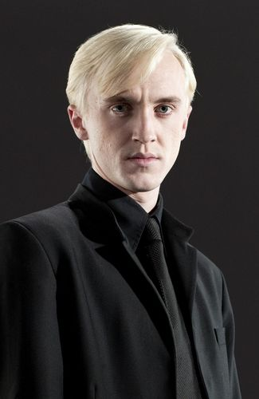

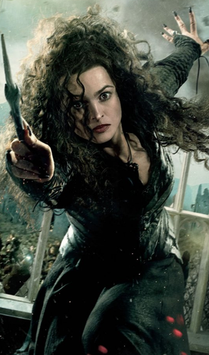
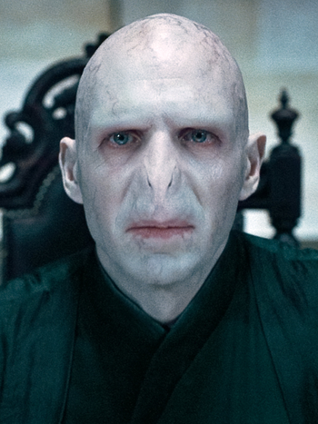
SLYTHERIN

Slide 15
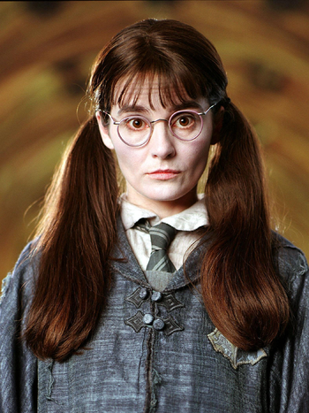
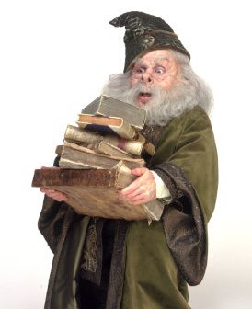


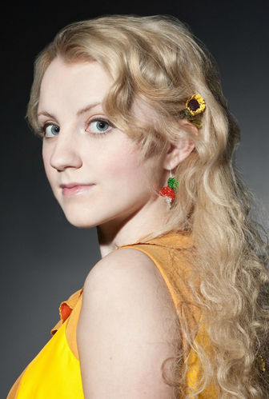
RAVENCLAW

Slide 16
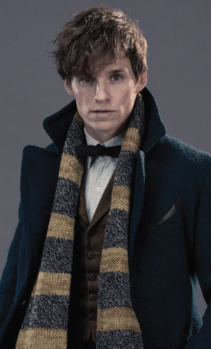


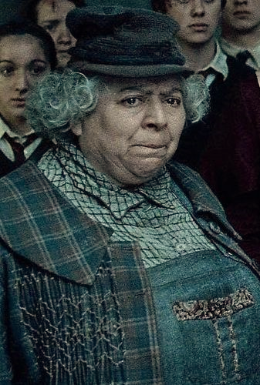
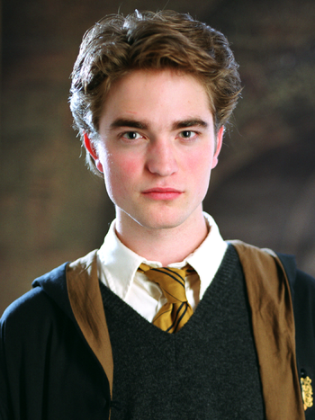
HUFFLEPUFF

Slide 17
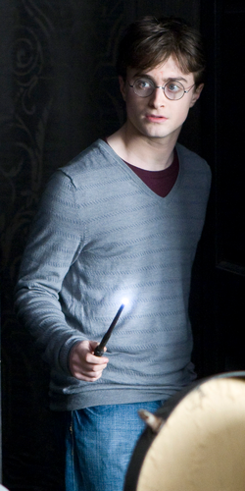


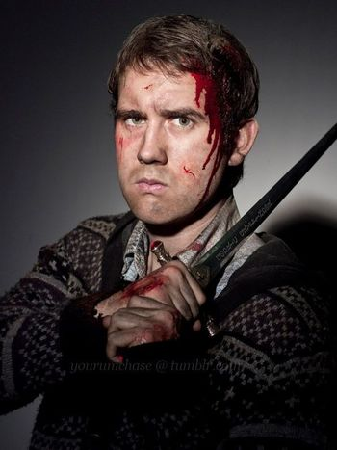
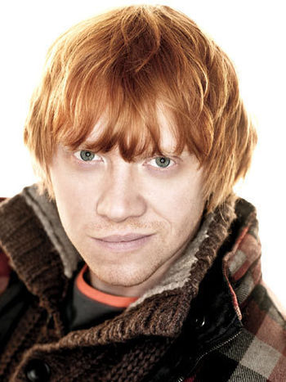
GRYFFINDOR

