Slide 1

The Mass media
in the life of modern society
Smirnova Elena
Gymnasium 92
1

Slide 2



RELEVANCE OF THE TOPIC
relevance of the topic
1
2
3
social networks
VIRTUAL
TOURS
READING
NEWS OR BOOKS

Slide 3

PURPOSE
OF THE
STUDY
The human brain is forced to constantly work with the flow of information coming online. People immerse in the media world. All our life consists of news scrolling. Some political scientists are talking about the formation of the fourth branch of government. The concept of “information warfare” becomes more and more popular between politicians because of the media appearance in our life
search
for
publications
compare
two countries
to sum up
news analysis

Slide 4
Types of presentation information

Slide 5

Internet
Quick
Available
Global storage
Variety of sources
1

Slide 6

Print
Verified source
Different periods of release
Many readers
Accurate and only important information
2

Slide 7


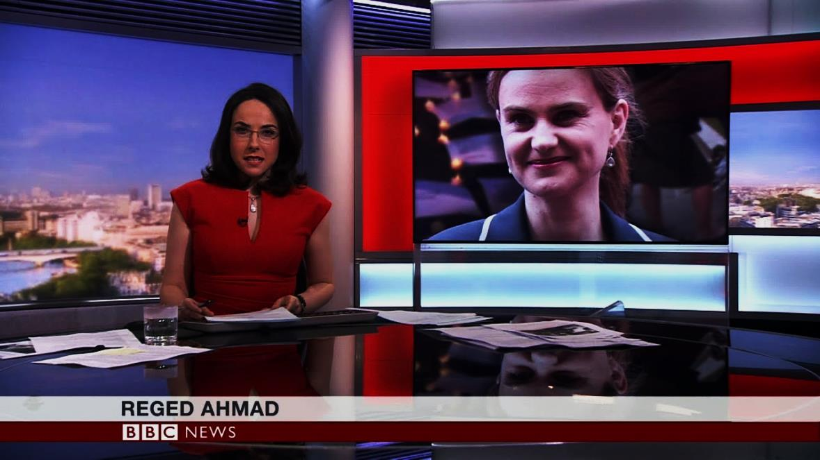

Broadcast
3

Slide 8


Film
A lot of information in one video
Prepared by a team of professionals
More thorough preparation
4

Slide 9
Types of presentation information.

Slide 10




Mass media is the forth branch of government

Slide 11
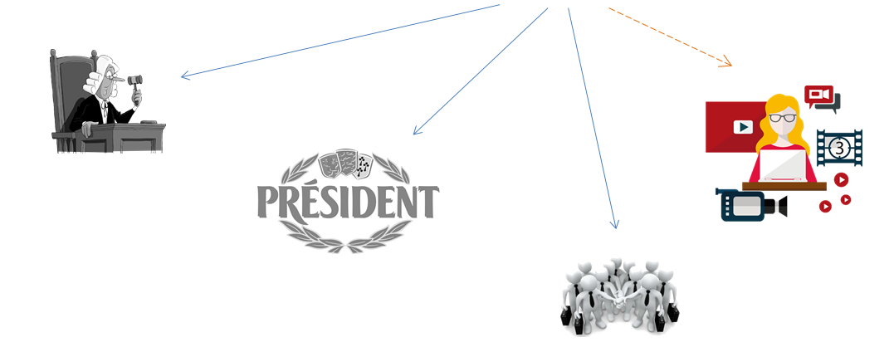



expectation vs reality
government
government
mass media

Slide 12
How does the media affect the opinion of residents?

Slide 13

The principle of priority
Information 1
Right!
WRONG!
Information 2

Slide 14



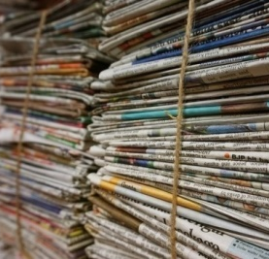
Repeating
listen
DOGS BETTER THAN CATS
Cats better
than dogs
-Dogs better than cats
watch
-Dogs better than cats
read
-Dogs better than cats

Slide 15

Everyday tale
By the way, aliens arrived and took
a couple of people,
but it doesn’t matter
There were a lot of people
walking outside
Today was the best
weather

Slide 16
News in
The USA and in Russia

Slide 17
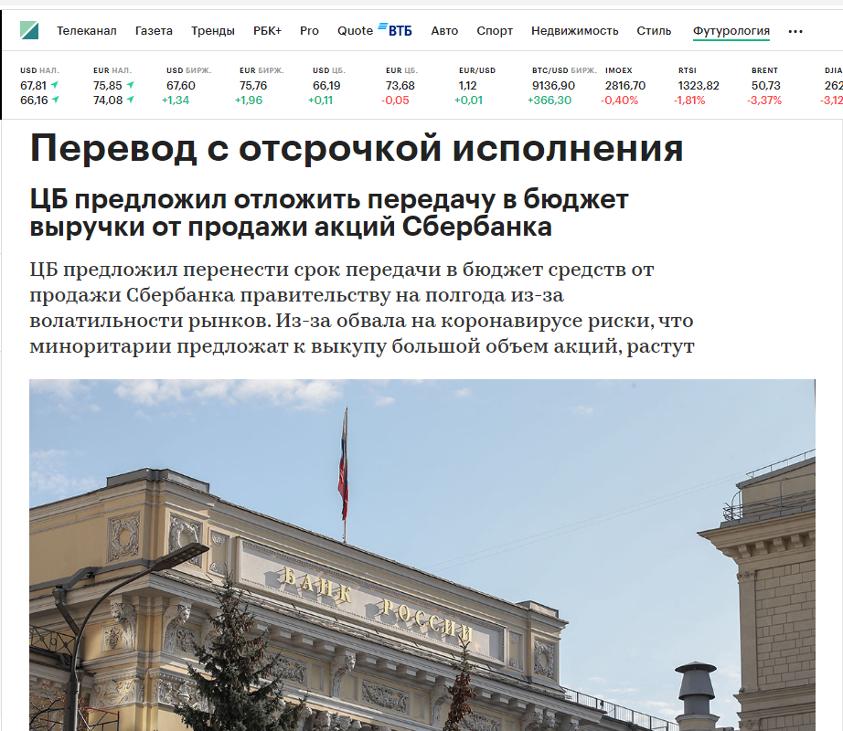
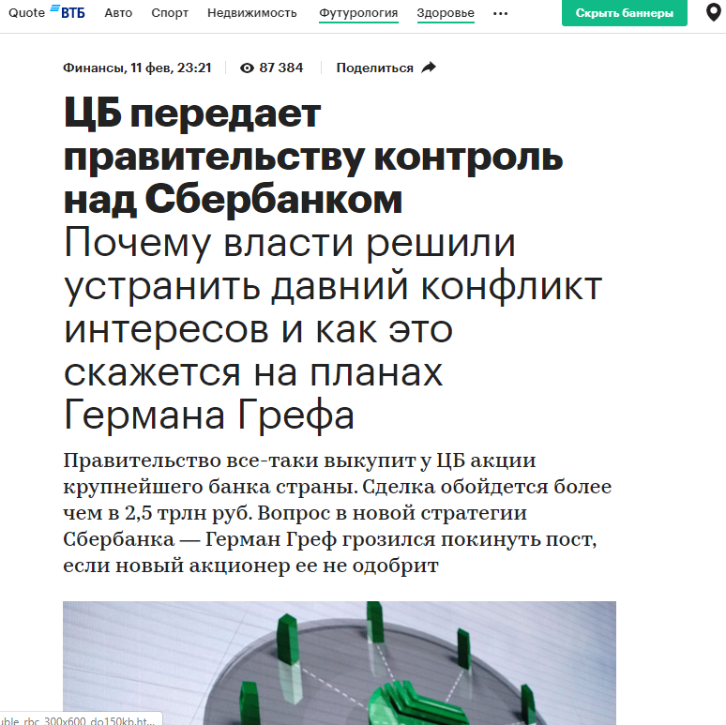
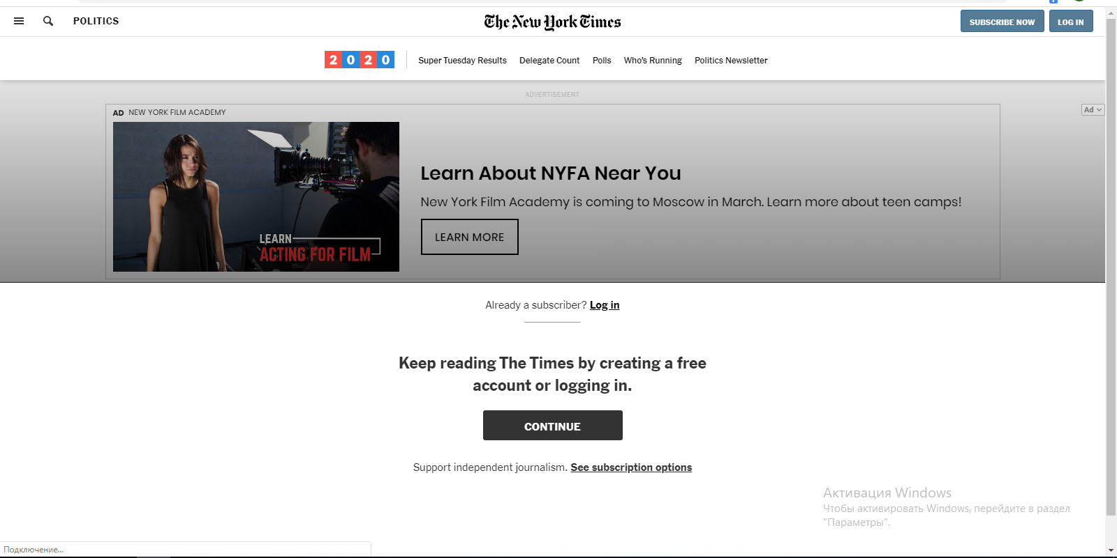
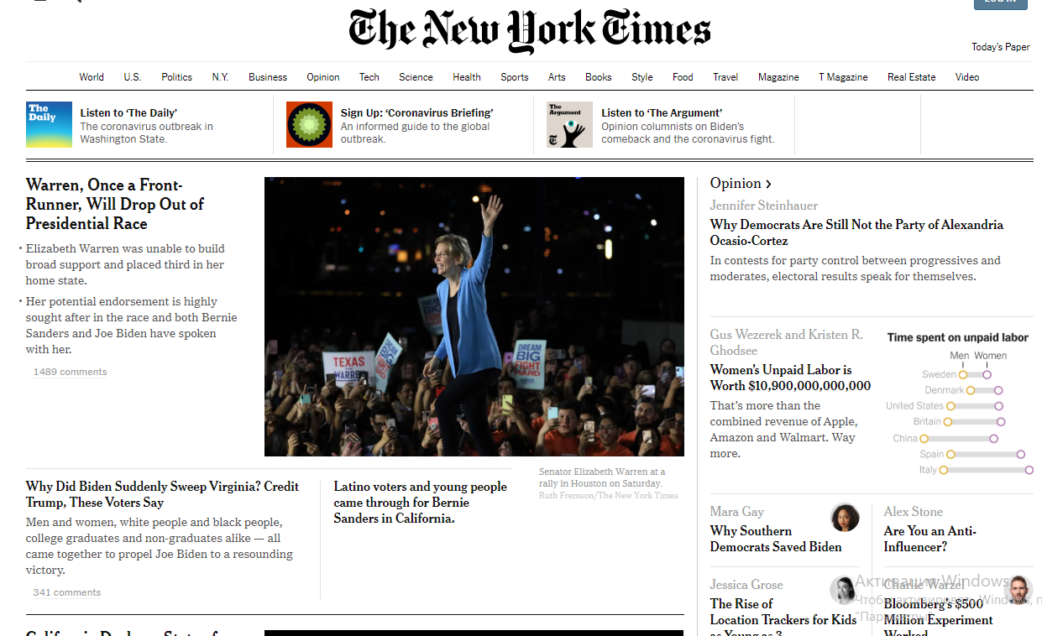

Slide 18
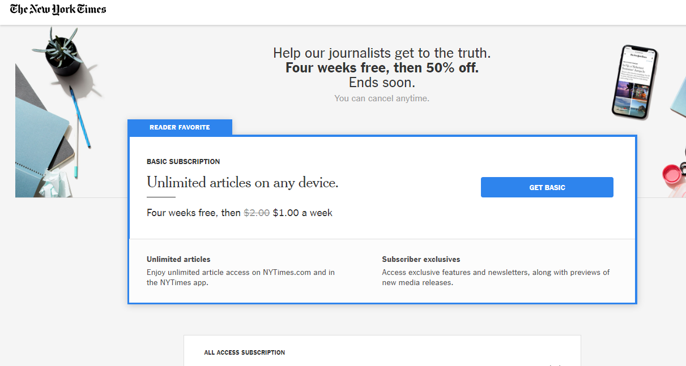
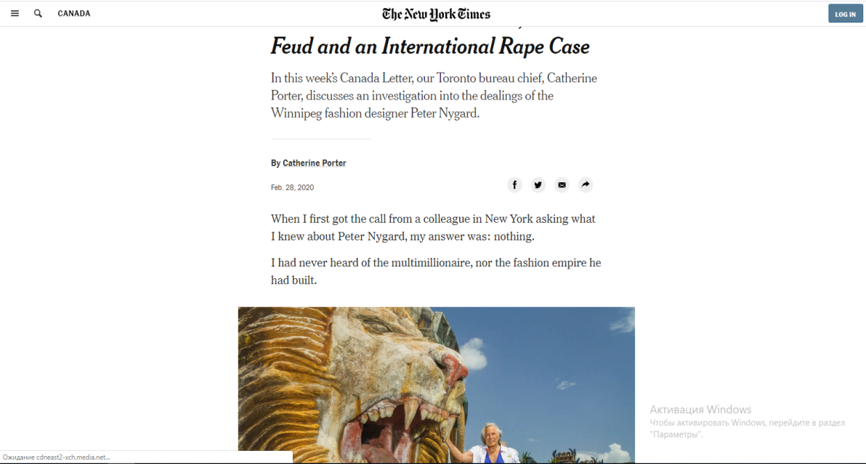
USA news

Slide 19
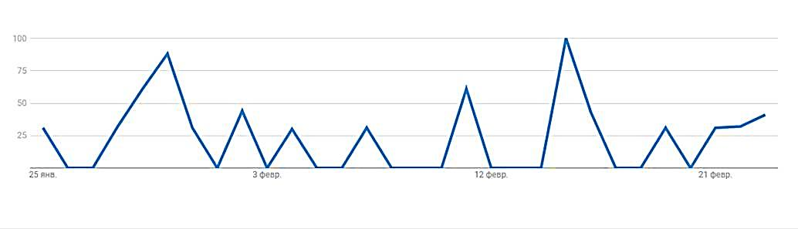
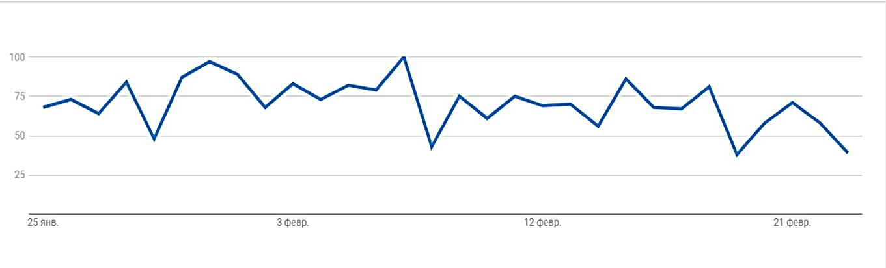
Popularity of news searching
Google analytics service was used
% of residents
USA
period of time
Russia
% of residents
period of time

Slide 20
The survey
practical part

Slide 21
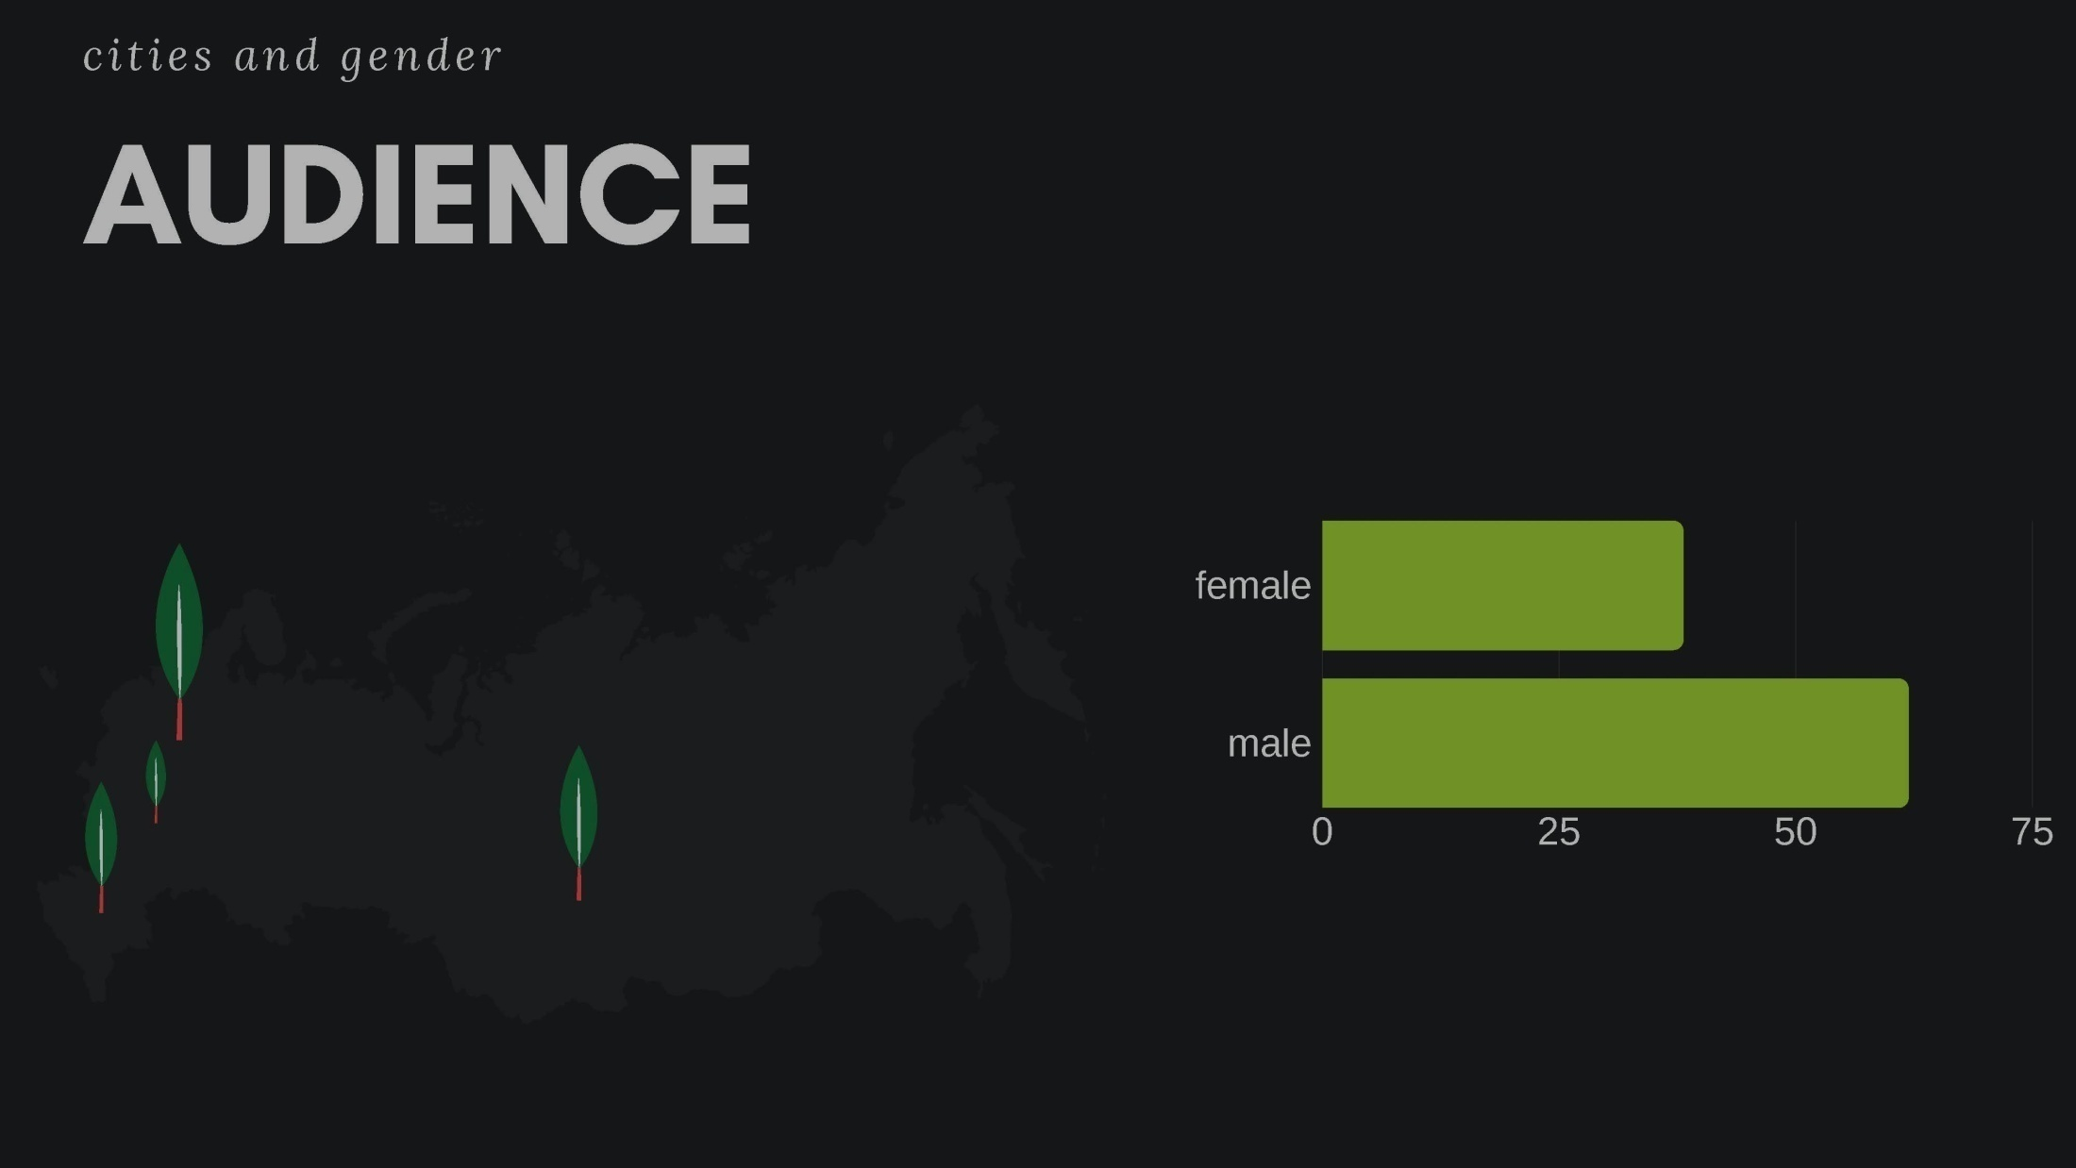

Slide 22
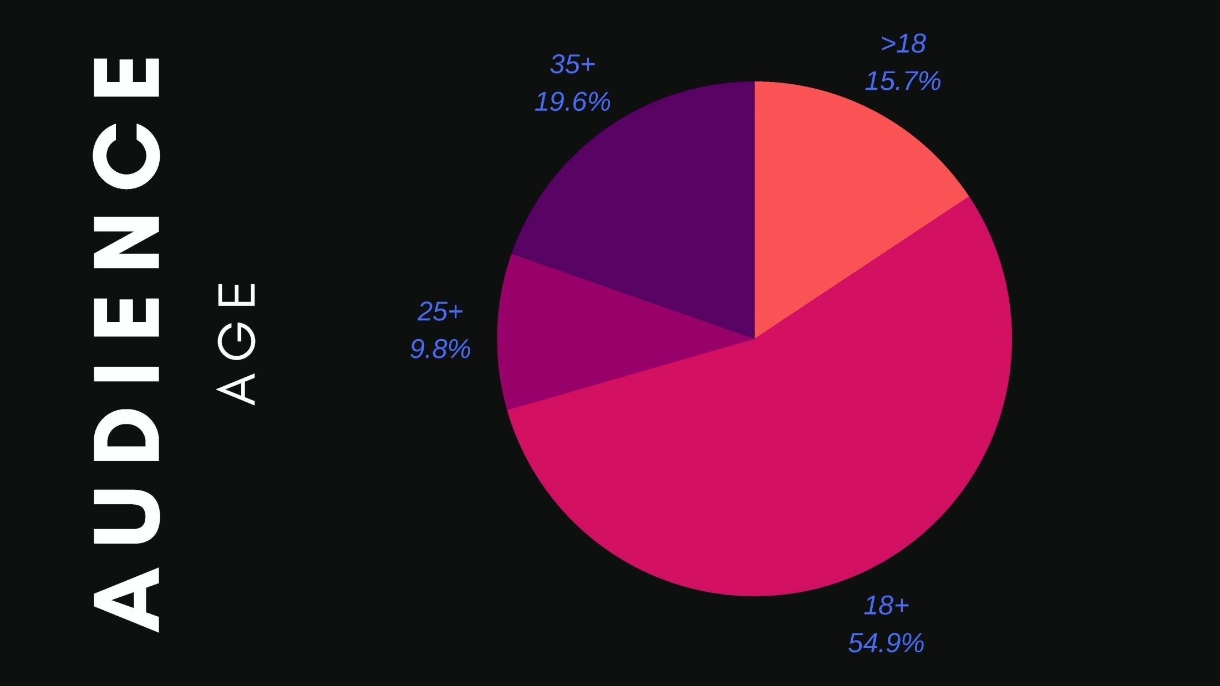

Slide 23
 | Russia | USA
Regularity of search
Kinds of sources
Types of news
56,5% every day
20,7 % never
32% every day
25% never
Internet
Social media
TV
TV
Internet
Print
worldwide events and politics (64,1% and 37%)
news about their regions or cities (58,7%)
economy (27,2%)
domestic policy (34,8%)
entrainment programs (68%)
domestic policy of
state (43%)
about economy of USA (34,8%)

Slide 24

Some tips for you
Analyze the causal connection of the information you get
Use different sources to check
Use the most independent sources.
Сheck who is the director and chief editor of the source of information.
Pay attention to intonation
Headline and first paragraph should have the same meaning.
Try to doubt what is written

Slide 25
Thank you for listening!

