Slide 1
FREE TIME
ГБОУ СОШ 473
Калининского района
Санкт-Петербурга
Мироненко В.В.

Slide 2
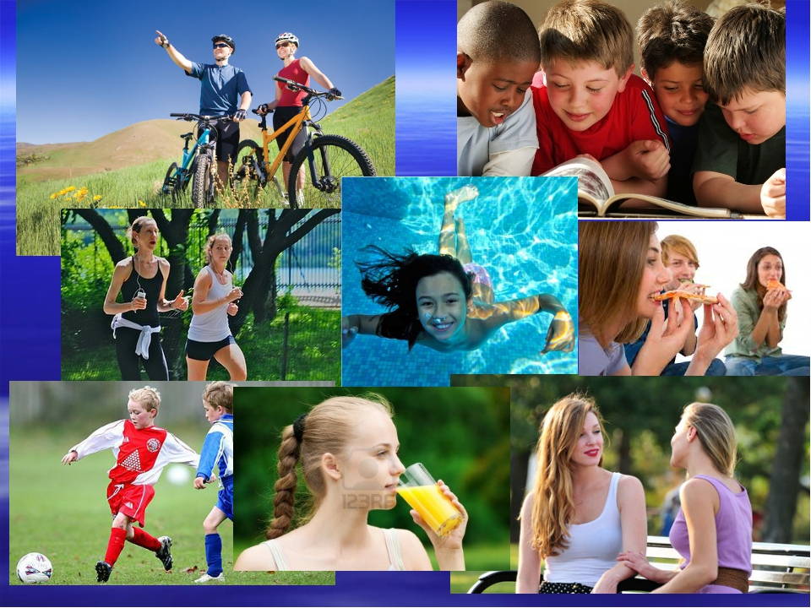

Slide 3
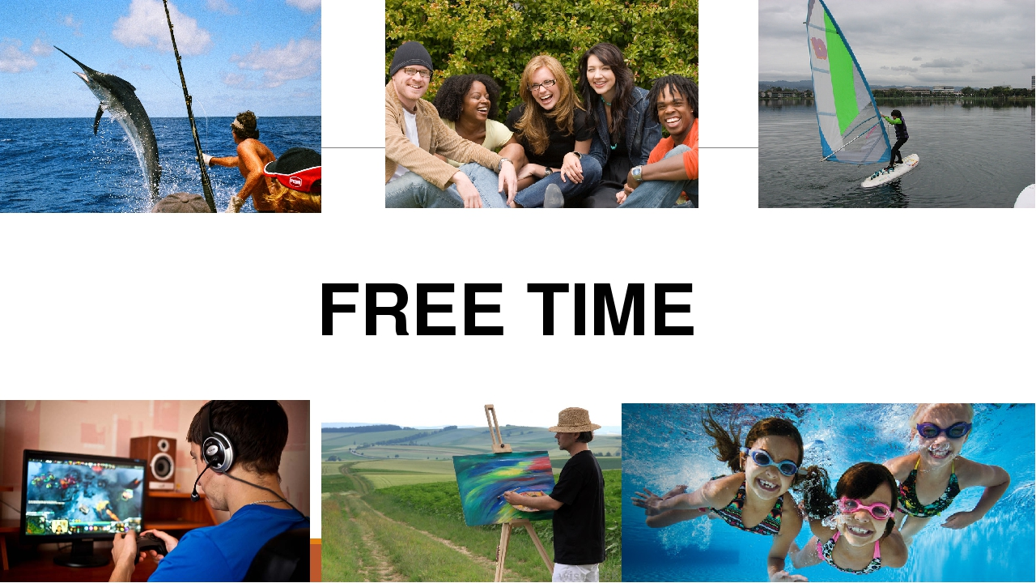

Slide 4
- What are Emma’s hobbies?
- What do you do in your free time?
(Ask and answer in pairs)
- Are Emma’s hobbies similar or different to yours?
Similar - похожие different - разные

Slide 5
Do you know what the most popular activity is? Let’s find it together.
Answer the questions .
1. What do you do at the weekend?
At the weekend I play football .
2. What don’t you do at the weekend?
At the weekend I don’t go shopping.
3. What do you usually like doing at the weekend?
At the weekend I usually like watching TV.

Slide 6
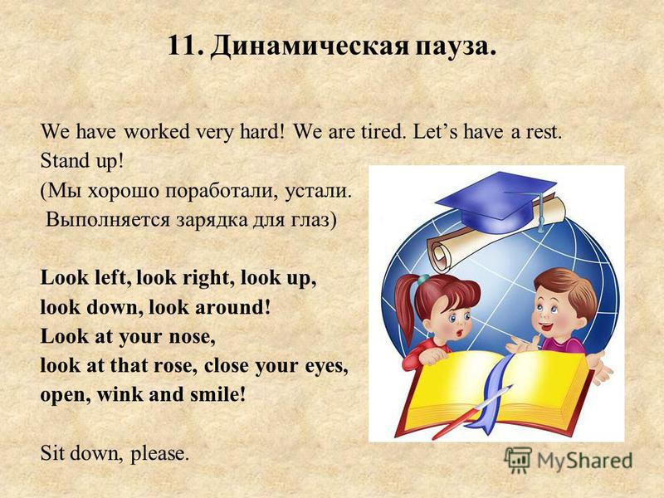
https://youtu.be/4zEUgTAoXuI
LET’S HAVE A REST

Slide 7
VERB COLLOCATIONS
read | a comic, magazines | listen to | the radio, music
go to | the beach, the cinema | play | basketball, computer games

Slide 8
Put marks to your partner.
4 sentences correct – put “5”,
3 correct – “4”,
2 correct – “3”,
0-1 correct – “2”
Check!

Slide 9
Now divide into 2 groups.
Compare your free time activities in your group.
Then each group comes to the board and every person tells 1 sentence about 1 classmate of your group.
Mind the ending –s or –es with the verbs, when we use the subjects He, She It.
For example:
On the weekend Lera watches TV and reads the book.
In his free time, Sasha watches football match and plays computer games. (You have 2 minutes.)

Slide 10
Let’s make the conclusion.
1.What did we do today?
2. What are the difficulties?
- As for me, It’s difficult to ….read speak listen to understand write fast…
3.Do you like our work today?
4. How do you think, what mark do you work at?
Draw the smile and give yourself the mark from “bad” to “excellent”.

Slide 11


