Slide 1
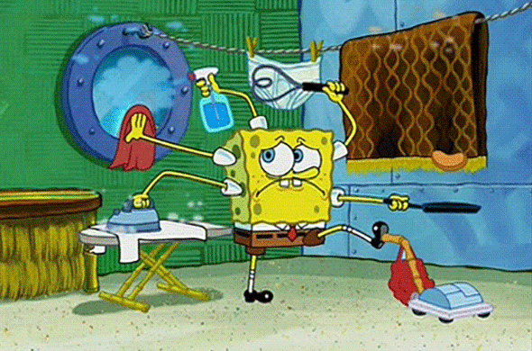
Helping at home and in the classroom

Slide 2

Заправлять кровать
help a lot at home
wash the dishes
feed the hamster
make a bed
tidy the room
take the rubbish out
weed the garden
take the dog for a walk
go to the supermarket
help with cooking
water the plants
collect the copybooks
feed the dog
clean the blackboard
empty the wastepaper bin
feed the turtle
feed the cat
help with shopping

Slide 3
Выносить мусор
help a lot at home
wash the dishes
feed the hamster
tidy the room
take the rubbish out
weed the garden
take the dog for a walk
go to the supermarket
help with cooking
water the plants
collect the copybooks
feed the dog
clean the blackboard
empty the wastepaper bin
feed the turtle
feed the cat
help with shopping

Slide 4
Покормить кота
help a lot at home
wash the dishes
feed the hamster
tidy the room
weed the garden
take the dog for a walk
go to the supermarket
help with cooking
water the plants
collect the copybooks
feed the dog
clean the blackboard
empty the wastepaper bin
feed the turtle
feed the cat
help with shopping

Slide 5
Много помогать по дому
help a lot at home
wash the dishes
feed the hamster
tidy the room
weed the garden
take the dog for a walk
go to the supermarket
help with cooking
water the plants
collect the copybooks
feed the dog
clean the blackboard
empty the wastepaper bin
feed the turtle
help with shopping

Slide 6
Покормить хомяка
wash the dishes
feed the hamster
tidy the room
weed the garden
take the dog for a walk
go to the supermarket
help with cooking
water the plants
collect the copybooks
feed the dog
clean the blackboard
empty the wastepaper bin
feed the turtle
help with shopping

Slide 7
Собирать тетради
wash the dishes
tidy the room
weed the garden
take the dog for a walk
go to the supermarket
help with cooking
water the plants
collect the copybooks
feed the dog
clean the blackboard
empty the wastepaper bin
feed the turtle
help with shopping

Slide 8
Помогать с готовкой
wash the dishes
tidy the room
weed the garden
take the dog for a walk
go to the supermarket
help with cooking
water the plants
feed the dog
clean the blackboard
empty the wastepaper bin
feed the turtle
help with shopping

Slide 9
Мыть посуду
wash the dishes
tidy the room
weed the garden
take the dog for a walk
go to the supermarket
water the plants
feed the dog
clean the blackboard
empty the wastepaper bin
feed the turtle
help with shopping

Slide 10
Покормить черепаху
tidy the room
weed the garden
take the dog for a walk
go to the supermarket
water the plants
feed the dog
clean the blackboard
empty the wastepaper bin
feed the turtle
help with shopping

Slide 11
Опустошать корзину для бумаг
tidy the room
weed the garden
take the dog for a walk
go to the supermarket
water the plants
feed the dog
clean the blackboard
empty the wastepaper bin
help with shopping

Slide 12
Помогать делать покупки
tidy the room
weed the garden
take the dog for a walk
go to the supermarket
water the plants
feed the dog
clean the blackboard
help with shopping

Slide 13
Прополоть огород
tidy the room
weed the garden
take the dog for a walk
go to the supermarket
water the plants
feed the dog
clean the blackboard

Slide 14
Мыть доску
tidy the room
take the dog for a walk
go to the supermarket
water the plants
feed the dog
clean the blackboard

Slide 15
Идти в супермаркет
tidy the room
take the dog for a walk
go to the supermarket
water the plants
feed the dog

Slide 16
Покормить собаку
tidy the room
take the dog for a walk
water the plants
feed the dog

Slide 17
Выгуливать собаку
tidy the room
take the dog for a walk
water the plants

Slide 18
Поливать цветы
tidy the room
water the plants

Slide 19
Убираться в комнате
tidy the room

Slide 20
Robinson Crusoe

Slide 21


