Slide 1

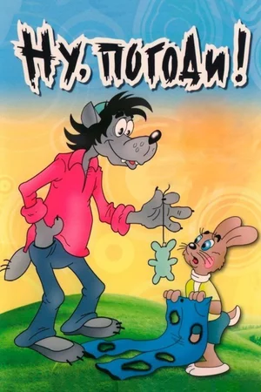

Slide 2
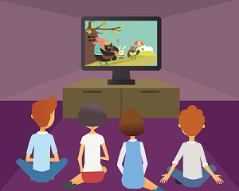
Look at the pictures and guess the topic of the lesson. Then choose the best answer.
Cartoon favourites! Cartoon time.
Playing video games.
Watching TV.

Slide 3
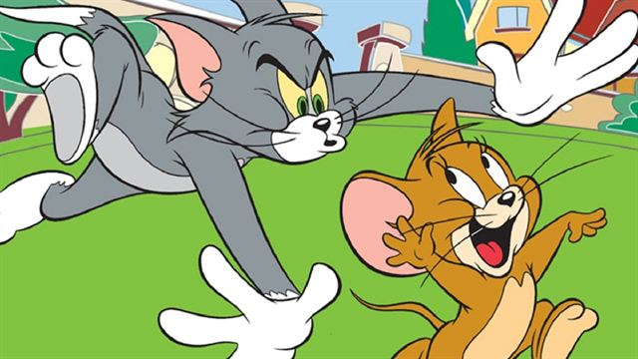
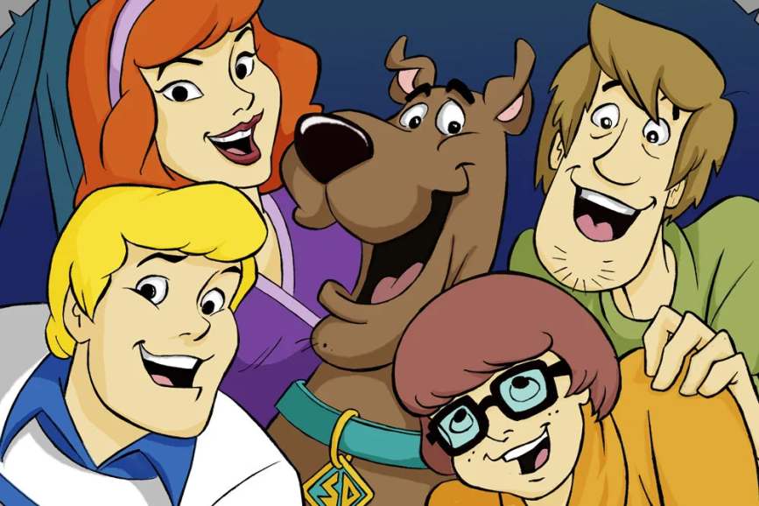
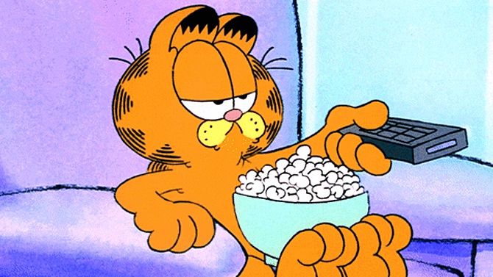
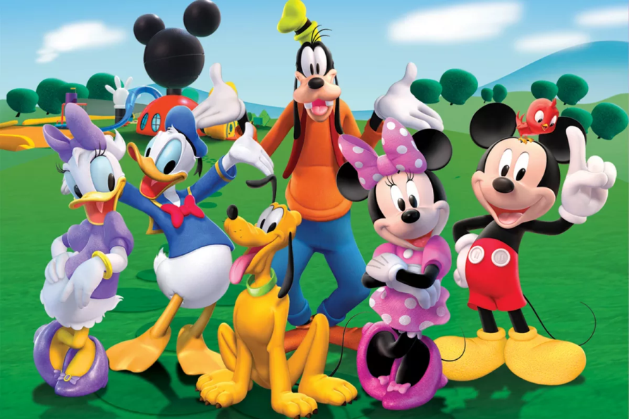
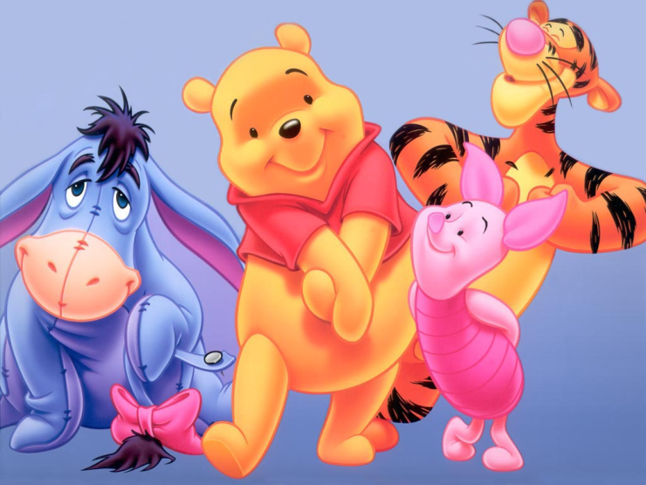
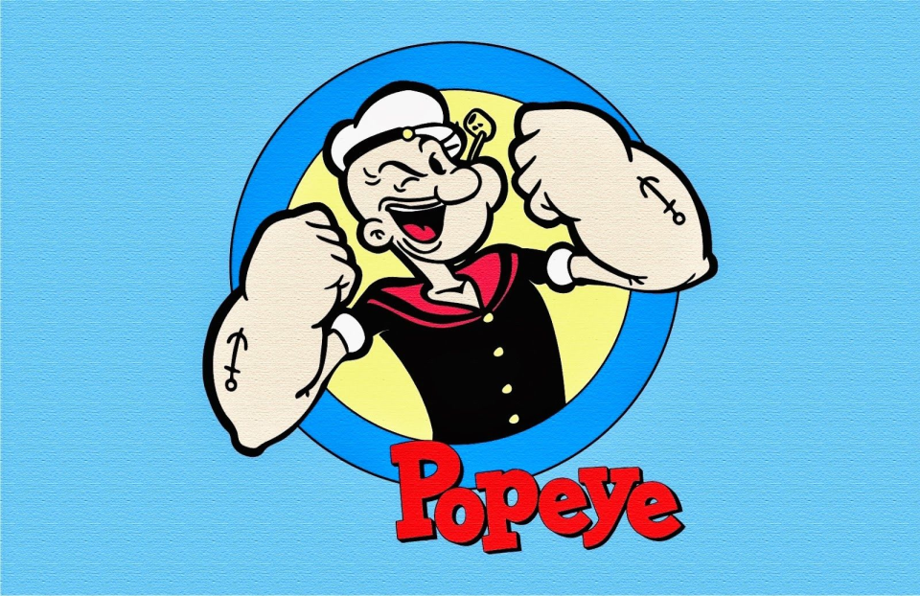
American cartoon characters

Slide 4
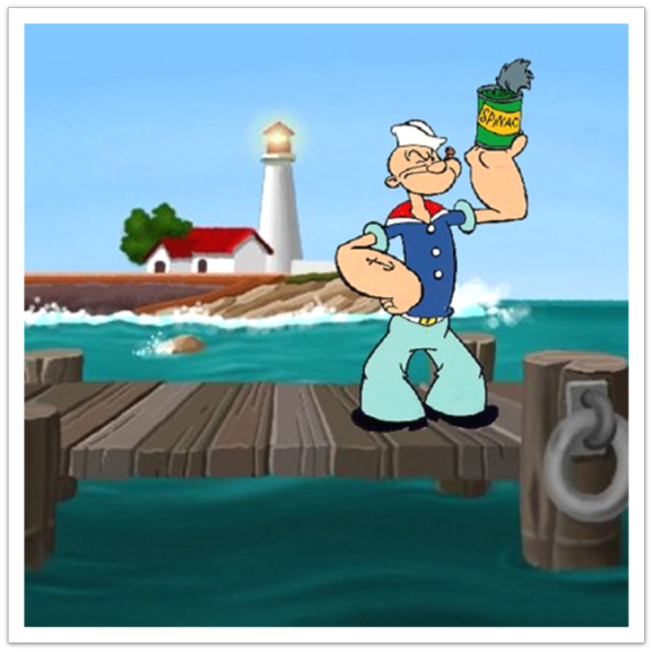
Read and fill in:
spinach
helping
sailing
eating
Scooby snacks
I am Popeye the sailor man!
What do I like doing?
Well, of course I like 1) ………….
and I love eating 2) ……………. !

Slide 5
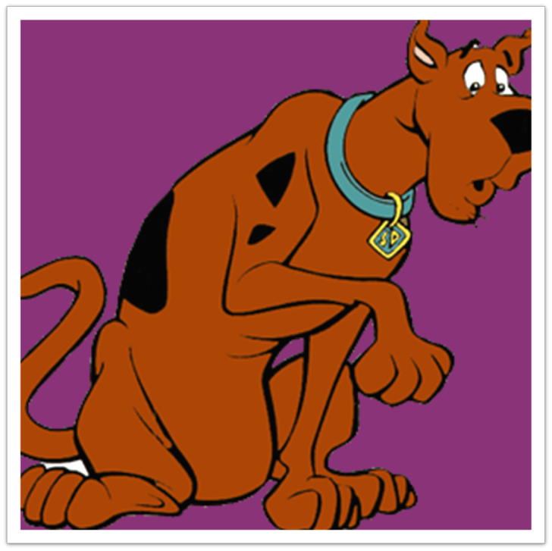
Read and fill in:
helping
eating
Scooby snacks
My name’s Scooby Doo! I’m a very clever dog and I like 3) …………. my owner, Shaggy! Oh, yes … and I love eating 4) ………………..….!

Slide 6
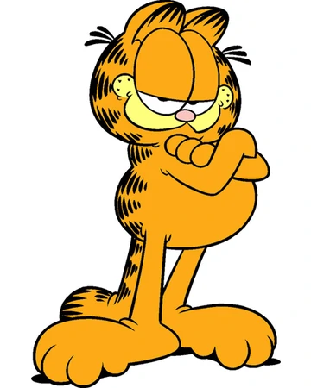
Read and fill in:
eating
Do you know me?
Yes, I am Garfield the cat! I love sleeping and 5) ………. !

Slide 7



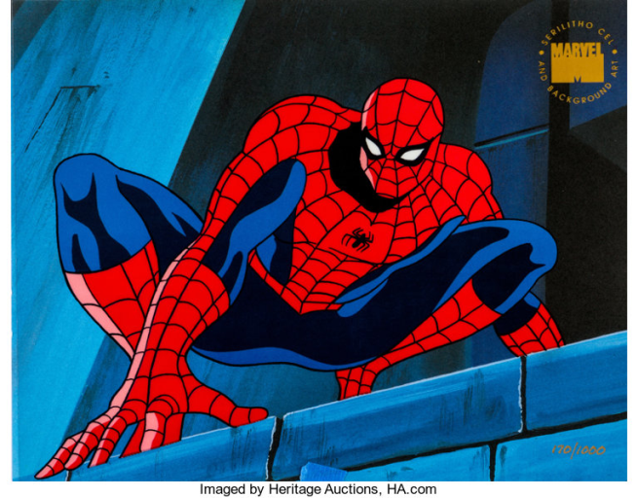
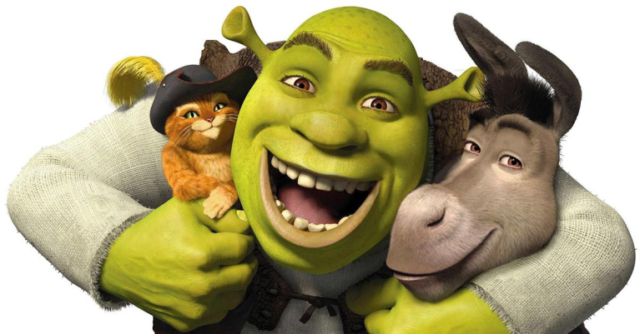


Slide 8
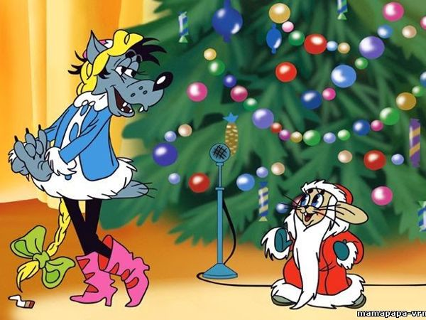
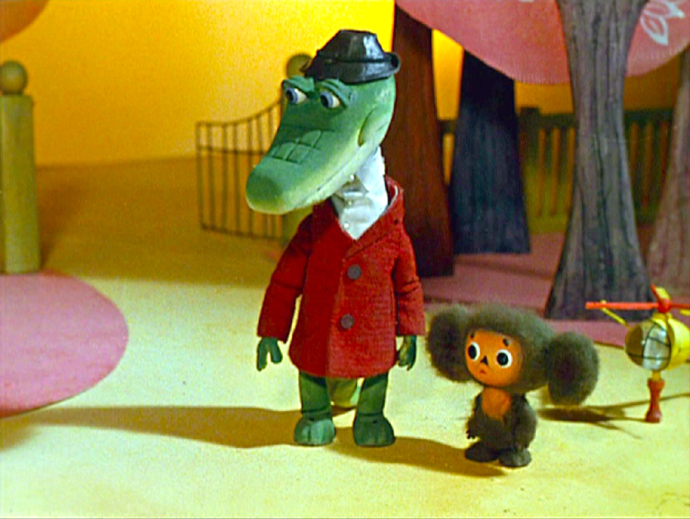
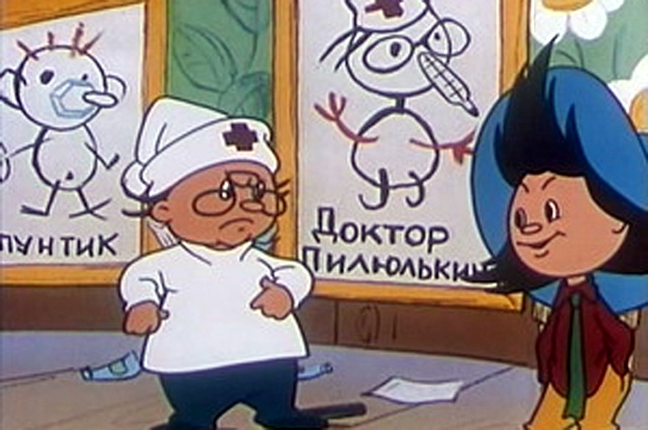
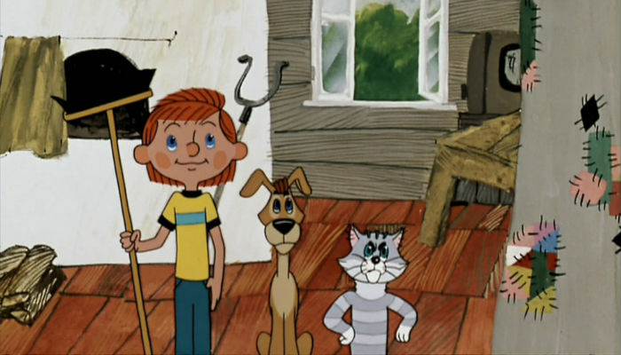
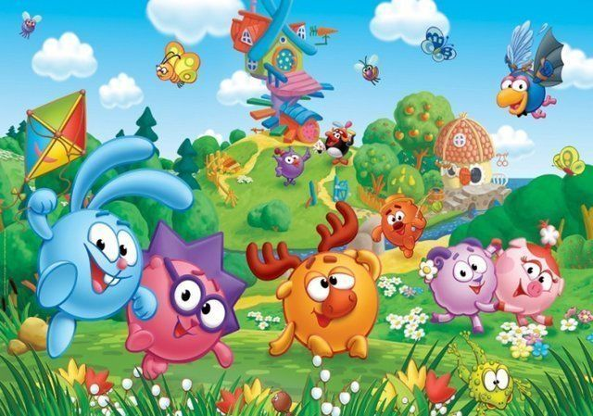
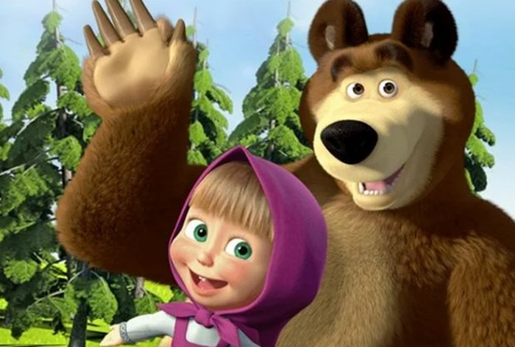
Russian cartoon characters

Slide 9
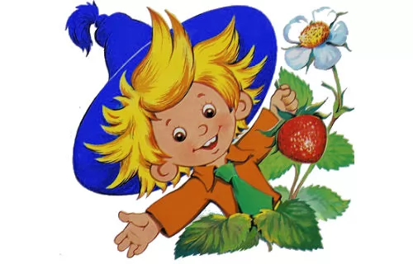
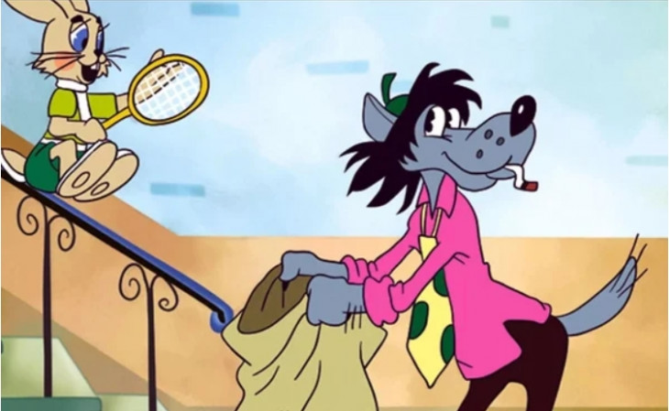
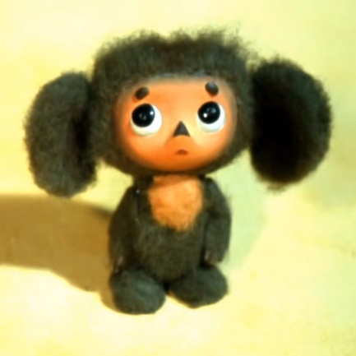
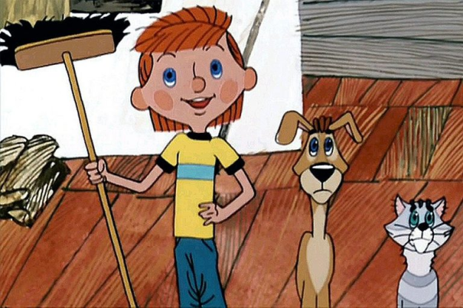
Who is it? Read and match
1. “I don’t know who I am. I don’t know my name. I don’t have any friends.”
3. “I’ve got a dog and a cat, but they are not my pets, they are my friends. They live in the country.”
2. “I live in a flower city and I like wearing bright things. The big blue hat is my favourite. I don’t like girls.”
4. “I‘m not happy. I can’t catch the small hare. I’ve got big teeth and I want to eat the hare up.”

Slide 10
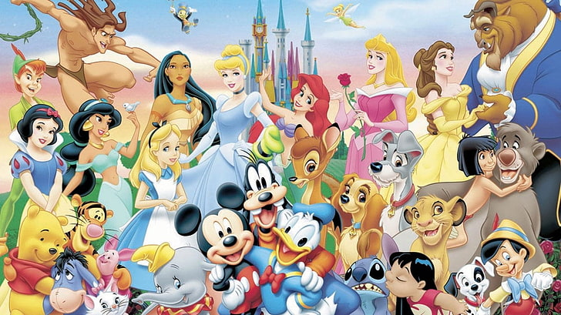
Homework

Slide 11
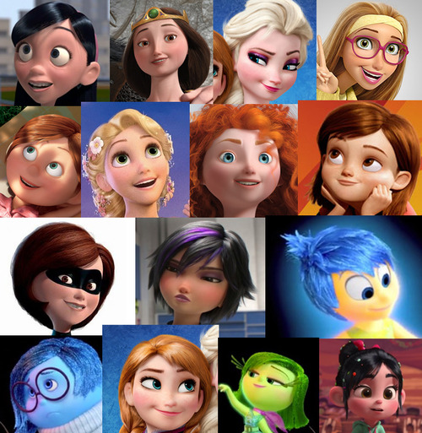
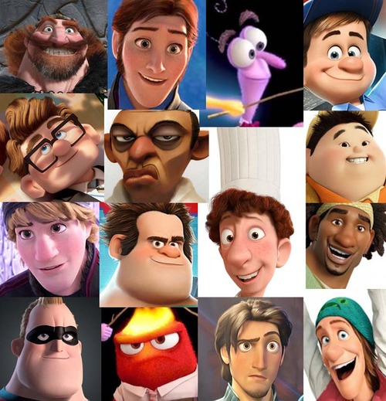
How are you feeling?

