Slide 1
Habits
Spotlight 9
Module 7d
Objectives of the Lesson:
to learn to talk about healthy and unhealthy habits
to practise using modal verbs and conditional sentences in speech

Slide 2
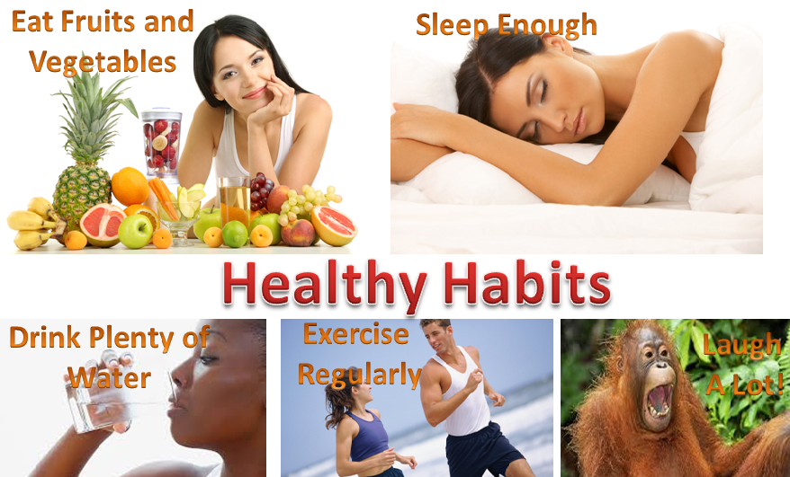

Slide 4


Slide 5


Slide 6
Match verbs 1-9 to the phrases a-i to form collocations
stay
keep
avoid
go
work out
get
lose/ put on
go on
9) cut down on/ give up
a enough sleep
b fit
c a sensible diet
d jogging
e in shape
f weight
g stress
h in the gym
i junk/ fatty foods, fizzy drinks

Slide 7
Key:
1) b/e stay fit/ in shape
2) b/e keep fit/ in shape
3) g avoid stress
4) d go jogging
5) h work out in the gym
6) a/b/e get enough sleep/ fit/ in shape
7) f lose/ put on weight
8) c go on a sensible diet
9) i cut down on/ give up junk/ fatty foods, fizzy drinks

Slide 8
tasty
thirsty
slice
dessert
nutritious
home-made
treat
snacks
starving
roast

Slide 10


Slide 11

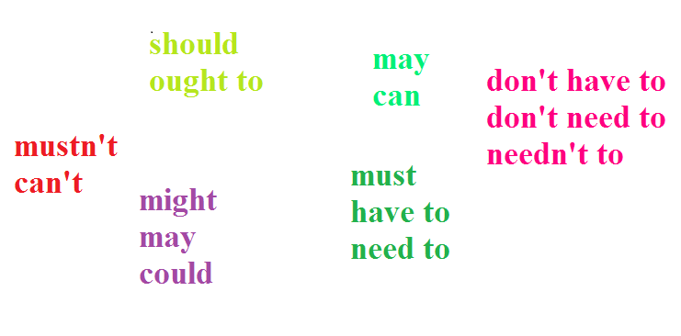
YES NO

Slide 14

- Do you think you have a healthy life style?
- Is it possible to have a healthy life style in modern world?
- Why do many people try to have a healthy life style?
- What do you prefer, to eat everything you like, drink a lot, smoke,
have no physical exercise and die at the age of 60 or lead a healthy life and live until 100?

