Slide 1
UK Souvenirs
Васильева С.О.
учитель английского языка
МБОУ «Ново-Ямская СОШ»
Старицкий р-он, Тверская обл.

Slide 2
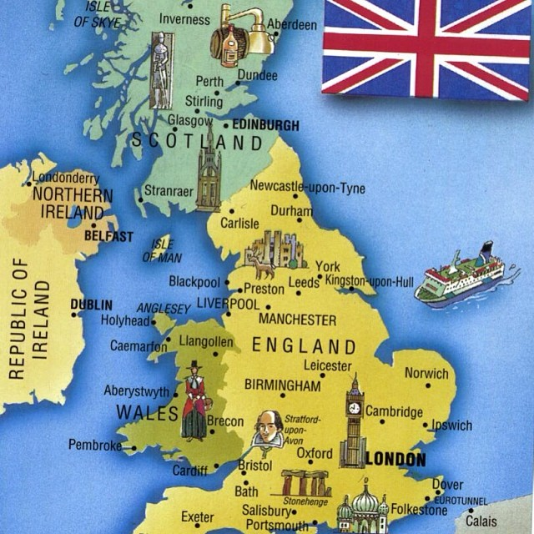
What is the UK?
What countries does the UK consist of?
Name the countries.

Slide 3
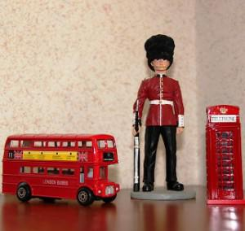
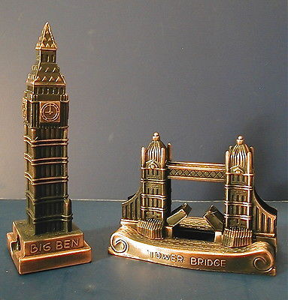
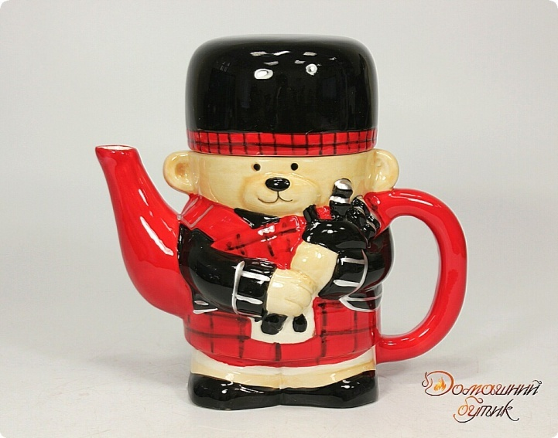
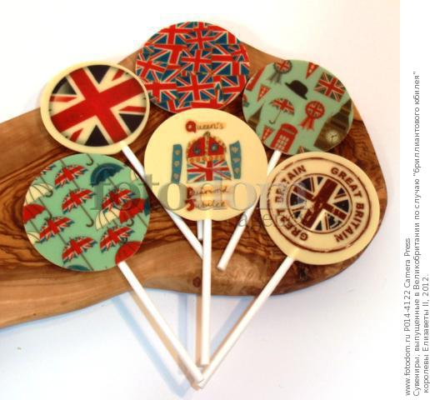
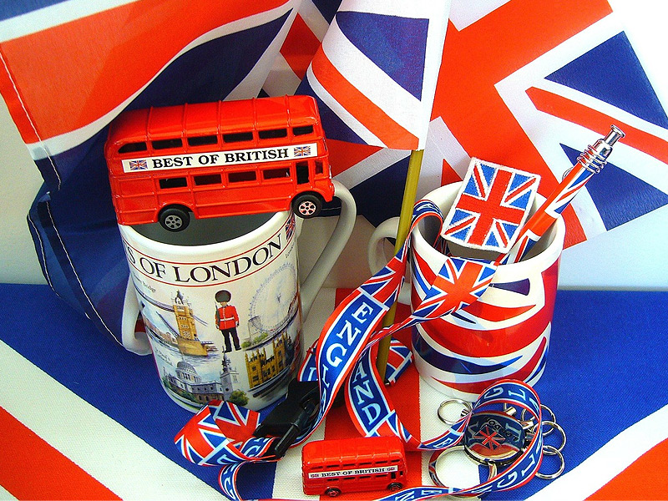
There are a lot of souvenirs you can buy in the UK.

Slide 4
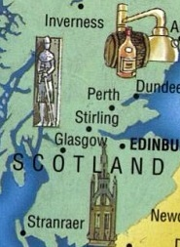
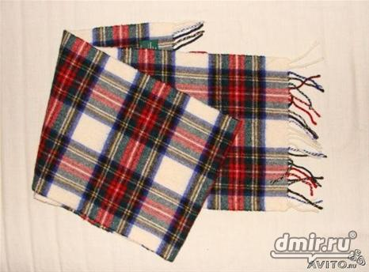
This is a tartan scarf from Scotland.

Slide 5
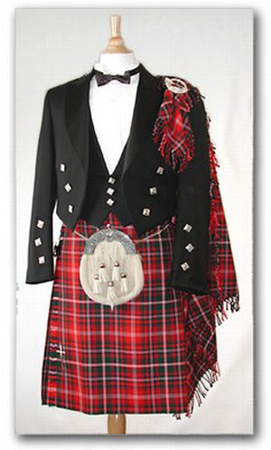
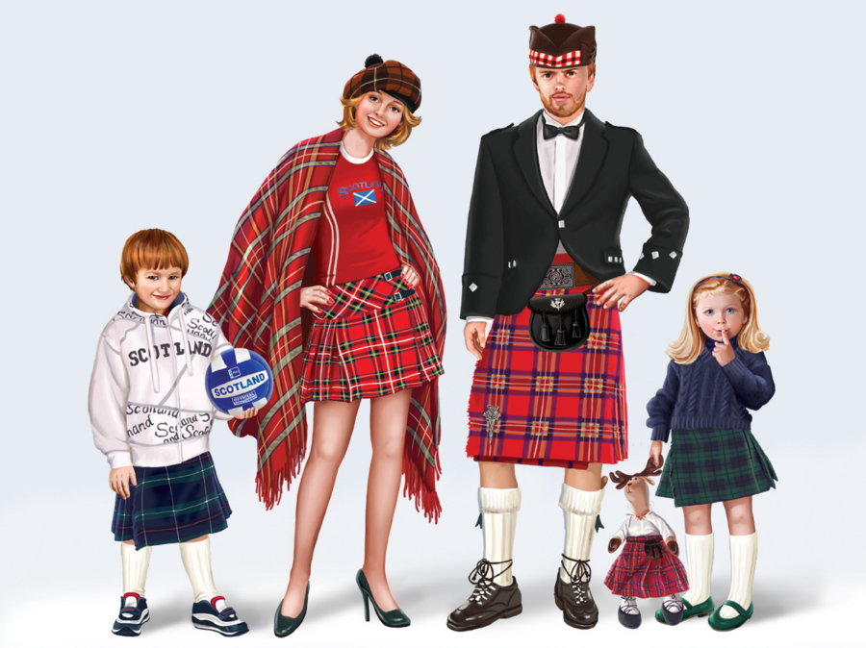
Tartan clothes is very popular in Scotland.

Slide 6
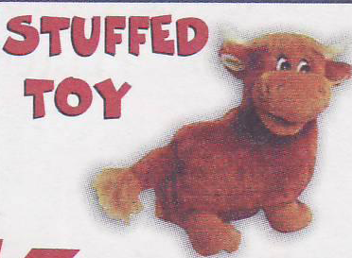
This is a stuffed toy. It looks like a cow.

Slide 7
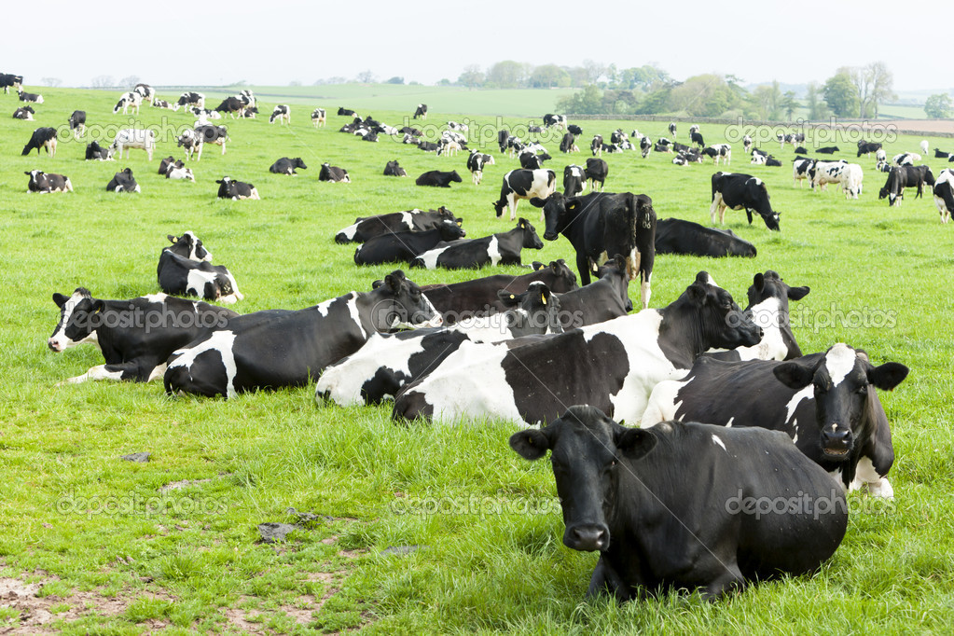
There are a lot of cows in Scotland

Slide 8
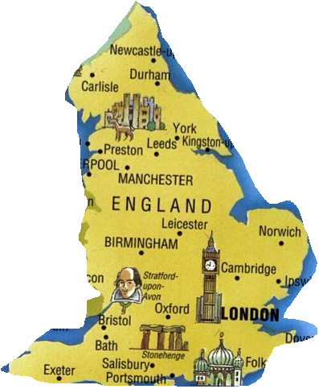
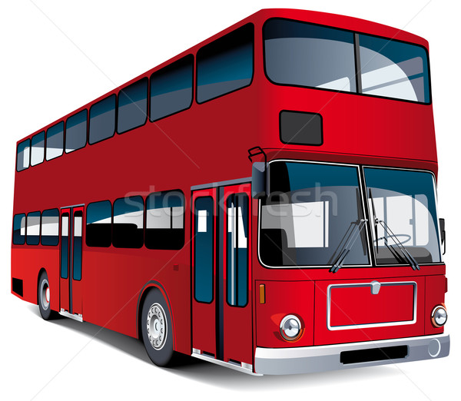
These are toy buses. They are double-decker buses.

Slide 9
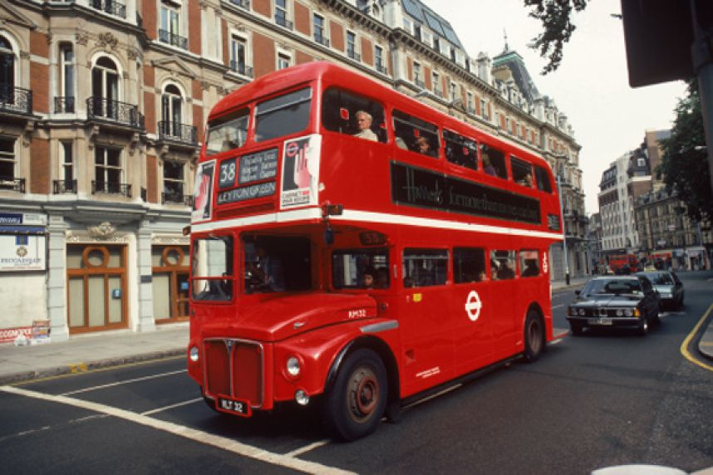
You can see them in London.

Slide 10
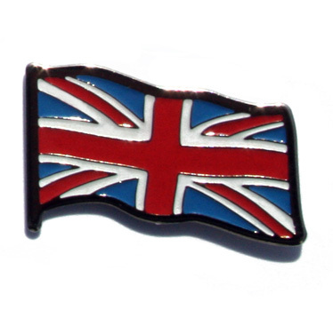
This is a pin. It has got a Union Jack on it. The Union Jack is the flag of the UK.
The Union Jack

Slide 11
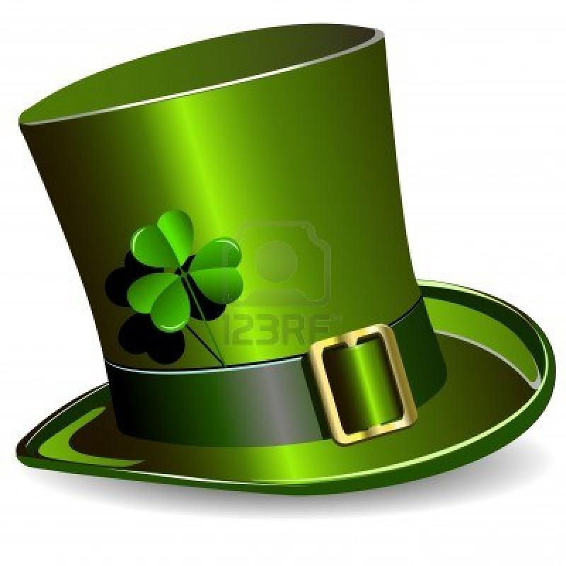
This is a hat. It has got shamrock on it.

Slide 12
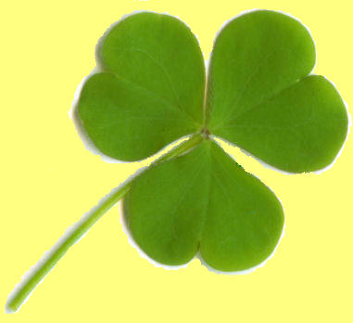
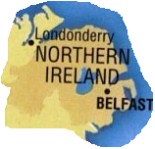
The shamrock is the symbol of Northern Ireland.

Slide 13
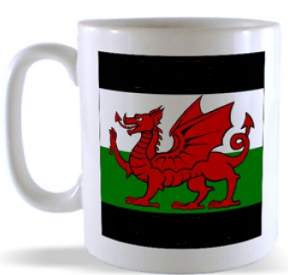
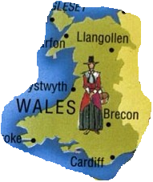
This is a mug. It has got a Welsh dragon on it.

Slide 14
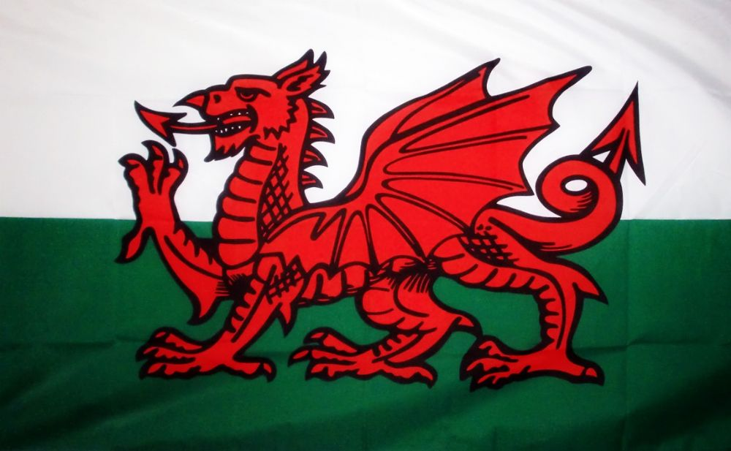
The Welsh dragon is on the flag of Wales.

Slide 15
Find the countries of the UK
X | T | H | M | O | U | S | W | B | O | F | H | J | R | H
F | G | E | N | G | L | A | N | D | R | N | H | S | D | W
Q | D | V | I | O | N | G | T | M | L | S | X | E | R | F
B | G | N | M | G | Y | S | I | E | H | C | C | N | U | K
O | N | O | R | T | H | E | R | N | X | O | S | N | K | R
Z | X | C | V | B | G | H | E | D | M | T | V | E | M | I
K | M | S | A | U | F | K | L | O | J | L | D | E | B | J
M | W | A | L | E | S | A | A | B | M | A | F | R | N | O
D | V | H | M | I | T | E | N | H | L | N | S | X | Z | V
G | E | H | L | O | P | Q | D | E | N | D | Y | J | O | L

Slide 16
Match the country and the nationality
The UK | Welsh
Northern Ireland | Scottish
England | British
Scotland | Irish
Wales | English

Slide 17
Match the country and the souvenir
HAT
PIN
Northern Ireland
Scotland
MUG
STUFFED TOYS
England
Double-decker bus
Wales
TARTAN

