Slide 1
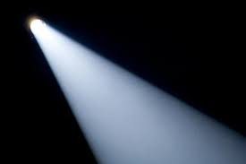
Let’s revise Spotlight 4
Govorova Alexandra Anatolevna

Slide 2
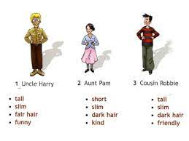
Uncle Harry is tall. He has got…

Slide 3
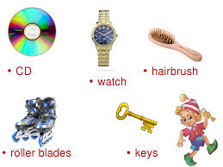
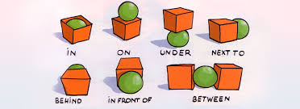
Where is my hairbrush?
It is on the table.

Slide 4
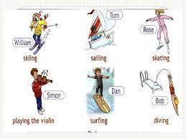
What is William doing?
He is skiing.

Slide 5
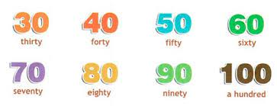
How old is your grandfather?
He is sixty-two.

Slide 6
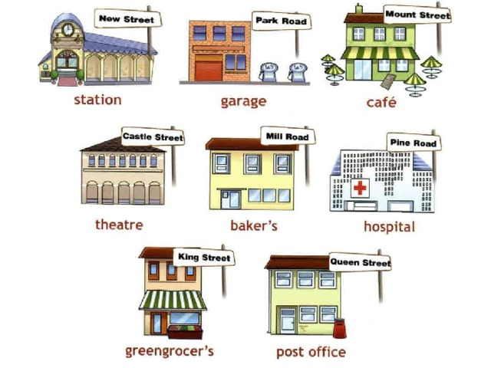
Where do people work?
At a hospital.

Slide 7
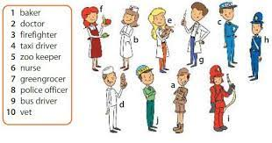
What do you do?
I am a doctor

Slide 8
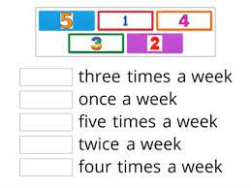
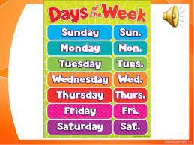
How often….?

Slide 9
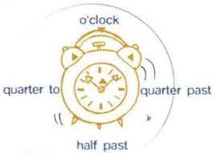
What time is it?
It is…….

Slide 10
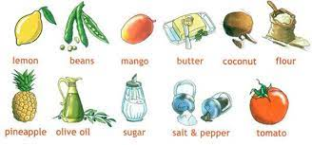
Pirates fruit salad
-Give me a mango, please.
-Here you are.

Slide 11

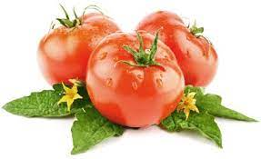
Much/Many
How many tomatoes are there?
How much olive oil is there?
A lot of/a lot…..

Slide 12
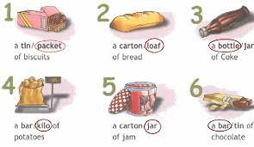
Make a meal of it

Slide 13
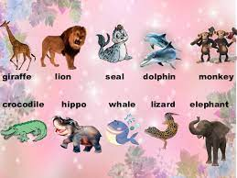
Funny animals

Slide 14
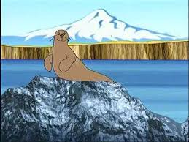
What is a seal doing?
It is clapping.
It always claps at lunch time.

Slide 15
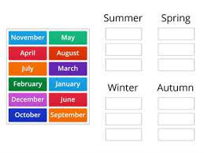
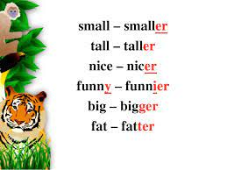
Months

Slide 16
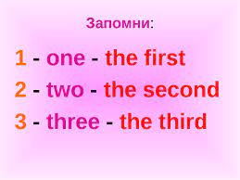
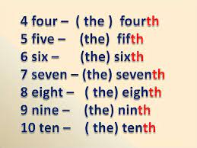
Remember!

Slide 17
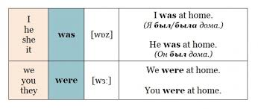
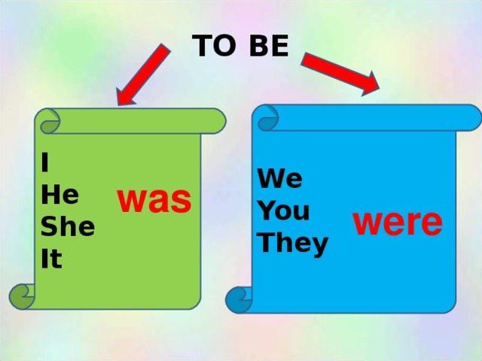
Past simple of the verb “to be”

Slide 18
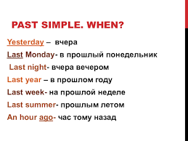
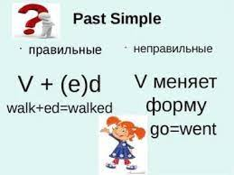
Past Simple
Did you go…….?
I didn’t go………

Slide 19
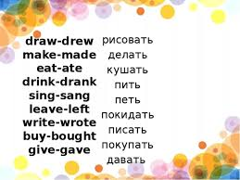
Irregular verbs
Come- came приходить
Win-won выигрывать
Meet-met встречать
Sleep-slept спать
Take-took брать
Swim-swam плавать

Slide 20
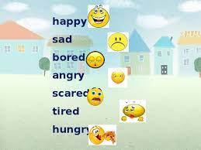
Emotions
I am hungry

Slide 21
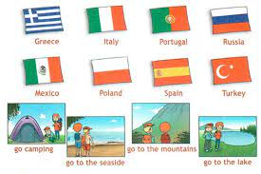
Where are you going to go on holiday?
I am going to go to Australia

Slide 22
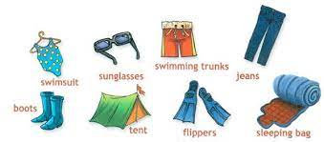
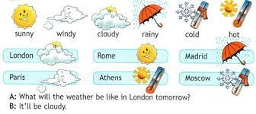
It will be sunny tomorrow. It won’t be cold.
I am going to take…..

Slide 23
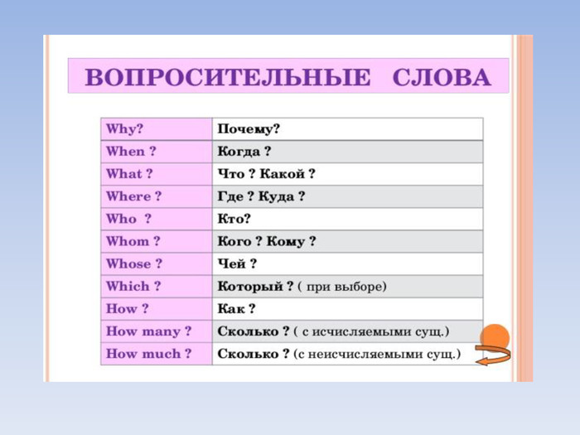
Question words

Slide 24

Good bye
Thank you for your attention.

