Slide 1
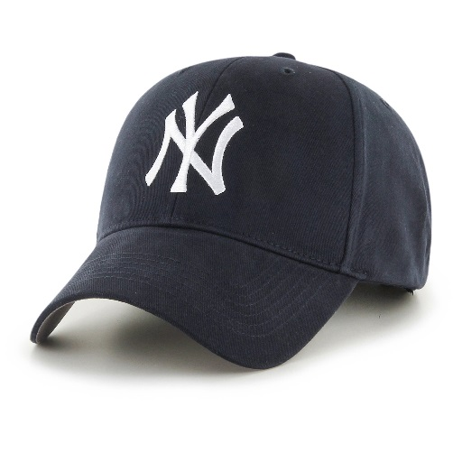
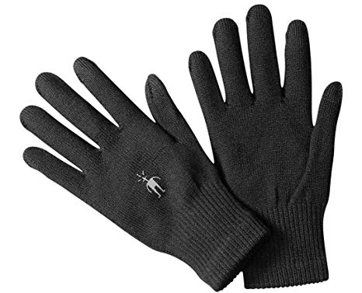
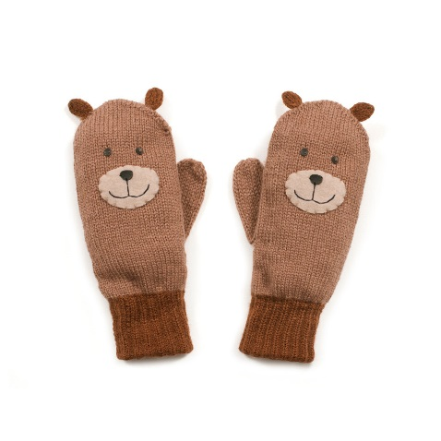
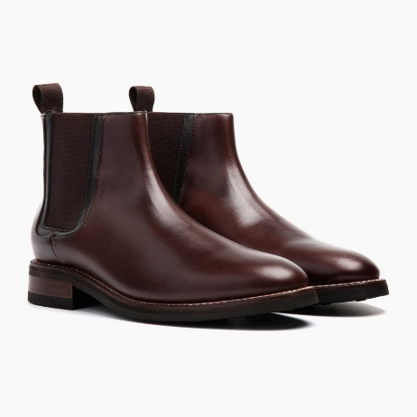
ppShoing rof clstheo
-It is my size.
-How much is it?
-I like blue dresses.

Slide 2
Shopping for clothes
-It is my size.
-How much is it?
-I like blue dresses.

Slide 3
Sh - shop, short, shoe, shirt, T-shirt, fashion, cushion.

Slide 4
Check:
T-shirt
shorts
a dress
a skirt
jeans
mittens
a hat
socks
boots
shoes
…

Slide 5
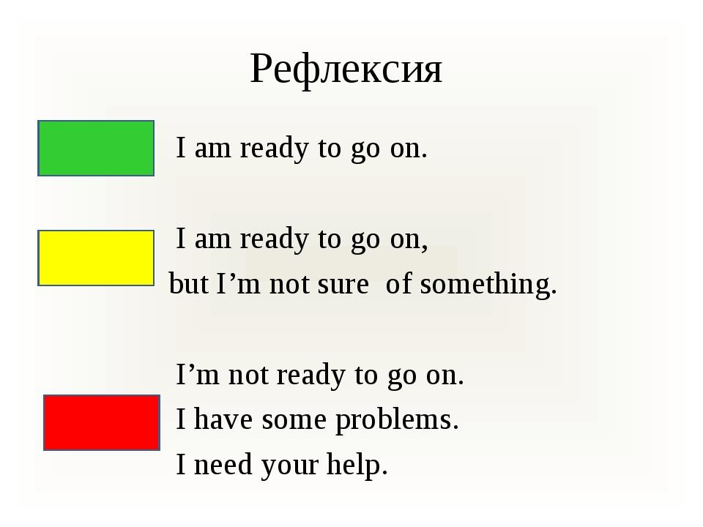

Slide 6
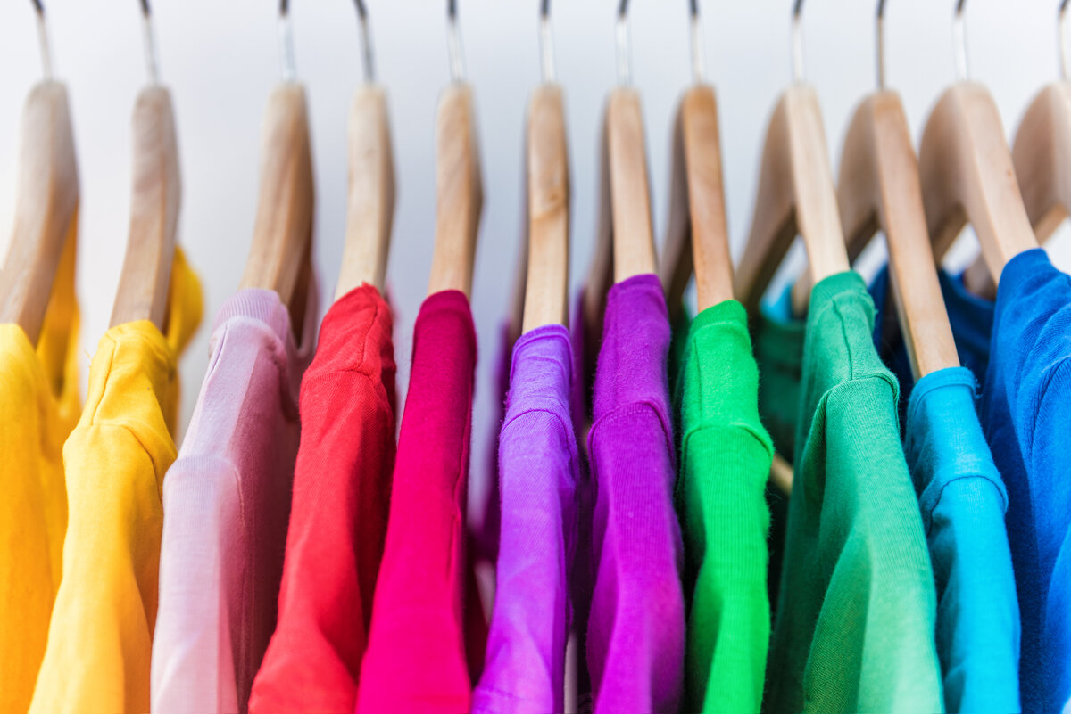
Thank you for your work!
Good bye!

