Slide 1
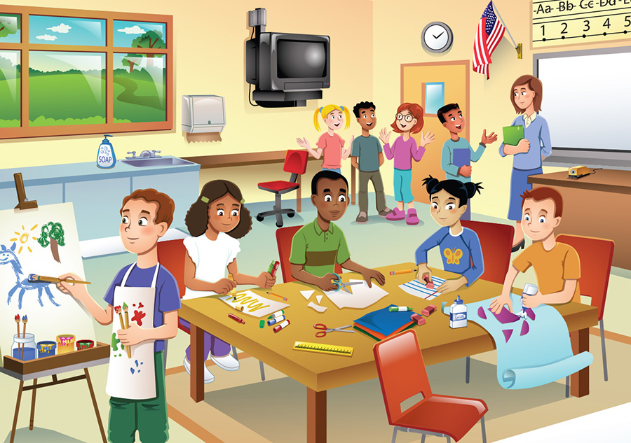
Fun Time
Составитель: учитель английского языка Мукриева М.И

Slide 2
Цели и задачи:
1) закрепление лексики и грамматики по темам «Мои друзья», «Мой дом»;
2)воспитание дружелюбное отношение друг другу и умение работать в команде;
3)развитие навыков внимания и памяти

Slide 3
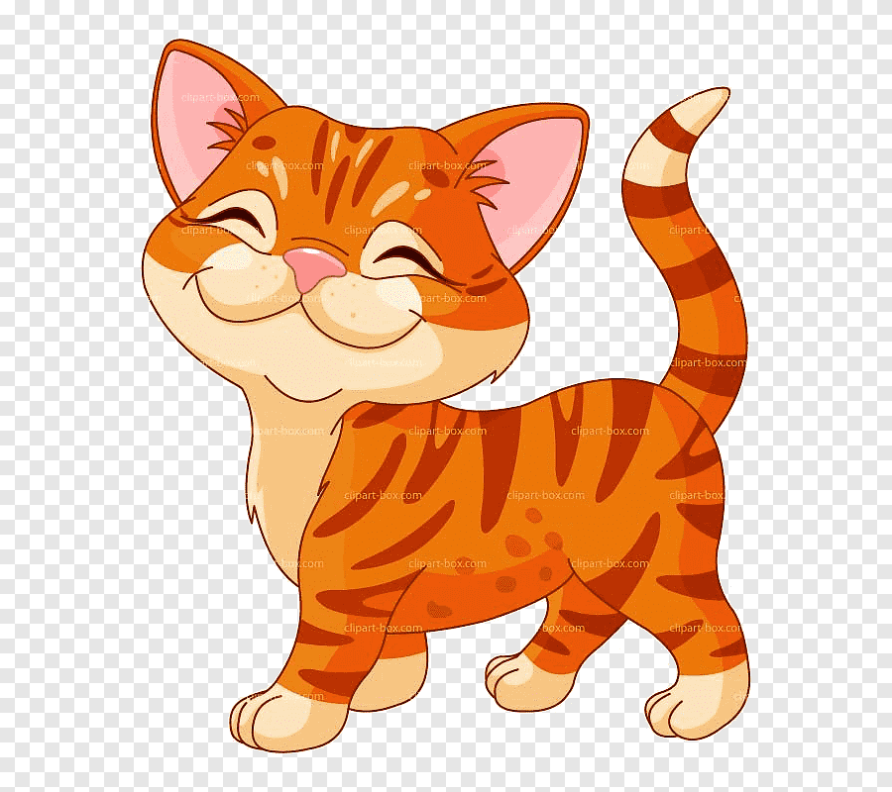
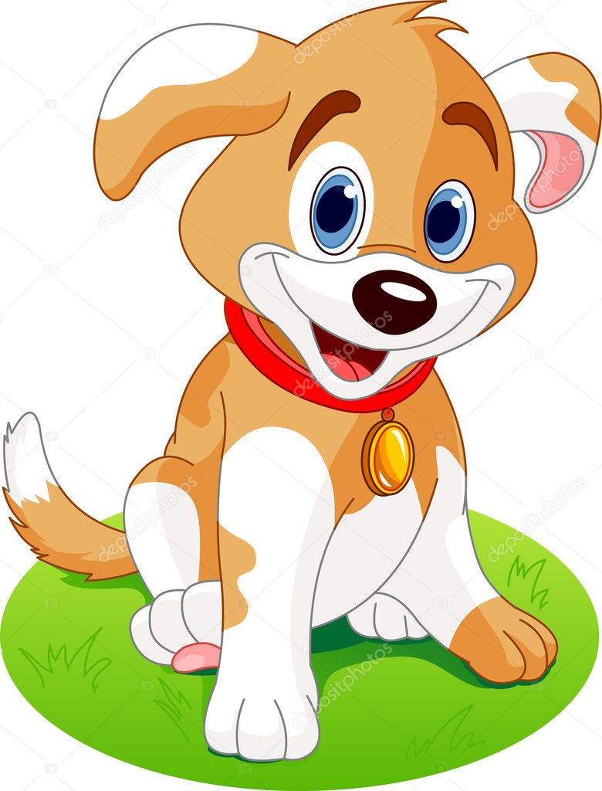
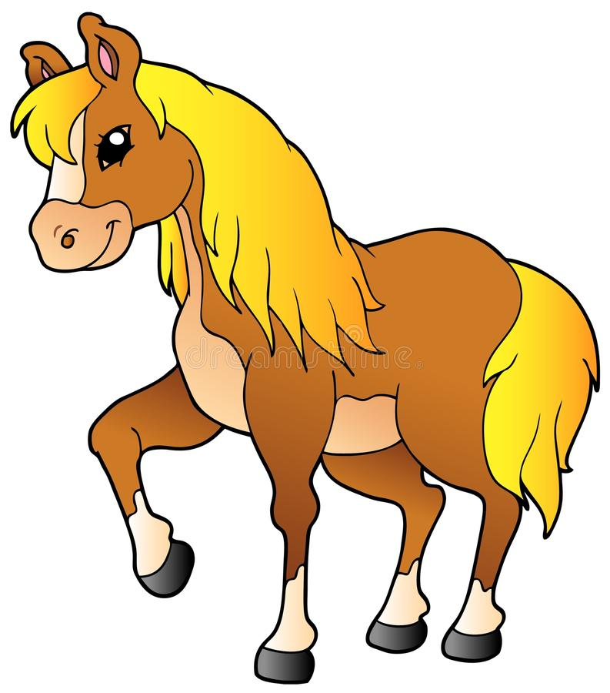
Groups

Slide 4
ABC
Rr, Ll,Vv, Gg, Oo, Pp, Aa, Ss, Cc, Ii.
Keys:
Aa,Cc, Gg, Ii, Ll, Oo, Pp, Rr, Ss, Vv.

Slide 5
Команда 1: [n] [m] [k] [ᴧ] [ᴂ] [ʊ] [t] [h] [ə] [ʃ] [ɪ] [g]
Команда 2: [r] [ɜ] [l] [d] [s] [v] [ᴐ] [ᴜ] [w] [f] [g] [ᴂ]
Команда 3 : [m] [ᴧ] [ᴂ] [t] [h] [ɪ] [r] [s] [ᴐ] [w] [f] [g]

Slide 6
Guess words
1) o m o e b r d
2) m t b a o r h o
3) c n i t e k h
4) a r e n g d

Slide 7
Keys
1) bedroom
2) bathroom
3) kitchen
4) garden

Slide 8
Заполни пропуски буквосочетаниями ow, ou, ir, er.
m____se, c_____, b______d, h______se, fl____er, cl___n, g_______l, t_____n, sh_____t, h___

Slide 9
Ответы:
ow, ou, ir, er.
mouse, cow, bird, house, flower, clown, girl, town,
shout, hir

Slide 10
Hапишите перевод
Я -
Ты -
Он -
Она -
Он, она, оно-
Мы -
Вы -
Oни -

Slide 11
Keys
Я - I
Ты - You
Он - He
Она - She
Он, она, оно- It
Мы - We
Вы - You
Oни - They

Slide 12
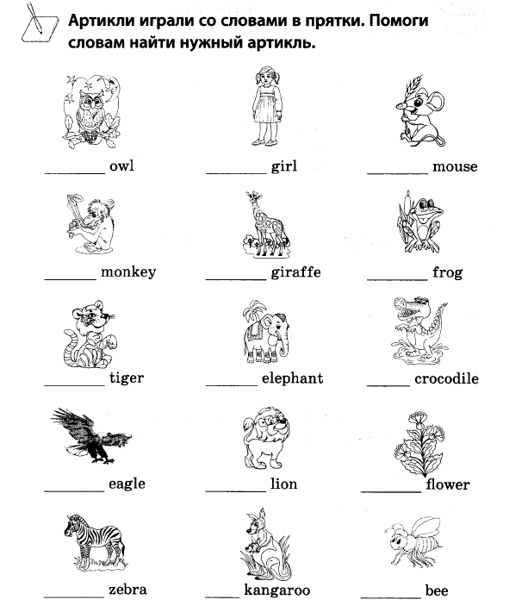

Slide 13
Правильно расшифруйте предложения.
Команда 1 OnetwothreeIlikecatsandcatslikeme.
Команда 2 OnetwothreeIlikedogsanddogslikeme.
Команда 3 OnetwothreeIlikehorsesandhorseslikeme.

Slide 14
Keys
Команда 1 One two three I like cats and cats like me.
Команда 2 One two three I like dogs and dogs like me.
Команда 3 One two three I like horses and horses like me.

Slide 15
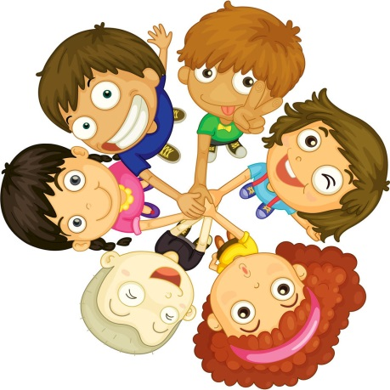
The best reader
Команда 1:
The frog is green, green and green.
And so is the tree. One, two, three.
Red, red, red the rose.
Blue, blue, blue the dress.
Grey, grey, grey the rat.
And so is the cat

Slide 16

Команда 2:
Sally, Sally, tell me true
Sally, Sally, who are you?
I am a little girl.
Billy, Billy, tell me true
Billy, Billy, who are you?
I am a little boy.

Slide 17

Команда 3:
I have got a dog,
His name is Jack.
His head is white,
His nose is black.
I take him out
Every day.
Such fun we have!
We run and play.

Slide 18
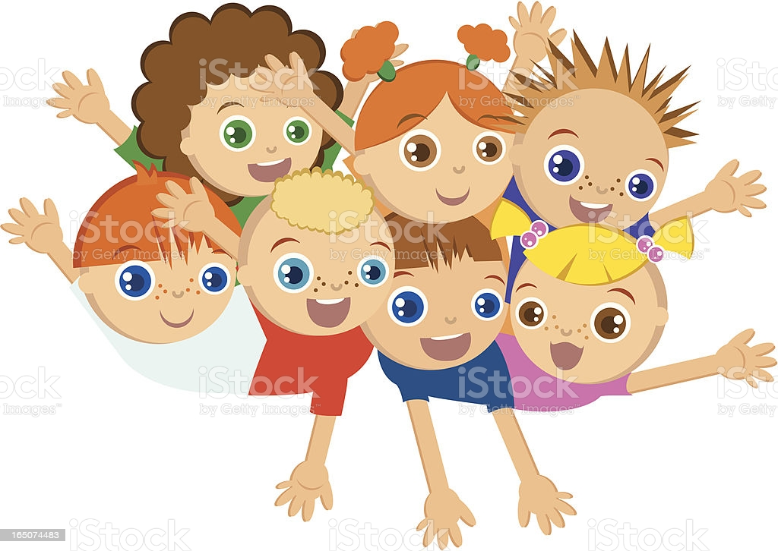
The best translator

Slide 19
Команда 1: Hello. My name is Maxim. I’m from Russia. This is my family. This is my mummy and daddy. Their names are Andrei and Natalia . This is my little brother, Vlad . This is our dog, Rex. He’s so funny! This is our house. I like our house! It’s lovely!

Slide 20
Команда 2: This is Karen. She is from Great Britain. She is six years old. Look at Karen’s family. This is Karen’s daddy. His name is Tom. This is Karen’s mummy. Her name is Rose. This is Karen’s brother. His name is Harry. Look at their house. It’s lovely!

Slide 21
Команда 3: Hello! I’m Isabel. I’m from Mexico. Meet my family. This is my mummy and daddy. Their names are Dora and Carlos. This is my little brother. His name is Pedro. Look at our lovely house!

Slide 22

Thank you for the attention

