Slide 1
ENVIRONMENTAL PROBLEMS

Slide 2
Complete the sentences with the words from the chart.
wasting | endangered | reduce | extinct | protect
rainforests | survive | consumes | habitat | advertised
He ___________________ too much sugar.
How can we ___________________ our environment?
People should stop ___________________ natural resources.
Deforestation doesn’t give chances to wildlife species to ___________________.
The Tasmanian tiger became ___________________ in 1936.

Slide 3
Complete the sentences with the words from the chart.
wasting | endangered | reduce | extinct | protect
rainforests | survive |  | habitat | advertised
He consumes too much sugar.
How can we ___________________ our environment?
People should stop ___________________ natural resources.
Deforestation doesn’t give chances to wildlife species to ___________________.
The Tasmanian tiger became ___________________ in 1936.

Slide 4
Complete the sentences with the words from the chart.
wasting | endangered | reduce | extinct
rainforests | survive |  | habitat | advertised
He consumes too much sugar.
How can we protect our environment?
People should stop ___________________ natural resources.
Deforestation doesn’t give chances to wildlife species to ___________________.
The Tasmanian tiger became ___________________ in 1936.

Slide 5
Complete the sentences with the words from the chart.
 | endangered | reduce | extinct
rainforests | survive |  | habitat | advertised
He consumes too much sugar.
How can we protect our environment?
People should stop wasting natural resources.
Deforestation doesn’t give chances to wildlife species to ___________________.
The Tasmanian tiger became ___________________ in 1936.

Slide 6
Complete the sentences with the words from the chart.
 | endangered | reduce | extinct
rainforests |  |  | habitat | advertised
He consumes too much sugar.
How can we protect our environment?
People should stop wasting natural resources.
Deforestation doesn’t give chances to wildlife species to survive.
The Tasmanian tiger became ___________________ in 1936.

Slide 7
Complete the sentences with the words from the chart.
 | endangered | reduce
rainforests |  |  | habitat | advertised
He consumes too much sugar.
How can we protect our environment?
People should stop wasting natural resources.
Deforestation doesn’t give chances to wildlife species to survive.
The Tasmanian tiger became extinct in 1936.

Slide 8
Complete the sentences with the words from the chart.
 | endangered | reduce
rainforests |  |  | habitat | advertised
6. Many wild animals are ___________________ because of pollution.
7. The concert was ___________________ all over the city.
8. ___________________ are important environmental areas and many people want them to be protected.
9. Pollution endangers wildlife ___________________.
10. I want to ___________________ the consumption of meat to the minimum.

Slide 9
Complete the sentences with the words from the chart.
 |  | reduce
rainforests |  |  | habitat | advertised
6. Many wild animals are endangered because of pollution.
7. The concert was ___________________ all over the city.
8. ___________________ are important environmental areas and many people want them to be protected.
9. Pollution endangers wildlife ___________________.
10. I want to ___________________ the consumption of meat to the minimum.

Slide 10
Complete the sentences with the words from the chart.
 |  | reduce
rainforests |  |  | habitat
6. Many wild animals are endangered because of pollution.
7. The concert was advertised all over the city.
8. ___________________ are important environmental areas and many people want them to be protected.
9. Pollution endangers wildlife ___________________.
10. I want to ___________________ the consumption of meat to the minimum.

Slide 11
Complete the sentences with the words from the chart.
 |  | reduce
 |  |  | habitat
6. Many wild animals are endangered because of pollution.
7. The concert was advertised all over the city.
8. Rainforests are important environmental areas and many people want them to be protected.
9. Pollution endangers wildlife ___________________.
10. I want to ___________________ the consumption of meat to the minimum.

Slide 12
Complete the sentences with the words from the chart.
 |  | reduce
6. Many wild animals are endangered because of pollution.
7. The concert was advertised all over the city.
8. Rainforests are important environmental areas and many people want them to be protected.
9. Pollution endangers wildlife habitat.
10. I want to ___________________ the consumption of meat to the minimum.

Slide 13
Complete the sentences with the words from the chart.
6. Many wild animals are endangered because of pollution.
7. The concert was advertised all over the city.
8. Rainforests are important environmental areas and many people want them to be protected.
9. Pollution endangers wildlife habitat.
10. I want to reduce the consumption of meat to the minimum.

Slide 14
GLOBAL PROBLEMS
ACID RAIN
DEFORESTATION
FLOODING
POLLUTION
RUBBISH
Trees are very important for global health. They are part of our ecosystem, they give us different materials and resources, they are homes to the wild world of plants and animals. They make air clean and they are so beautiful. However, people are quickly cutting down forests for different reasons.

Slide 15
GLOBAL PROBLEMS
ACID RAIN
DEFORESTATION
FLOODING
POLLUTION
RUBBISH
Big cities make about a ton of it for each family each year. To fight with wastes new technologies and strict rules are introduced. For example, people should throw their waste into differently coloured bins - for paper, glass, plastic. Second-hand things are specially collected and are reused by poorer people.

Slide 16
GLOBAL PROBLEMS
ACID RAIN
DEFORESTATION
FLOODING
POLLUTION
RUBBISH
It is one of the most serious pollution problems. What happens is this. First, factories sent gases into the air. There they mix and are carried away for hundreds of miles by the wind. Finally, they fall back to the earth when it rains or snows. When it happens, it pollutes thousands of lakes and rivers, killing fish and other wildlife. It can also destroy forests and land.

Slide 17
GLOBAL PROBLEMS
ACID RAIN
DEFORESTATION
FLOODING
POLLUTION
RUBBISH
It happens when water cannot disappear or dry fast enough in rivers or after heavy rains. It often happens after winter. For example, in Siberia snow turns into water while rivers are still under ice.

Slide 18
GLOBAL PROBLEMS
ACID RAIN
DEFORESTATION
FLOODING
POLLUTION
RUBBISH
We give this name to waste products that get into the air, water, land and they can’t be broken quickly by natural process. It harms the health of plants, animals, people. To make it less dangerous governments make laws to protect the environment — we need all to keep our environment clean and healthy.

Slide 19
GLOBAL PROBLEMS
What do we need trees for?
How can people fight with wastes?
How does acid rain happen?
Why are acid rains dangerous?
How does flooding happen?
Why is pollution dangerous?

Slide 20

GREEN LIVING TIPS
RECYCLED
RECLAIMED
UP-CYCLED
CRADLE-TO-CRADLE
products are designed to be returned to the manufacturer and made into a new thing.
products are made from different materials thrown into a recycling box.
high-quality products are made from lower-quality goods.
products are made from old materials.

Slide 21
GREEN LIVING TIPS
FALSE
It is easy to be eco-friendly.
Recycling often results in lower quality goods.
Reclaimed products are made from new materials.
“Up-cycling” helps keeping material in use.
According to cradle-to-cradle idea the life and afterlive of products aren’t planned from beginning to end.
TRUE
FALSE
TRUE
FALSE

Slide 22


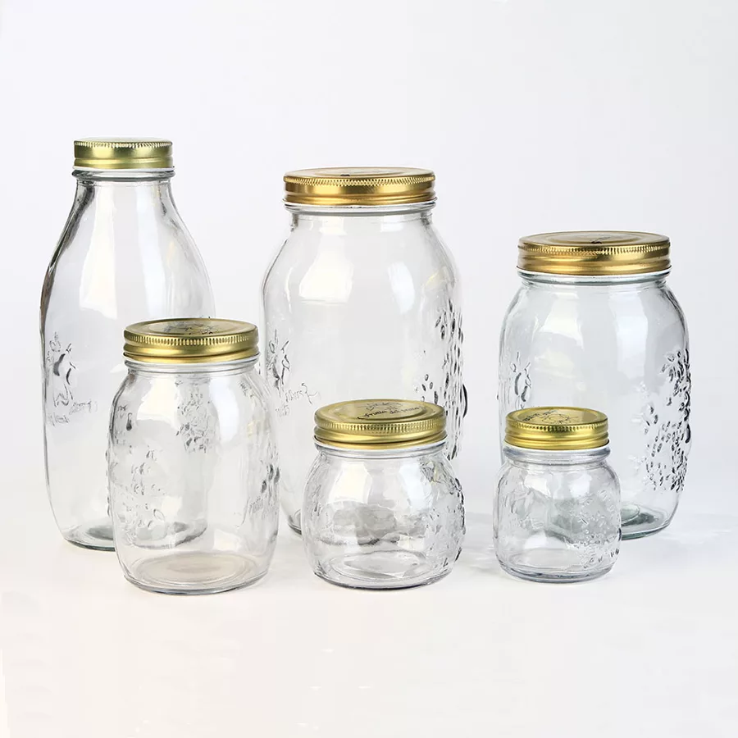
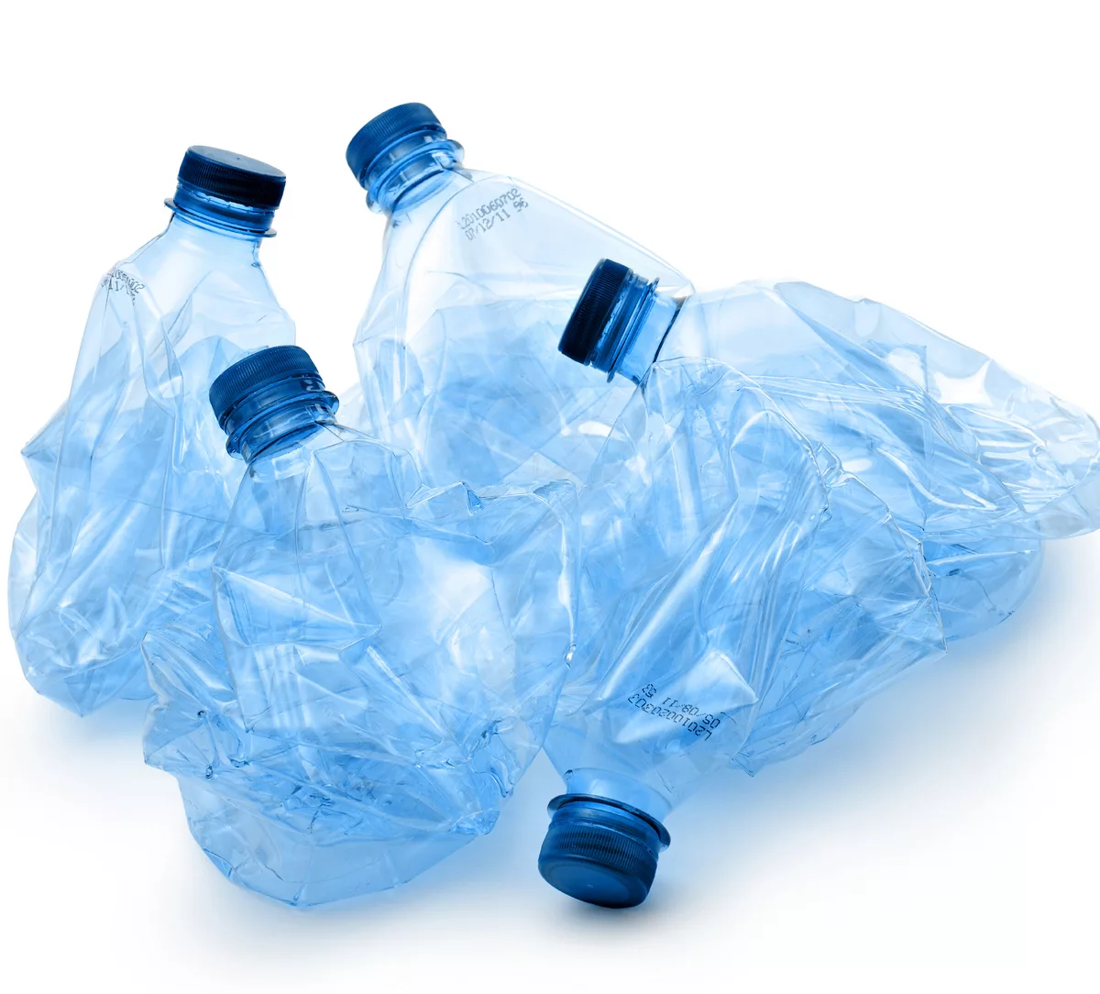
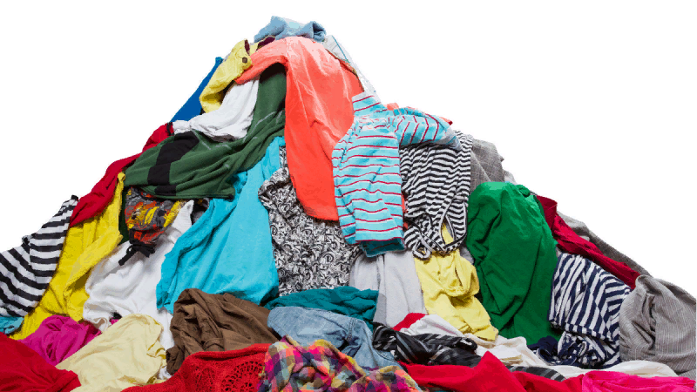
3R – REDUCE, REUSE, RECYCLE
to make something smaller or less in size, importance | to use something again for a different purpose | to treat waste materials so that they can be used again

Slide 23
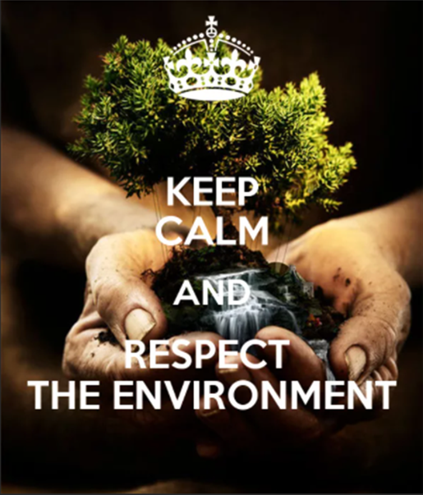
HOMETASK
Choose any ecological problem and describe it according to the plan. Write 100-120 words:
What is the problem?
What does it lead to?
What can people do to solve this problem?

Slide 24


