Slide 1
My Favourite Food!
Моя любимая еда!
План-конспект урока составлен учителем английского языка
МОУ СОШ № 29
Л.А.Петросян

Slide 2
The Poem
That is Sue. She is two.
That is Joe. He is four.
This is Kate. She is eight.
That is Ben. He is ten.

Slide 3

Угадай слово
O 2 | O 3 | F 1 | D 4

Slide 4
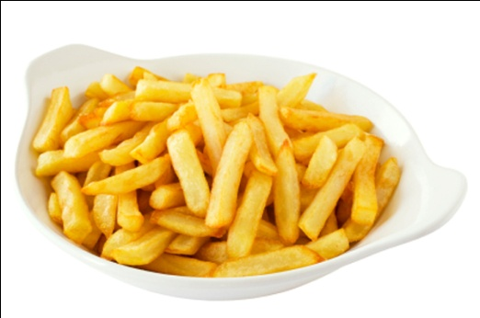
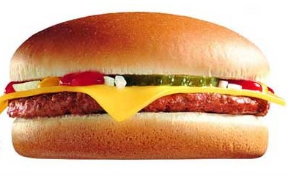
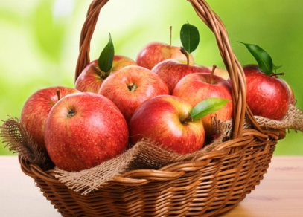
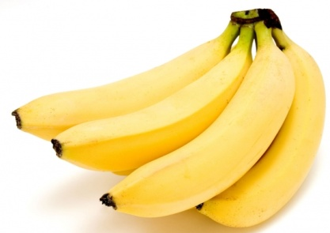
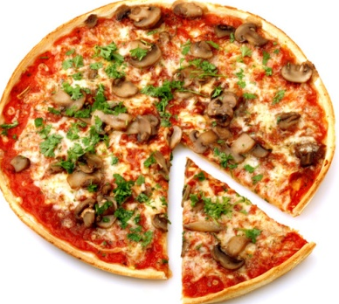
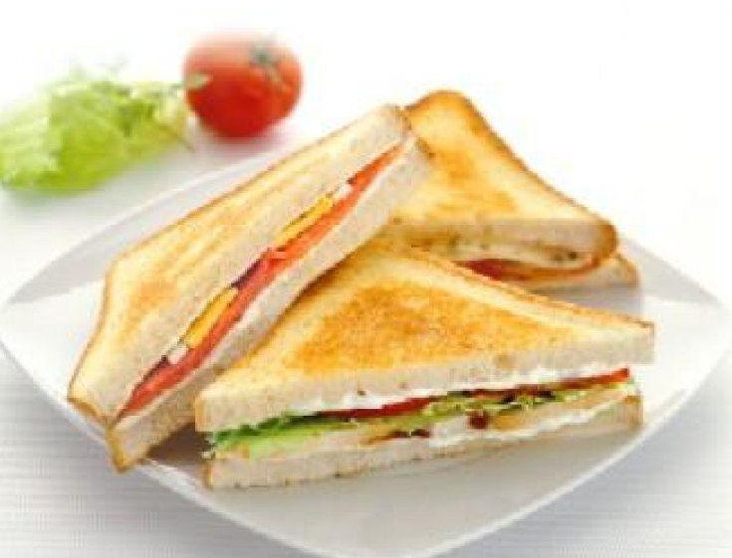

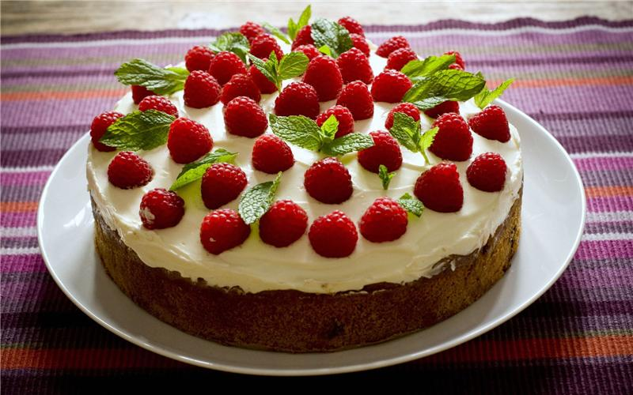
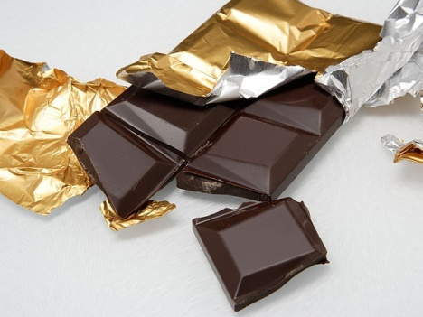
Food
Read and translate
Burgers Chips
Apples Bananas Pizza
Sandwiches Milk
Cake Chocolate

Slide 5
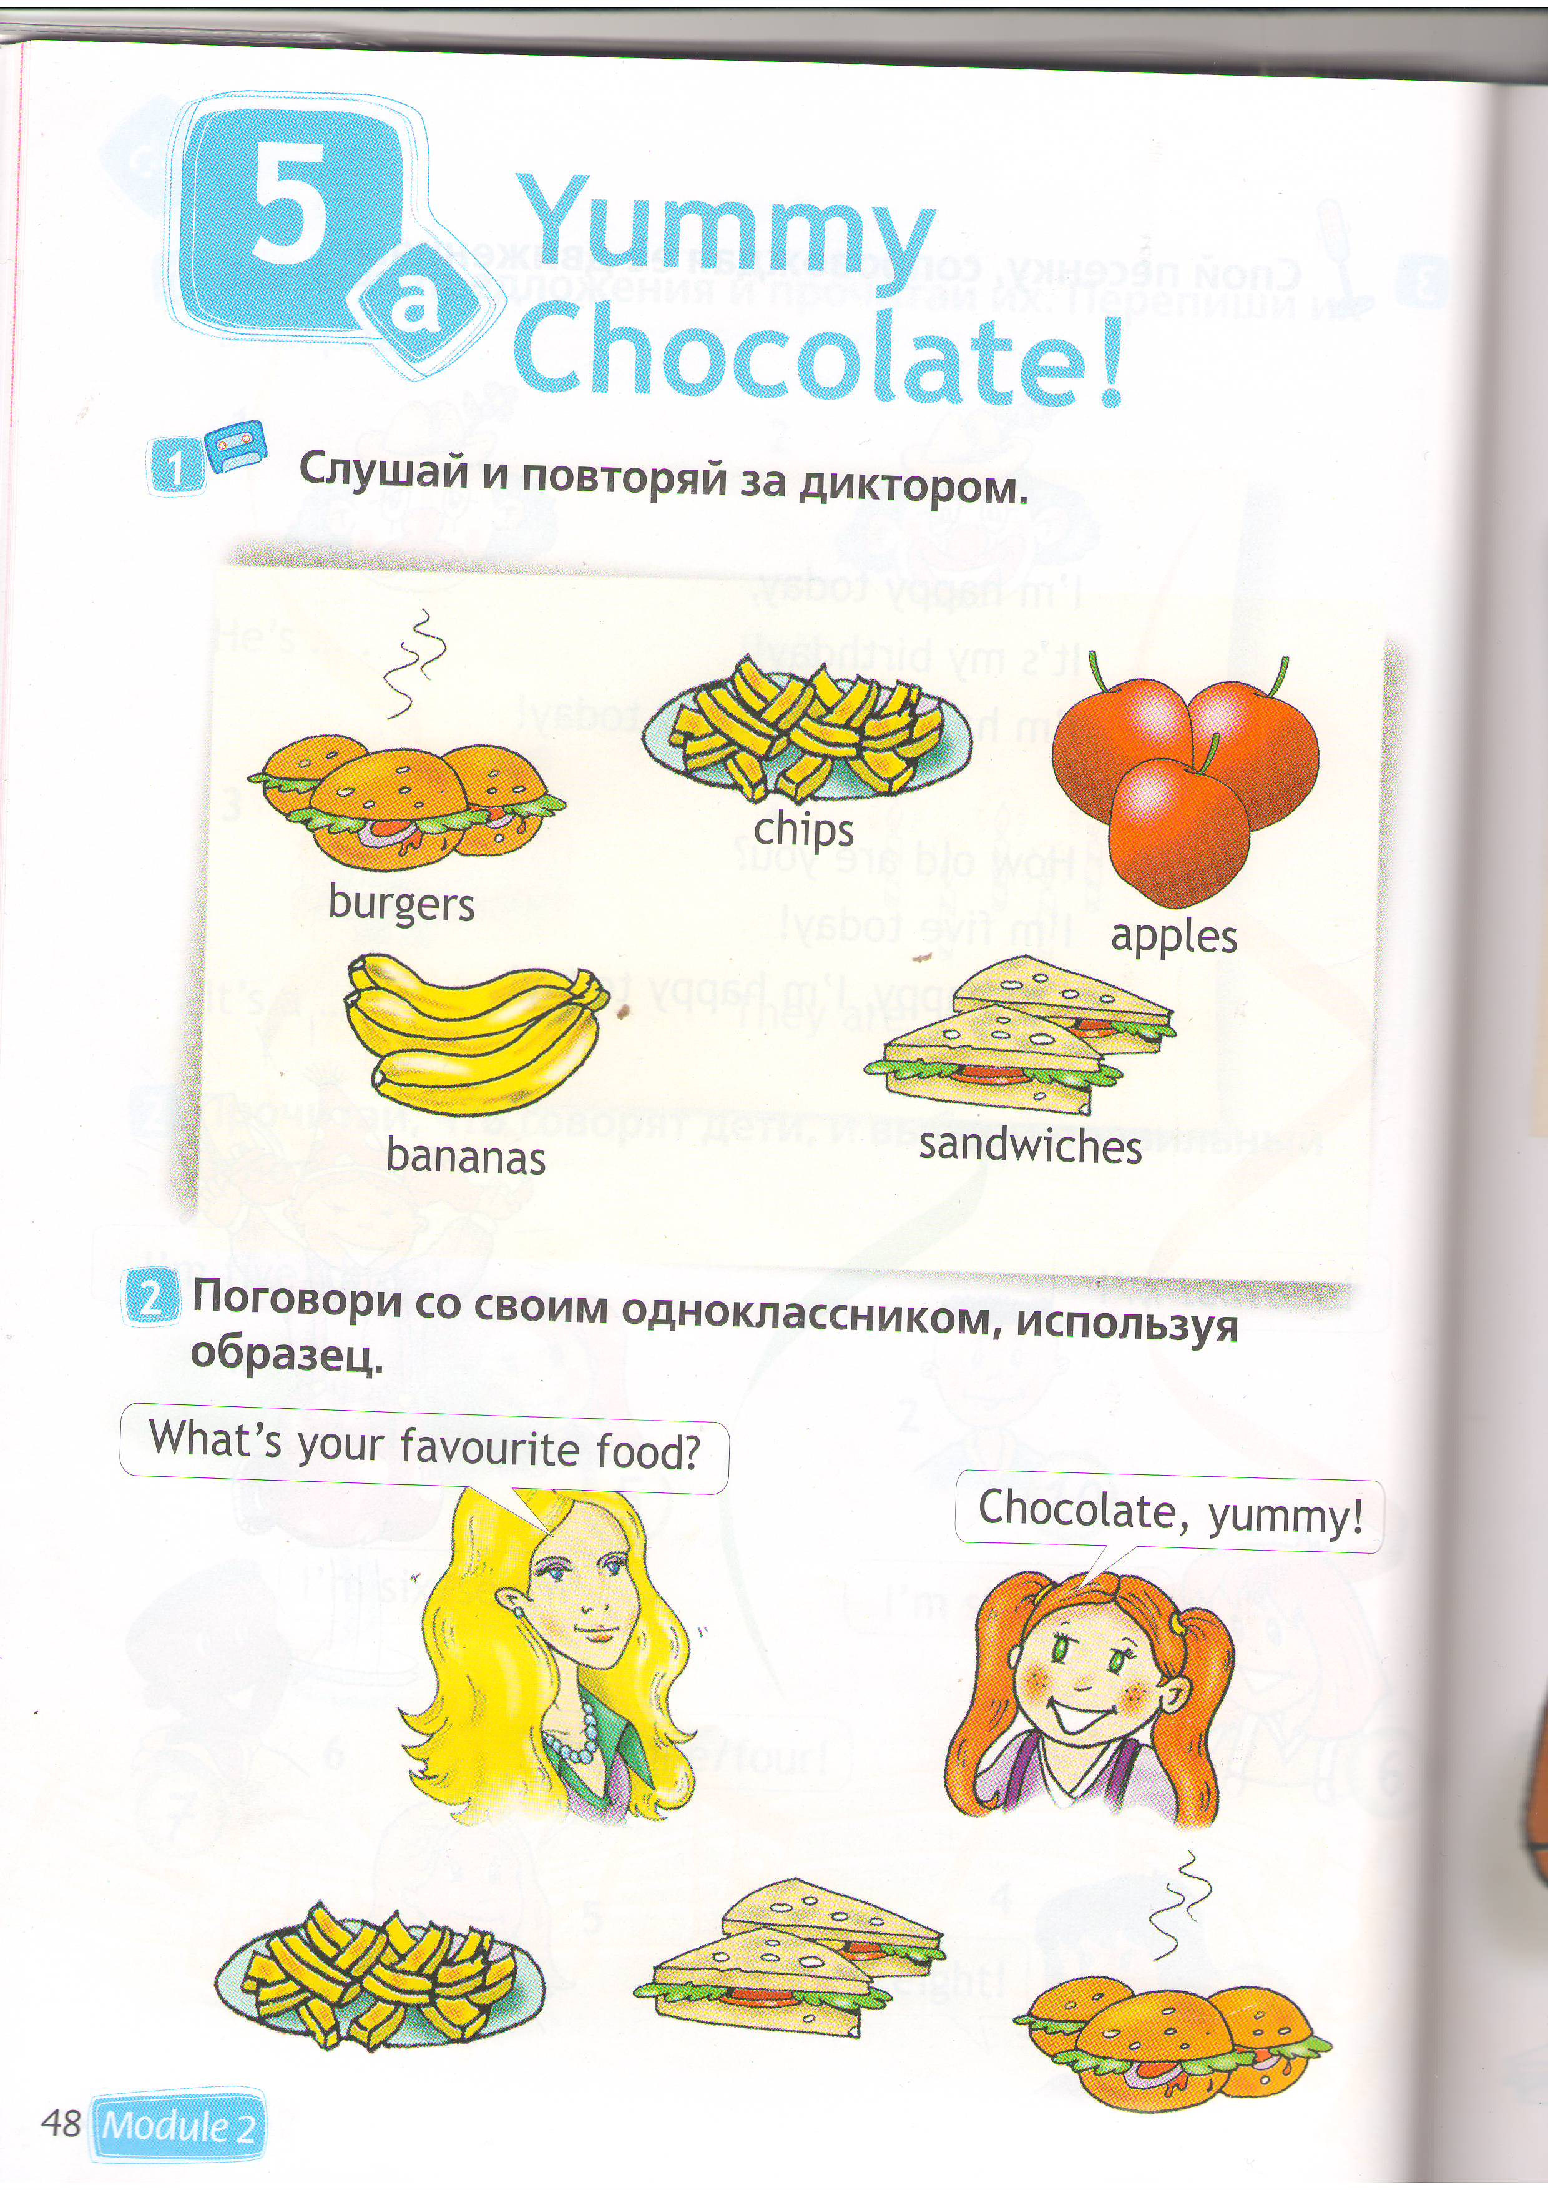
- What’s your favourite food?
- Pizza, yummy!

Slide 6
Answer the questions
- How many burgers are there?
- How many bananas are there?
- How many apples are there?
- How many pizzas are there?
- And chocolate?

Slide 7
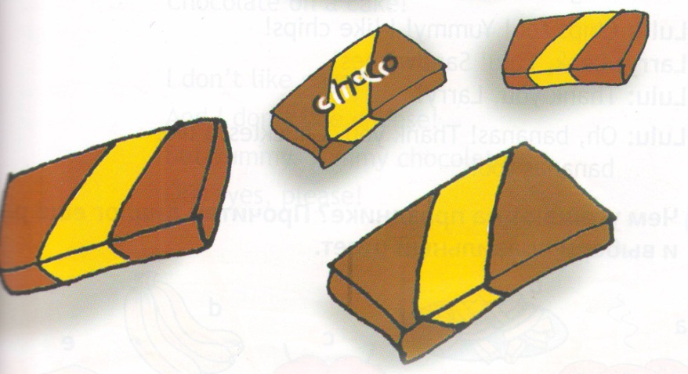

Let’s sing!
One, two, three, four,
Yummy chocolate,
Give me more!
Five, six, seven, eight,
My favourite food
Is CHOCOLATE!

Slide 8
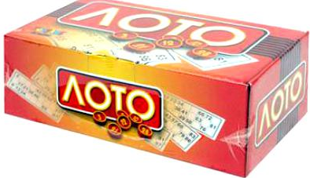

Let’s play!

Slide 9
Множественное число
1 burger - 2 burgers
1 apple – 3 apples
1 bird – 4 birds
1 bed - 5 beds

Slide 10
Образуйте множественное число
One radio ------ (3)________
One candle------(9)_________
One bird-------(7)_________
One garden----(8)________
One apple-----(6)_________
One banana-----(4)________
One burger------(2)________
One table-------(5)________

Slide 11
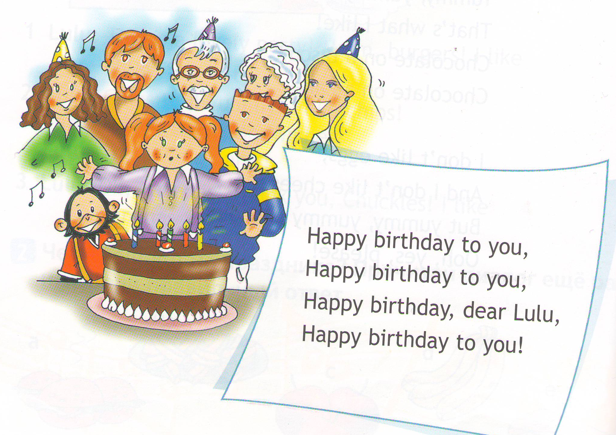
Happy birthday to you!

Slide 12
HOMEWORK
Рабочая тетрадь №1,2 с 26.

Slide 13


