Slide 1
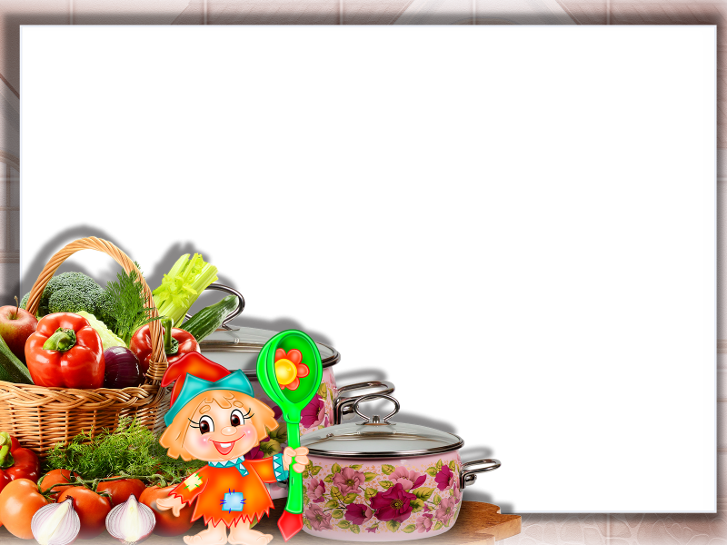
Муниципальное автономное образовательное учреждение «Средняя общеобразовательная школа №1» г.Когалым
“Master chef”
Spotlight-5
Module 8b
The presentation by
English teacher Valeyeva S. I.

Slide 2
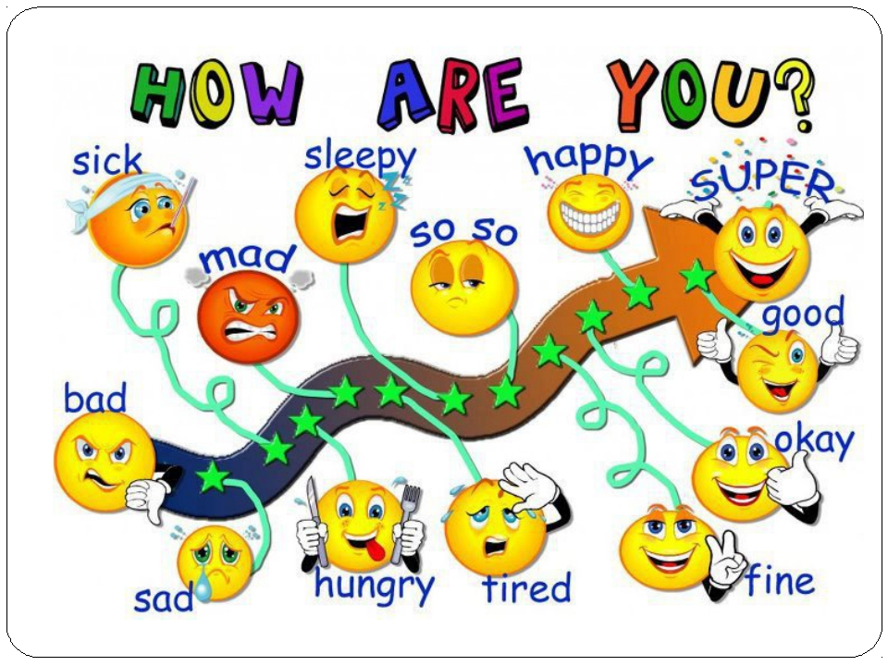

Slide 3
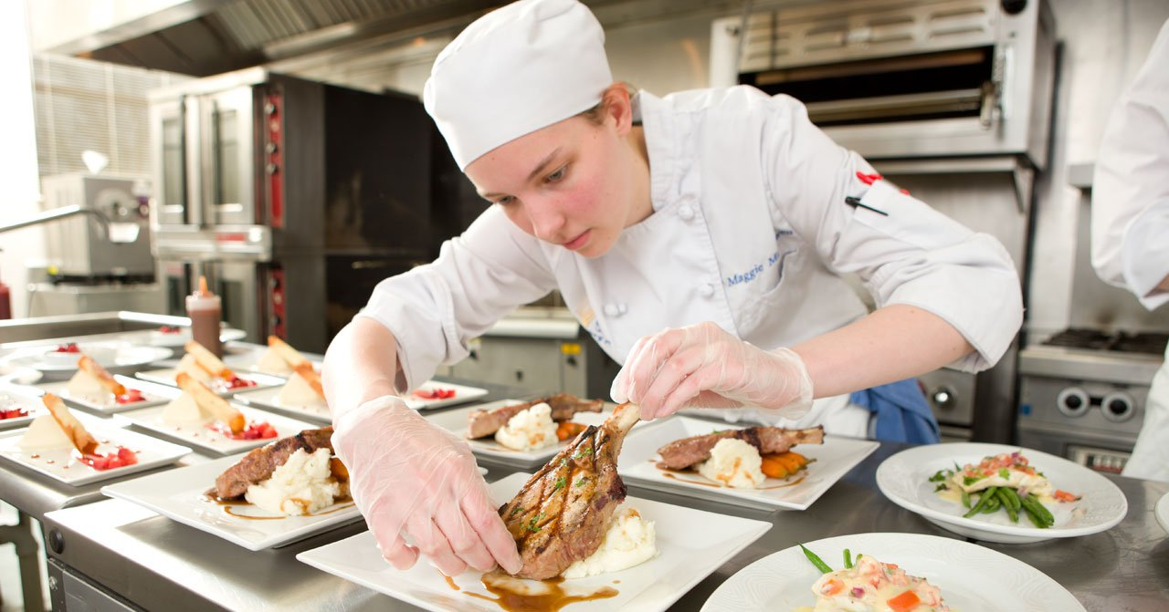

Slide 4
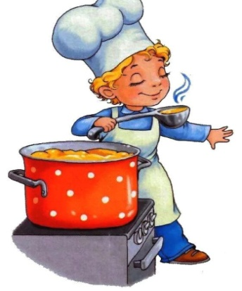
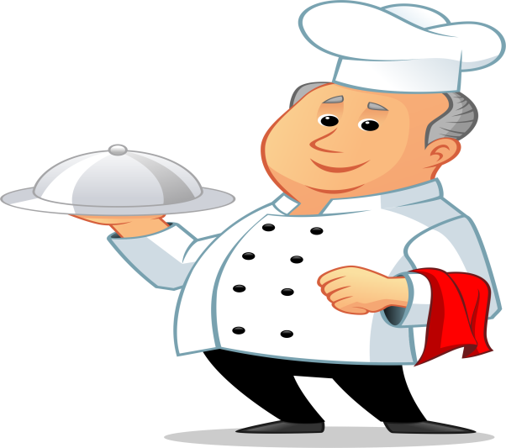
Фонетическая зарядка
How many cookies could a good cook cook
If good cook could
cook cookies?
A good cook could cook as many cookies
As a good cook
who could cook cookies

Slide 5
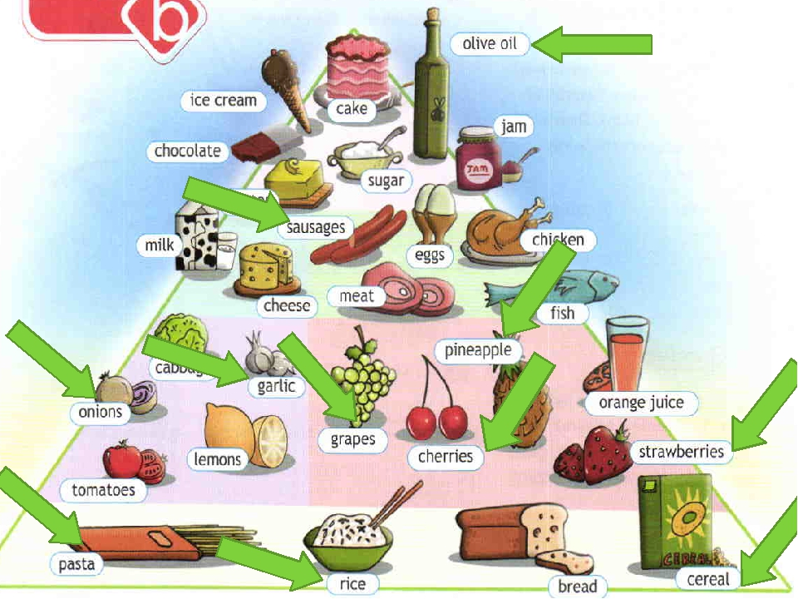
1.I eat/drink/…for breakfast/lunch/dinner
2.I like cherries , but I don’t like grapes
Really ? I like …

Slide 6
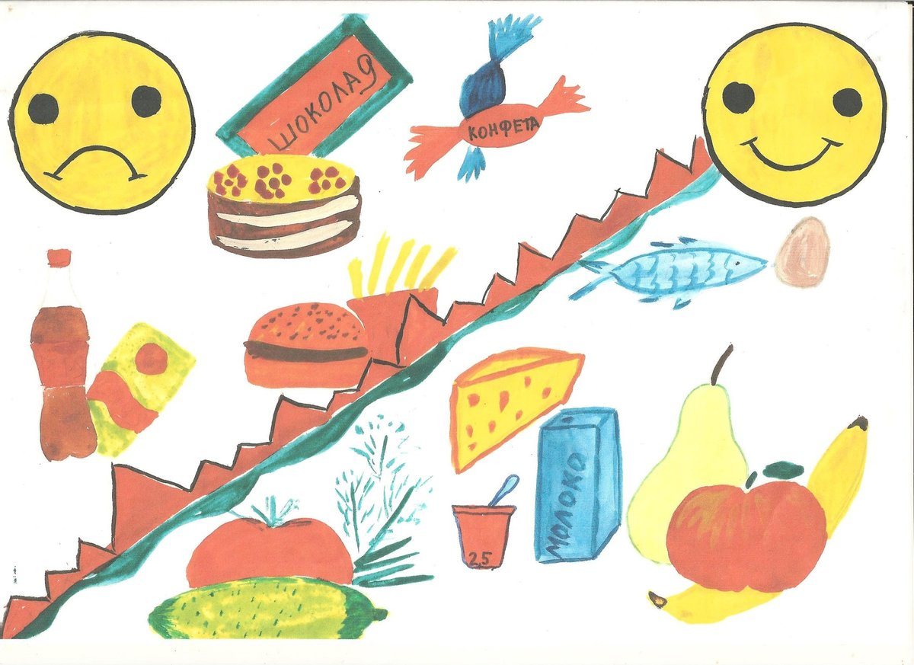
Healthy /Unhealthy

Slide 7
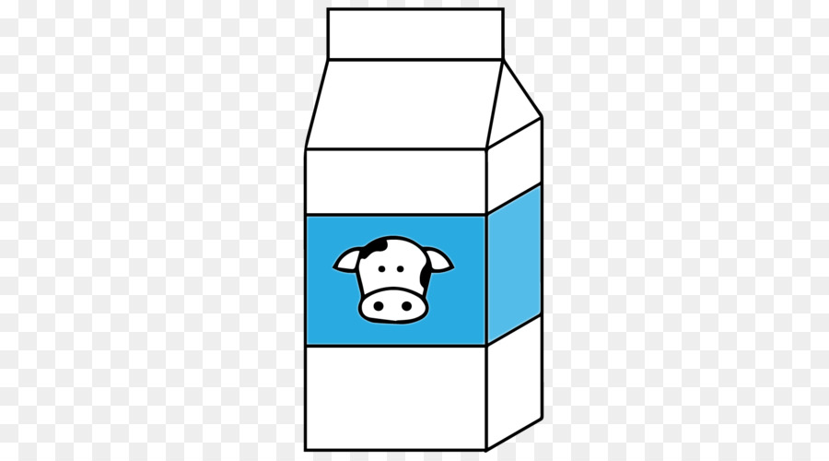

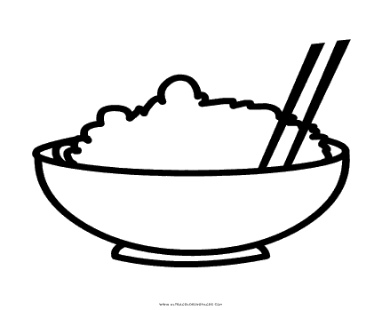

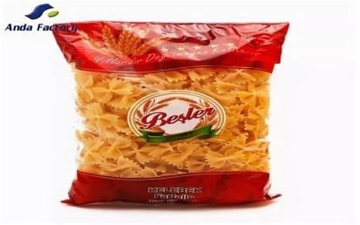

Containers . Look and fill the gaps.
A carton of –
A box of -
A bowl of –
A glass of -
A packet of –
A bottle of-

Slide 8
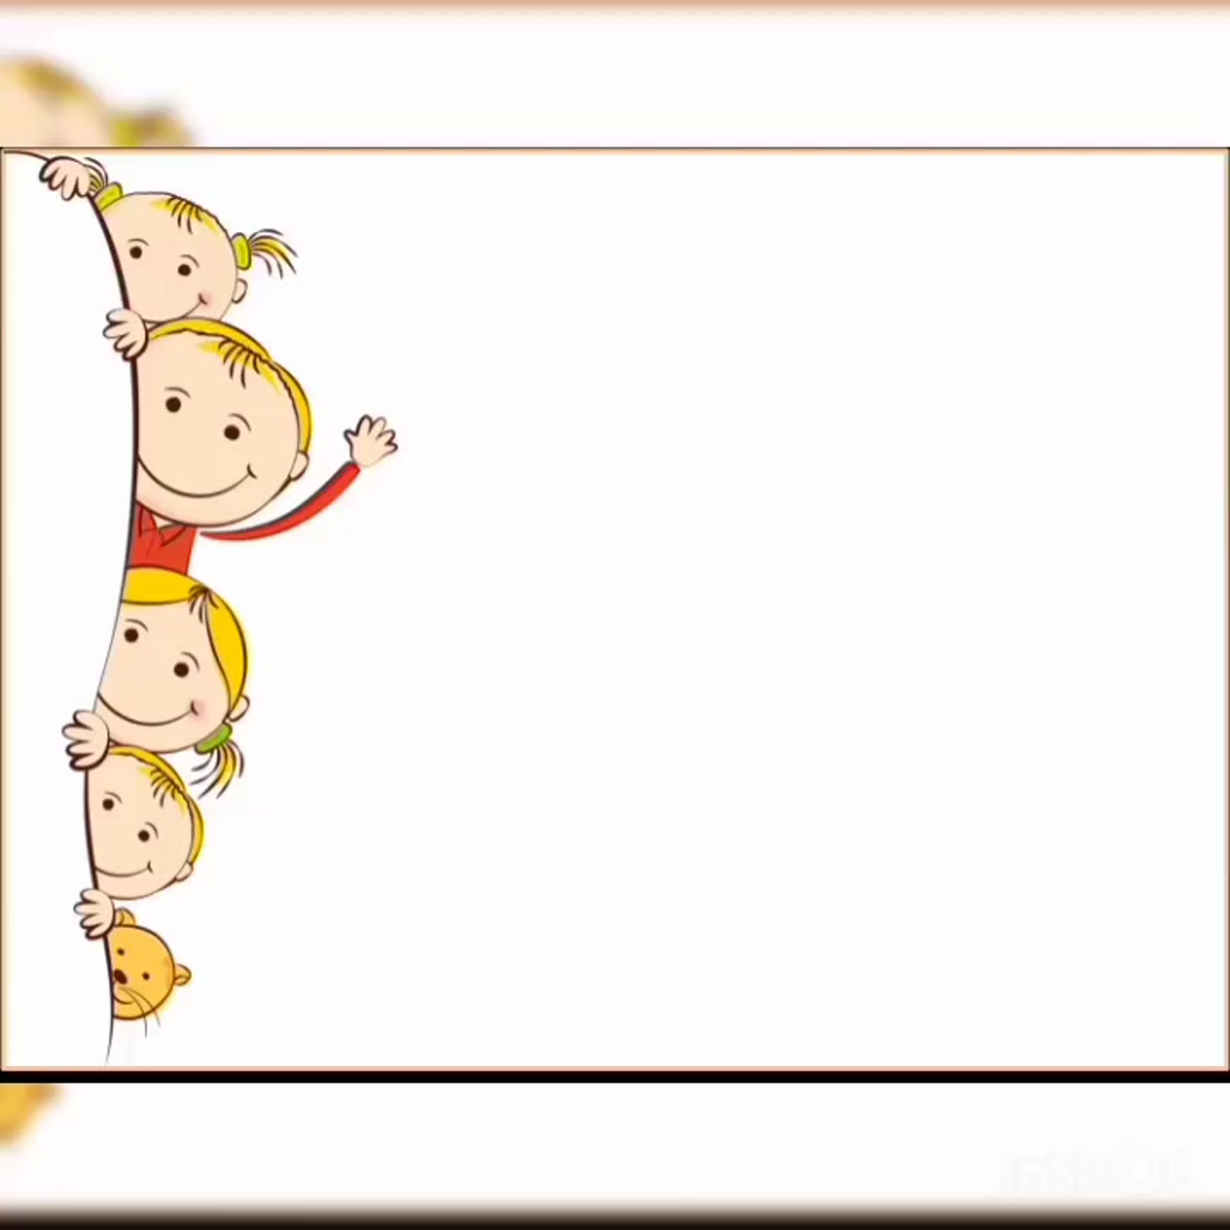
Now listen and check:
a carton of milk
box of cereal
a bowl of rice
a glass of orange juice
a packet of pasta
a bottle of olive oil

Slide 9

Reading – ex., 3,p., 98
Read the first exchange . What is the dialogue about? Listen , read and check.
Write their shopping list . Then read the dialogue aloud.

Slide 10
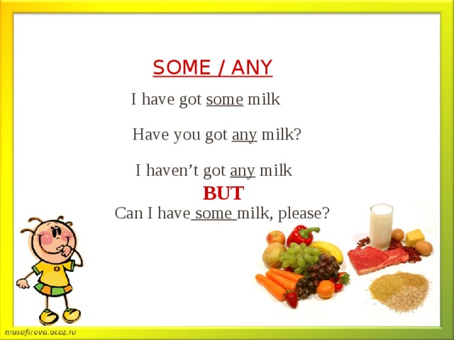

Slide 11
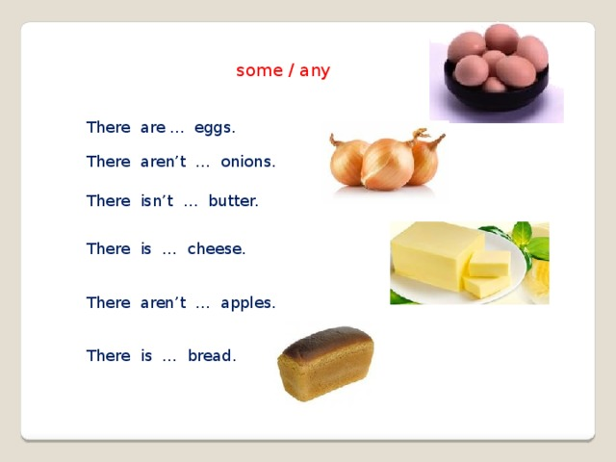

Slide 12
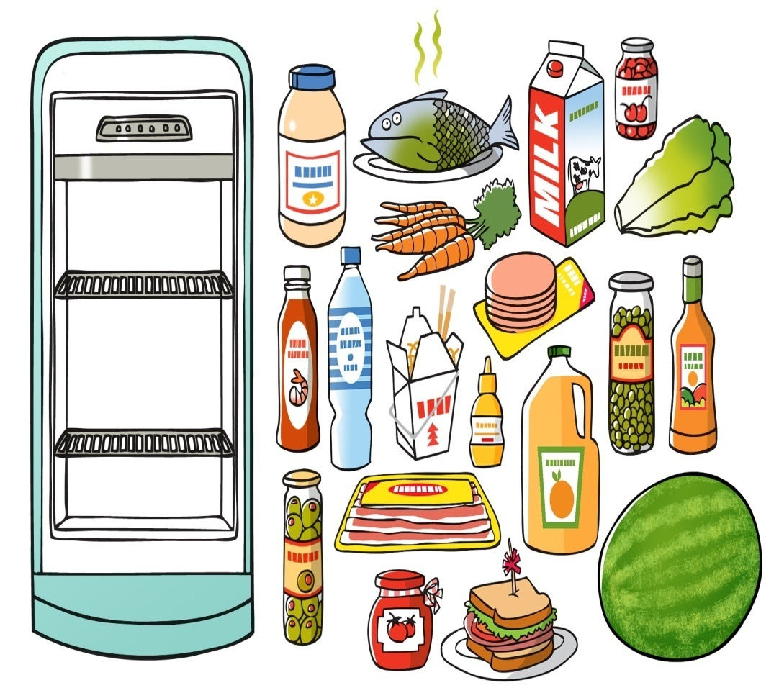
Let’s go shopping
«Выясни какие продукты необходимо купить»
Are there any bananas?
-No, there aren’t any.
Is there an orange?....

Slide 13

Let’s have a break!

Slide 14
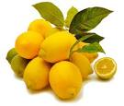
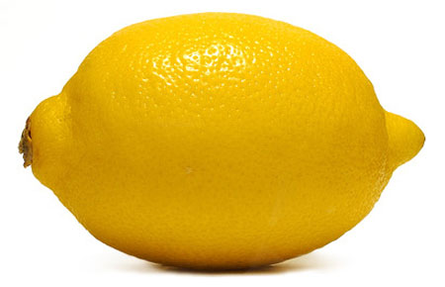
How many lemons do we need?
A lot - много
Not many – не много

Slide 15
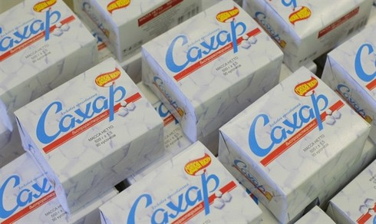
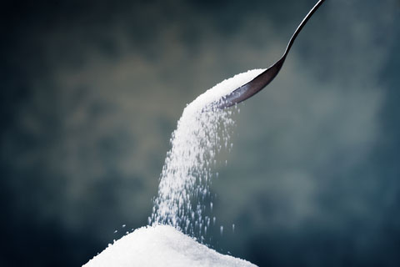
How much sugar do we need?
A lot-
много
Not much-
не много

Slide 16
Choose the right variant
How much / many milk is there?
How much / many chairs are there?
How much / many coffee is there?
How much / many juice is there?
How much / many girls are there?
How much / many bread is there?
How much / many children are there?
How much / many water is there?

Slide 17
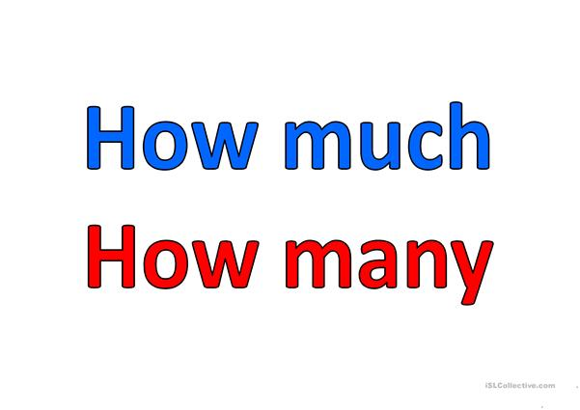
How ……. rice is there? Not…..
How……..potatoes are there? Not….
How……..biscuits are there? Not….
How……..milk is there? Not….
How……..apples are there? Not….

Slide 18
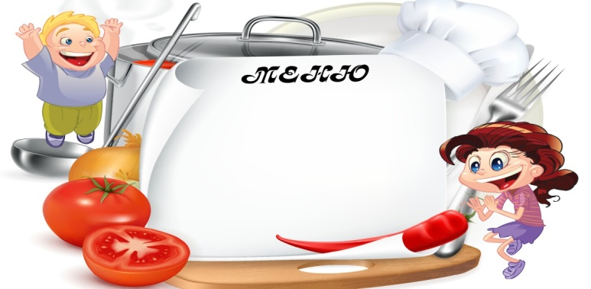
Speaking
You want to cook you favourite meal tonight
Discuss what you need for healthy menu.
Use the dialogue in ex., 3 as model
I want to cook …..
I need…..

Slide 19
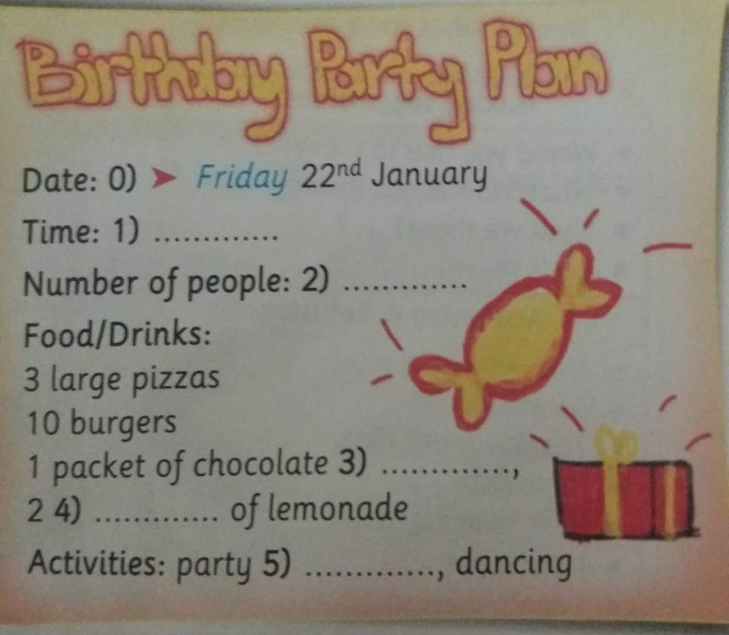
Listening
Bob and Ann are talking about something
What are they talking about Listen and check
Listen and fill the missing words

Slide 20



Рефлексия
I liked the lesson
I liked the lesson , but it was difficult
I didn’t like the lesson

Slide 21
Homework
ex. 9 p., 99
Imagine it’s your birthday.
Write your birthday party plan.
Write:
Date/time/number of people/food and drinks /activities

