Slide 1




SANTAS’S PHOTO ALBUM
Santa took some photos this year. He wants to make a photo album but he is very busy nowadays. Let’s help him!
2021

Slide 2




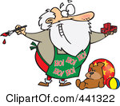
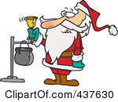

1
Santa is screaming.
Santa is pulling his sack.
Santa is painting a toy.
Santa is painting a toy.
2
Santa is doing judo.
Santa is ice skating.
Santa is ringing a bell.
Santa is ringing a bell.

Slide 3


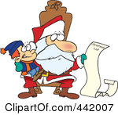
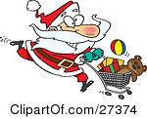
3
Santa is flying a plane.
Santa is buying toys.
Santa is reading.
Santa is pulling his toy sack
4
Santa is painting a toy.
Santa is reading.
Santa is buying toys.
Santa is carrying a present

Slide 4

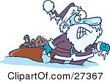
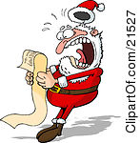

5
Santa is screaming.
Santa is pulling a toy sack.
Santa is reading
Santa is ringing a charity bell
6
Santa is pulling a toy sack.
Santa is carrying a present.
Santa is screaming.
Santa is ice skating.

Slide 5

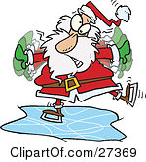
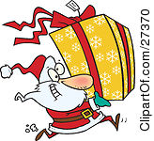

7
Santa is buying toys.
Santa is carrying a present.
Santa is ice skating.
Santa is flying a plane.
8
Santa is pulling his sack.
Santa is putting on his uniform.
Santa is carrying a present.
Santa is ice skating.

Slide 6


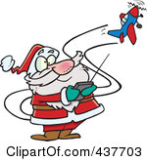
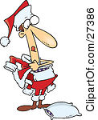
9
Santa is jumping.
Santa is reading the Xmas list.
Santa is flying a remote control plane.
Santa is flying a remote control plane.
10
Santa is screaming.
Santa is putting on his uniform.
Santa is putting on his uniform.
Santa is ringing a bell.

Slide 7
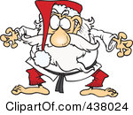
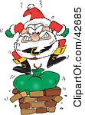

11
Santa is screaming.
Santa is painting a toy truck.
Santa is doing judo.
Santa is jumping.
12
Santa is carrying a big present.
Santa is doing judo.
Santa is jumping.
Santa is reading.

Slide 8
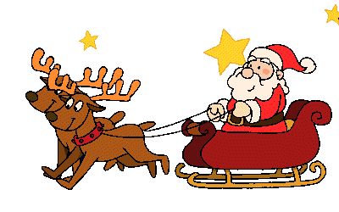


SEE YOU NEXT YEAR

