Slide 1
How do you know English – speaking countries?

Slide 2
Цель: расширение и углубление знаний страноведческого характера у обучающихся.
Задачи:
повышение мотивации обучающихся к изучению английского языка;
всестороннее развитие личности, включая интеллектуальную, эмоционально-волевую и духовно-нравственную сферы;
развитие творческих способностей обучающихся, самостоятельности, эстетичных вкусов;
воспитание любви и уважения к культурному наследию стран, язык которых изучается.

Slide 3
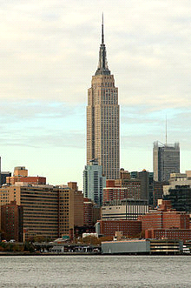
1
It is a 102-storey skyscraper located in Midtown Manhattan. It stood as the world`s tallest building for 40 years, from its completion in 1931 until construction of the World Trade Center's North Tower was completed in 1972. Now it is currently the third-tallest completed skyscraper in the United States and the 22nd-tallest in the world. It is:
Chrysler Building
the Willis Tower
the Empire State Building
the Sears Tower

Slide 4
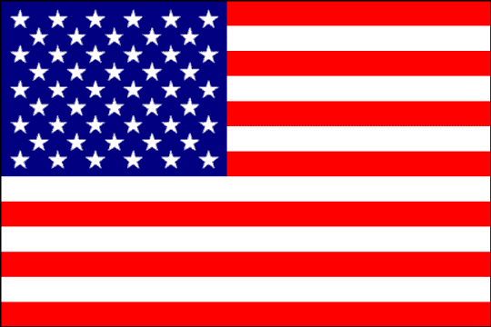
2
American flag has several most popular names. Which one of the following is not the name of the United States` flag?
Union Jack
Grand Union Flag
Stars and Stripes
Star-Spangled Banner

Slide 5
3
It is known that 50 stars on the US flag represent 50 states of the country. What can you say about 13 stripes on it? What do they mean?
13 first American presidents
13 most famous presidents
13 biggest states
13 original states

Slide 6
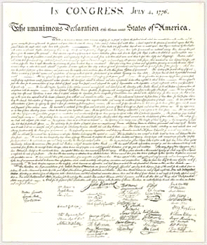
4
“We hold these truths to be self-evident, that all men are created equal, that they are endowed by their Creator with certain unalienable rights, that among these are Life, Liberty and the pursuit of Happiness.”
This quotation is from the document which was drafted by Thomas Jefferson and adopted by the Continental Congress. Which document is this quotation from?
The US Constitution
Emancipation Proclamation
The Declaration of Independence
The Bill of Rights

Slide 7
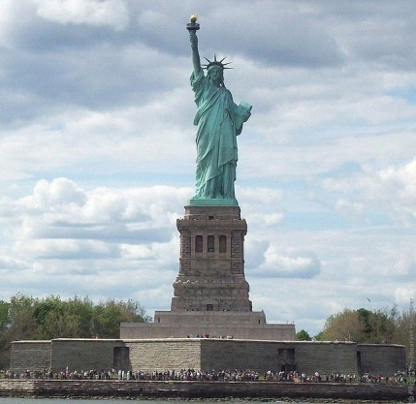
5
The Statue of Liberty is the large copper statue that stands on Liberty Island in New York Harbor. Its right arm holds a great torch. The left arm grasps a tablet. A crown rests on the head. At the feet there is something that symbolizes the overthrow of tyranny. What is it?
a broken stick
a broken shackle
a torn rope
a torn band

Slide 8
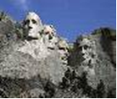
6
The Mount Rushmore National Memorial is a sculpture of the heads of four United States presidents:
B. Franklin, T. Jefferson, T. Roosevelt, G. Washington.
J. Kennedy, G. Washington, A. Lincoln, T. Roosevelt.
G. Washington, B. Franklin, T. Jefferson, J. Kennedy.
G. Washington, T. Jefferson, T. Roosevelt, A. Lincoln.

Slide 9
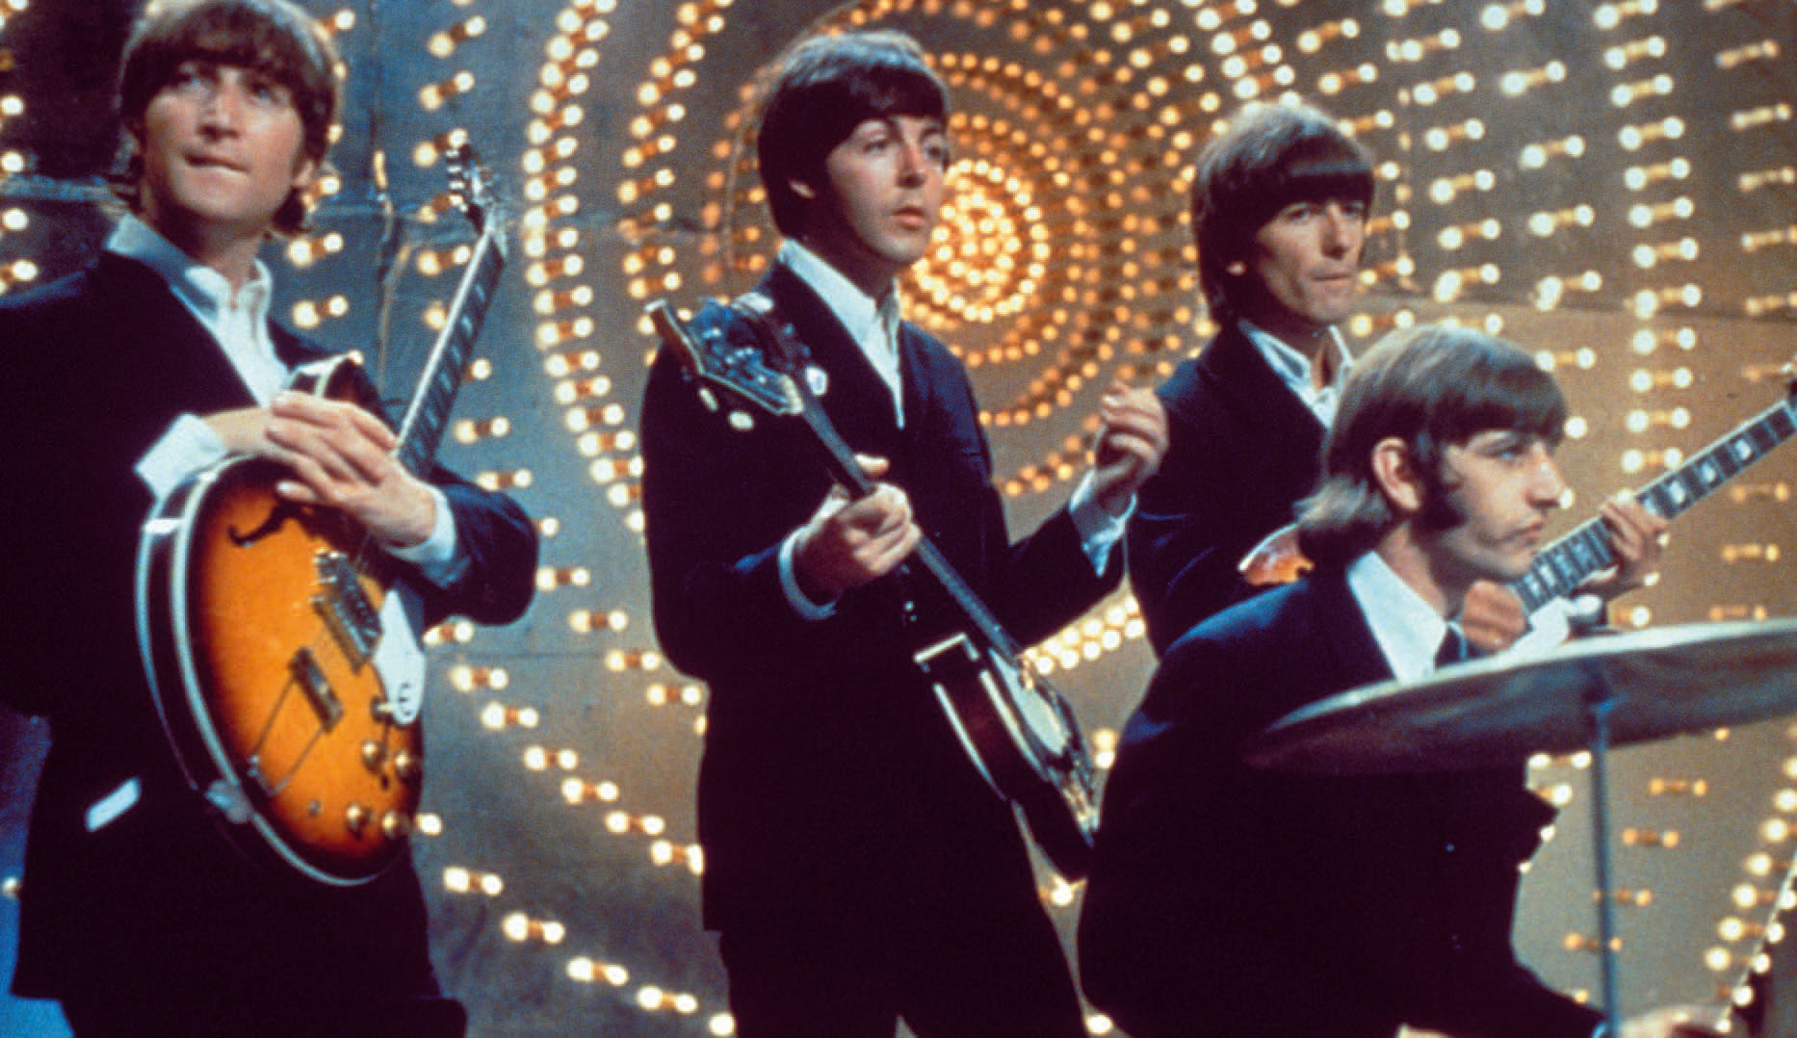
7
This is one of the most famous British pop bands. They were once known as “Johnny and the Moondogs”. What is their common name?
Rolling Stones
Deep Purple
Beatles
Pink Floyd

Slide 10

8
What is the official name of this flag?
Union Jack
Union David
Union Andrew
Union George

Slide 11

9
National parks of America make concessions to tourists. Visitors are warned of the dangers. In the mountains and forests of the northwestern states there is one animal that is especially to be feared. It is the largest and most ferocious carnivore in the world and will attack humans on sight. What animal is it?
a cougar
a wolf
a tiger
a grizzly

Slide 12
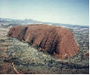
10
This is the most famous Australian monolith. It is situated in a desert, in a very heart of the continent. How do Australians call this rock?
Uluru
Australian Outback
The Red Center
Yarra

Slide 13
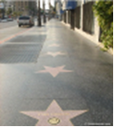
11
The second largest American city Los Angeles is famous for one of its suburbs, which is the capital of movie production. The biggest and most successful film studios – Disney, Universal, Fox, Columbia and others – are located here. These are star factories. What suburb is mentioned here?
Inglewood
Hollywood
Hidden Hills
Beverly Hills

Slide 14
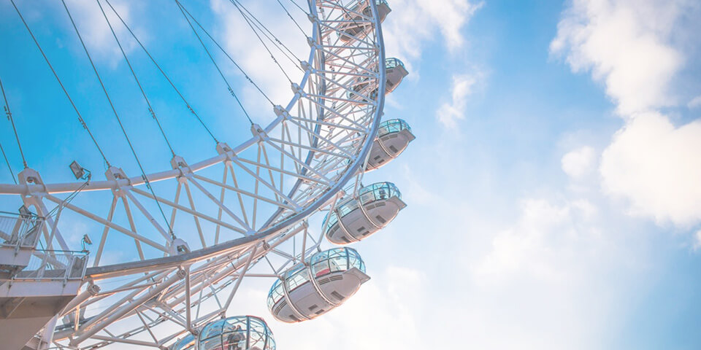
12
Where is the world`s highest wheel situated?
in Canberra
in Washington
in London
in Wellington

Slide 15
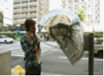
13
If you want to make domestic phone calls in England you should first dial:
“0”
“2”
“4”
“6”

Slide 16
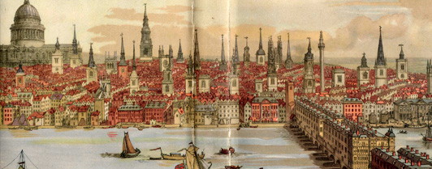
14
Who built London and named it as Londinium?
the French
the English
the Romans
the Celts

Slide 17
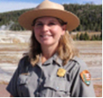
15
You can see these people in any National park of America. They are men and women with special qualities. They act as guides, and must be ready to answer questions on the plants, animals and geology of the parks. They must be ready to deal with emergencies of all kinds. Who are these people?
Scouts
Rangers
Teachers
Trainers

Slide 18
Answers (Ответы)
It is the Empire State Building.
“Union Jack”
13 original states of the country.
The Declaration of Independence.
A broken shackle
G. Washington, T. Jefferson, T. Roosevelt, and A. Lincoln.
Beatles
Union Jack
A grizzly
Uluru
Hollywood
in London
“0”
the Romans
Rangers

