Slide 1
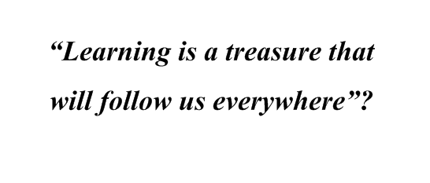
Davydovskaya Gymnasium
“Would you like to study in England?”

Slide 2
Word revision
Teaching. Interviewing
Watching video
Making dialogues
Group work
Home assignment
Reading for gist

Slide 3
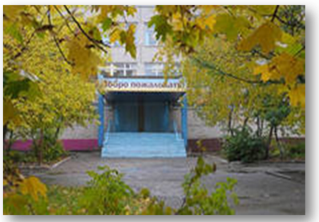
Let's practice! Spell!
g |  |  |  |  |  |  |  | m
gymnasium

Slide 4
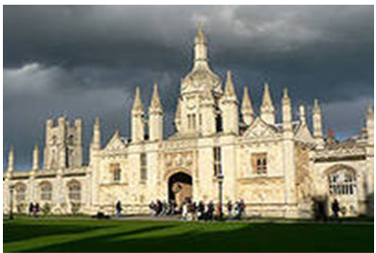
u |  |  |  |  |  |  |  |  | y
university

Slide 5
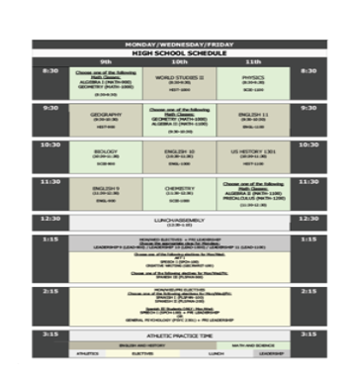
t |  |  |  |  |  |  |  | e
timetable

Slide 6
cafeteria

Slide 7
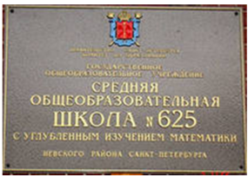
c |  |  |  |  |  |  |  |  |  |  |  | e
comprehensive

Slide 8
Give synonyms!
co-educational
mixed school
nursery school
kindergarten
not to pass an exam
to fail
to sit an exam
to take an exam

Slide 9
Explain in English
a two year form for 16 year olds to prepare for a university
after lessons activities
General Certificate of Secondary Education
a private/independent school
a national exam to enter a university
subjects to choose

Slide 10
Find the opposites!
to be at school
state school
boys’ (girls’)
school
to fail an exam
independent school
mixed (co-
educational) school
to pass an exam
to leave school

Slide 11
Let's discuss!
Education is
the process of getting knowledge
proverbs about learning
“Live and learn”
“One is never old to learn”
“There is no royal road to learning”
“Knowledge is power”
“Experience is the mother of wisdom”
“ Little learning is a dangerous thing”

Slide 12
Give your variant!

Slide 13
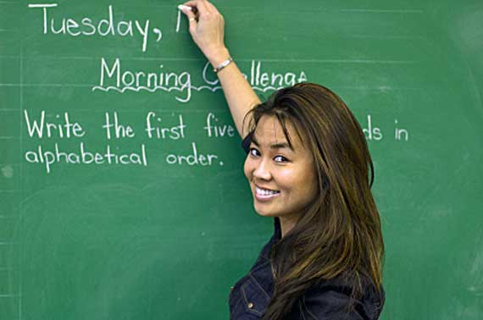
Continue!
A teacher is a person who …
This job requires …

Slide 14
Watch the film and answer the questions!
Questions:
a)When do British children start schooling?
b)How do they call schools for five years old children?
c)Is primary school compulsory for children or not?
d)In what types of schools is primary education given in Britain?
e)At what age do children usually finish infant & junior schools?
f)After finishing primary school children go to secondary schools, don’t they?
g)What types of secondary school do you know?
h)How long can pupils stay in secondary schools?
i)When do they take their 1st public exam?
j)Where will children go after the fifth form if they decide to continue their education?
k)Is schooling in the sixth form compulsory in Britain?
l)What kind of exam do they take after the sixth form?
m)Where will children go after the fifth form if they decide to leave school?

Slide 15
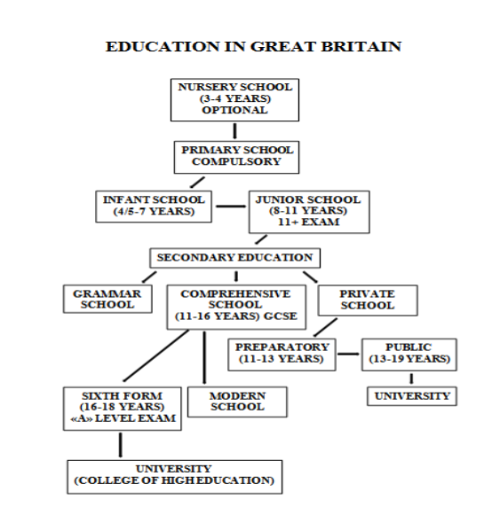

Slide 16
EDUCATION IN RUSSIA
kindergarten 3-6 years
optional
primary school compulsory
6/7-10/11 years
Secondary school
Basic General Secondary
10/11-15/16 years
comprehensive schools
private schools
Secondary(complete) school
15/16-17/18 years
vocational school
college
university/institute

Slide 17
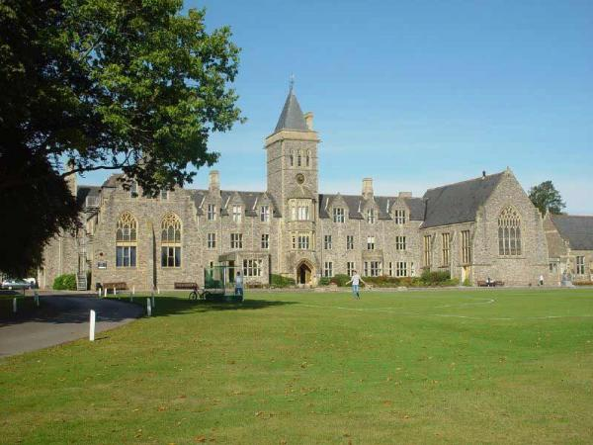
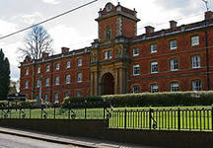
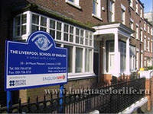
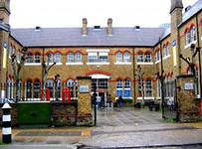
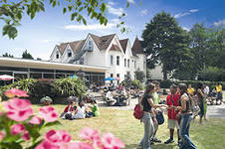
There are different types of schools in the UK.
Which one would you choose?

Slide 18
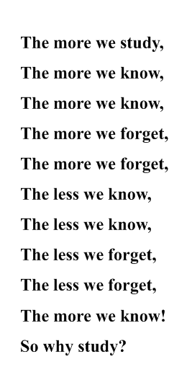

Slide 19
Good-bye!

